Slide 1
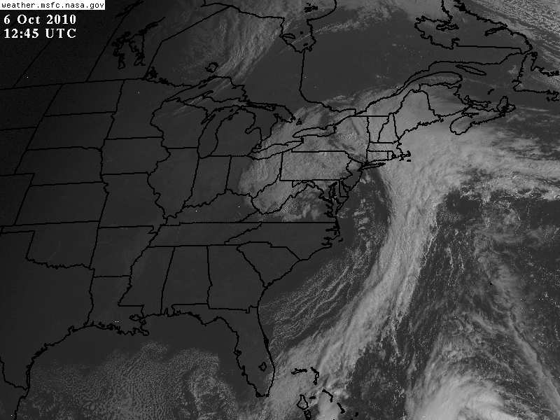
Detecting Cloud Type in Satellite Imagery

Slide 2
What allows us to distinguish features in satellite imagery?
Contrast between scenes (or pixels).
Contrast in visible due to:
Albedo differences
Contrast in IR due to:
Temperature differences

Slide 3
Cloud Classification
Clouds classified according to:
Height—defined by altitude of cloud base.
High—cirrus (Ci), cirrostratus (Cs), cirrocumulus (Cc)
Middle—Altostratus (As), Altocumulus (Ac)
Low—Stratus (St), stratocumulus (Sc), nimbostratus (Ns)
Clouds with vertical development—cumulus (Cu), cumulus congestus (Towering Cumulus-TCU), cumulonimbus (Cb)
Form—determined by stability and altitude
Cirriform—high altitude, ice crystals
Stratiform—stable atmosphere, flat, layered, featureless
Cumuliform—unstable, vertical development, cast shadows➔textured

Slide 4
Table from Ahrens: Approximate Height of Cloud Bases Above the Surface
CLOUD GROUP | TROPICAL REGION | MIDDLE LATITUDE REGION | POLAR REGION
High Ci, Cs, Cc | 20,000 to 60,000 ft (6000 to 18,000 m) | 16,000 to 43,000 ft (5000 to 13,000 m) | 10,000 to 26,000 ft (3000 to 8000 m)
Middle As, Ac | 6500 to 26,000 ft (2000 to 8000 m) | 6,500 to 23,000 ft (2000 to 7000 m) | 6500 to 13,000 ft (2000 to 4000 m)
Low St, Sc, Ns | Sfc to 6500 ft (0 to 2000 m) | Sfc to 6500 ft (0 to 2000 m) | Sfc to 6500 ft (0 to 2000 m)

Slide 5
Cloud Formation
Clouds form when air is cooled to its dew point.
For most clouds, the cooling process is upward vertical motion or lifting.
Stable atmospheres➔slow, gentle, large scale rising air motion--stratiform
Unstable atmospheres➔vigorous rising bubbles of air (thermals), strong, concentrated updrafts surrounded by larger cloud-free areas of sinking air--cumuliform
For fog, the cooling process can be radiational cooling or advection across a cold surface—stratiform—lifting not required, but cooling is.

Slide 6
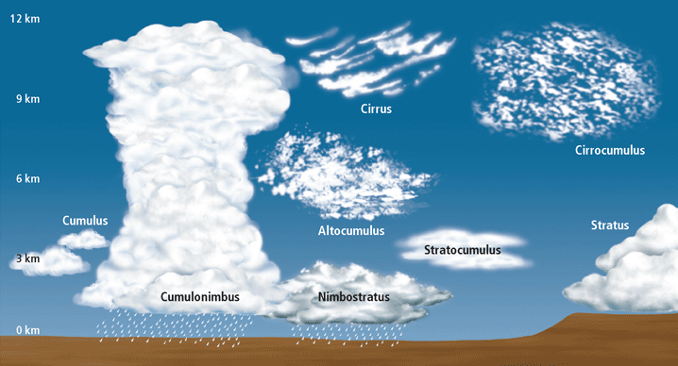

Slide 7
Visible Images
Visible images show “reflected” sunlight
Albedo of clouds related to cloud “thickness” (not vertical thickness so much as cloud “solidity” or density)
Different types of clouds and terrain reflect sunlight differently
“thick” clouds➔high albedo➔bright
“thin” clouds➔lower albedo➔grey
Shadows give texture➔vertical development
Shadows sometimes cast by higher clouds on lower clouds
Note: must have sunlight! Cannot typically get visible images at night (moonlight images do exist)

Slide 8
Visible Images Surface Reflectivity
All surfaces reflect varying amounts of sunlight
Surface Type | Albedo
Large Thunderstorm | 92%
Thick stratocumulus | 68%
Snow | 88-59%
Thin stratus | 42%
Thin cirrostratus | 32%
Forest | 12%
Water | 9%
From Radar and Satellite Weather Interpretation for Pilots, Lankford.

Slide 10
Visible Images Surface Reflectivity
Brightness on a visible image directly related to reflectivity
Highly reflective surfaces appear bright white
Low reflectivity surfaces appear gray or black
Thunderstorms → Bright white
Thin clouds → Grey
Oceans → Very dark

Slide 11
Visible Images
Small clouds and thin clouds may appear grey
Gaps between small clouds allow some of the Earth’s reflected energy through, when averaged with the clouds, the clouds appear greyer than normal
Thin clouds allow most of sun’s energy to pass through, reflecting very little sunlight, again appearing grey
Surface

Slide 12
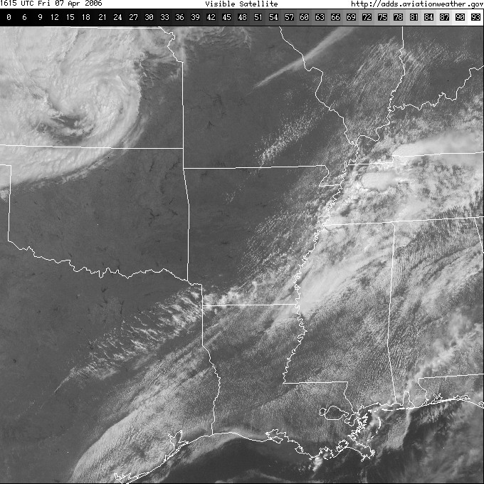
Visible Satellite Images
Legend indicates reflectivity
Thick, solid, dense clouds appear very bright
Thick
Thin
Thick

Slide 13
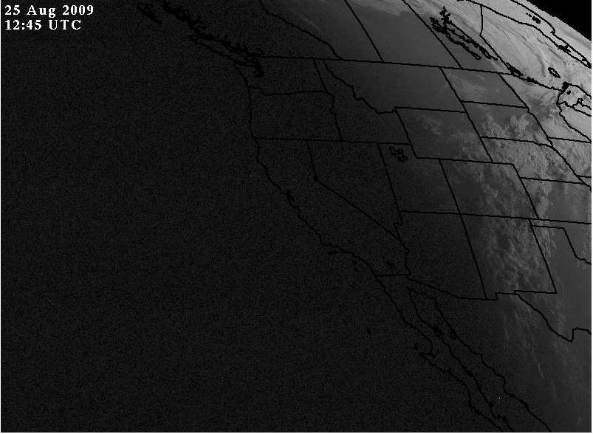
Visible Satellite Images Sunlight is required
Image taken near sunrise over mid-west
West Coast still dark
No sunlight, no image – area is NOT cloud free!

Slide 14
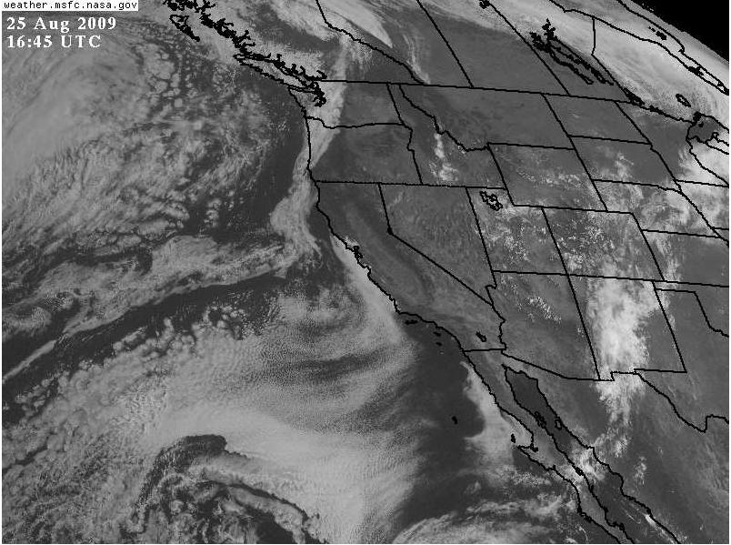
Visible Satellite Images Sunlight required
Same location 4-hrs later
Clearly, clouds did exist over west coast

Slide 15
Infrared (IR) Satellite Images

Slide 16
Infrared Images
All objects with a temperature above absolute zero radiate energy
The wavelength of energy depends on the temperature of the object
Because of the Earth’s temperature, it radiates most of its energy at infrared wavelengths
Sensing infrared energy allows us to determine the temperature of the Earth and clouds.
Since infrared sensors detect temperature not reflected light, they can be used at night

Slide 17
In VIS, cloud height not easily determined.

Slide 18
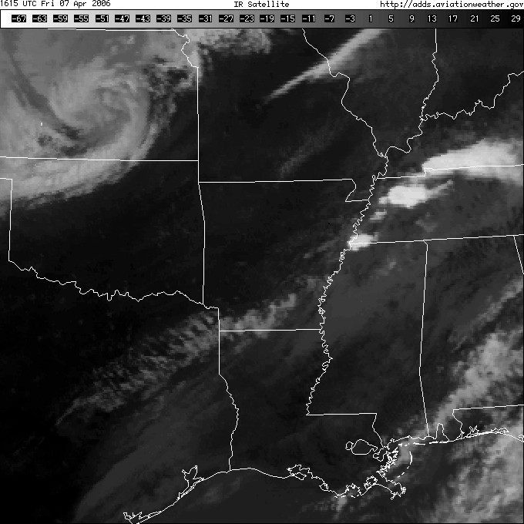
IR useful for cloud heights.
Displays cloud or surface temperature →can compare with tropospheric temps. to determine height
For black & white images:
Bright white → very cold temperatures →high clouds
Black → very warm temperatures →low clouds or surface
Temperature scale

Slide 19
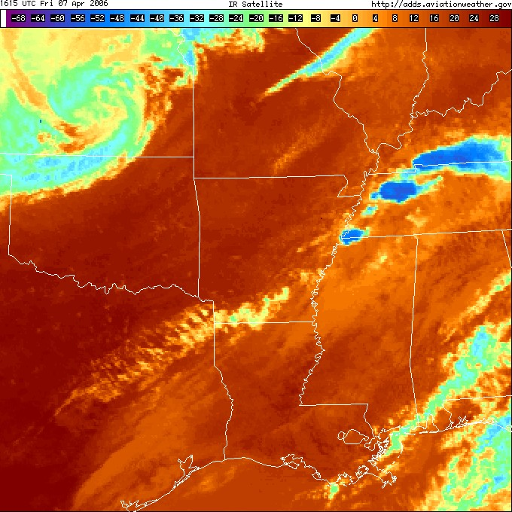
Infrared Satellite Images
Temperature scale
Colors frequently used to help better visualize temperature ranges.

Slide 20
Infrared Images—Cloud Height
IR sensors measure radiation amount, which is controlled by temperature and emissivity
If we assume the cloud surface is emitting like a blackbody, then in essence, IR sensors detect temperature
Colder temperatures occur higher in the troposphere
Warmer temperatures occur near the Earth’s surface
IR images give an excellent indication of cloud height
Using IR data with a temperature sounding allows us to determine the exact height of clouds
[Caveat: If clouds are not “optically thick” then brightness temperature may not accurately reflect cloud top temperature]

Slide 21
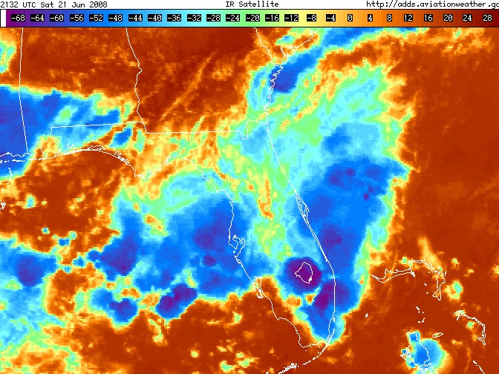
Using IR to Estimate Cloud Height
Step 1: Determine cloud top temperature
-68°C

Slide 22
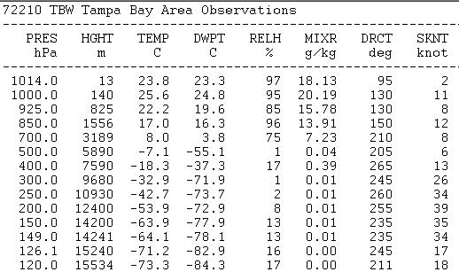
Using IR to Estimate Cloud Height
Step 2: Use current temperature sounding to estimate height at which the temperature was observed.
~15 km
-68°C
15km ~ 49,000 ft

Slide 23
Infrared Images Enhancement Curves
IR image enhancement can be used to emphasize specific temperature ranges or to increase contrast within a particular temperature range➔changes how the underlying brightness temperature (measured) info is displayed.
E.g., color scales on IR images are often “enhanced” to clearly differentiate very cold cloud tops from surrounding cold cloud tops.
helps identify areas of strong thunderstorms
strong thunderstorms often penetrate the tropopause where temperatures are a minimum
enhancing the color scale for cold temperatures makes the cold areas stand out

Slide 24
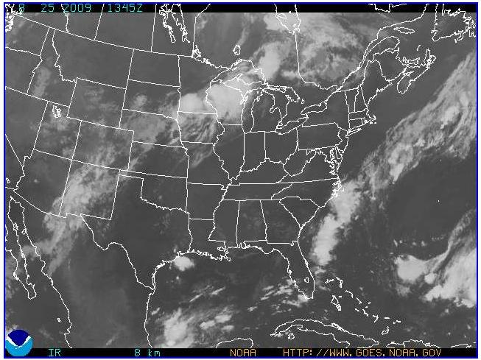
Infrared Images Enhancement Curves
Notice color scale to right of color image.
Only coldest temperatures are in color
Helps pinpoint areas with potential thunderstorms

Slide 25
Infrared Images Problems Detecting Fog (more on this later…)
Disadvantage: Low clouds and fog are difficult to see since their temperatures are nearly the same as the temperature of the Earth’s surface
Fog especially troublesome
Usually forms at night when visible images not available
Temperatures very close to surface temperature so IR images can’t tell the difference

Slide 26
Using VIS and IR Together
Best information is gained by using BOTH visible and IR images to determine cloud type
Cold clouds don’t always mean thunderstorms
IR Image If clouds are: | Visible Image AND if clouds appear: | Possible Cloud Type
Cold | Thick (white) | Cb or Nimbostratus
Cold | Thin (gray) | Cirrus
Warm | Thick (white) | Low Stratus, Fog
Warm | Thin (gray) | Cumulus, stratocumulus

Slide 27
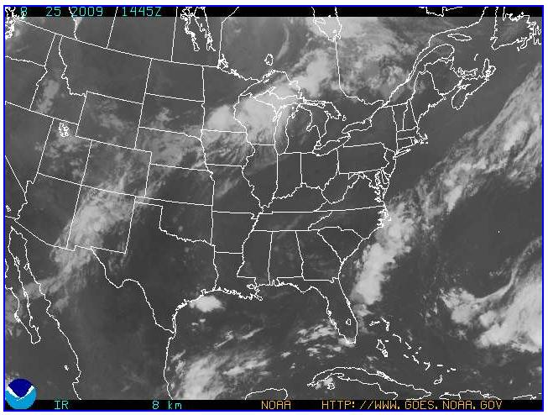
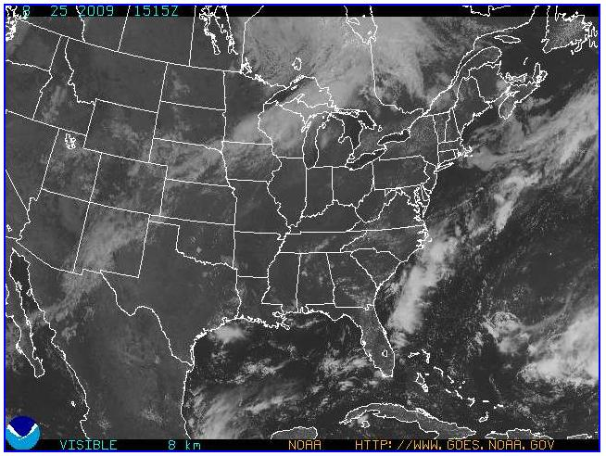
Using VIS and IR Together
IR
VIS
1
1
2
3
2
3
4
4
Stratus (warm, thick)
Cb (cold, thick) Note: verified with radar
Low stratus, fog (warm, thick)
Cumulus (warm, thin)

Slide 28
Features that aid in cloud identification
Brightness
Texture—due to shadows; only VIS
Smooth, lumpy, fibrous
Organizational pattern
Banded, linear, circular, cellular
Edge definition
Sharp
fuzzy
Size
Individual shape

Slide 29
Large scale patterns and terminology (see following slides):
Cloud shield
Cloud band
Cloud line
Cloud street
[Cloud finger—not really commonly used!]
Cloud element
Comma cloud

Slide 30
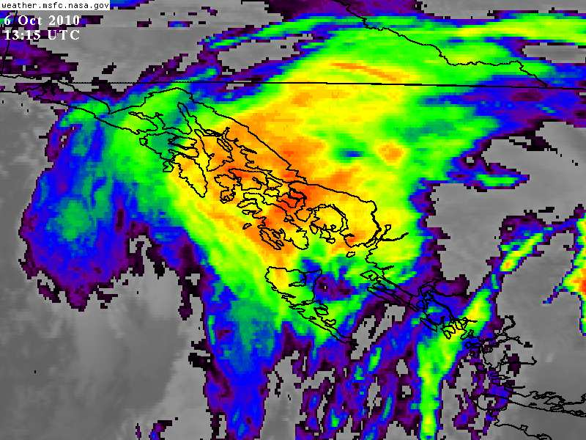
Cloud shield
Broad cloud pattern no more than four times as long in one direction as wide in the perpendicular direction.

Slide 31
Cloud Band
Nearly continuous cloud formation with a distinct long axis; the ratio of length to width is at least 4 to 1 and the width of the band is greater than 1 degree latitude.

Slide 32
Cloud Line
Narrow cloud band in which the individual cloud cells are connected and the line is less than 1 degree of latitude.
Cloud lines are indicative of low-level convergence.
Sometimes cloud lines are called “rope clouds,” especially when they are associated with the convergence along a surface cold front.
Rope clouds often evident over the ocean with weakening fronts.

Slide 33
Rope cloud animation from http://cimss.ssec.wisc.edu/goes/blog/archives/555

Slide 34
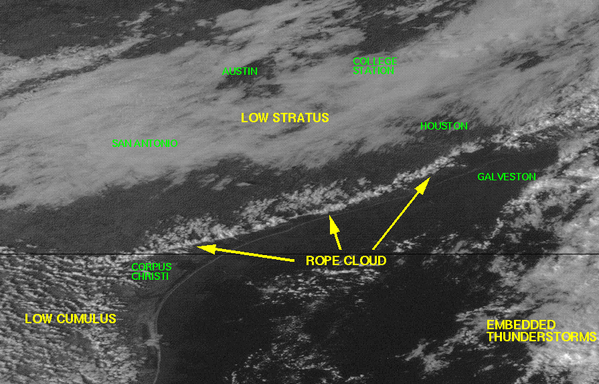
More on Rope Clouds:
http://www.met.tamu.edu/class/wflm/tut/sat/sat8.html
Copyright © 1996-2003 Texas A&M University, Texas A&M Atmospheric Sciences Department and Dr. John Nielsen-Gammon.

Slide 35
Cloud Street
A narrow cloud band of low-level convective clouds in which the individual cells are not connected. Several streets generally line up parallel to each other and along the low-level wind flow.

Slide 36
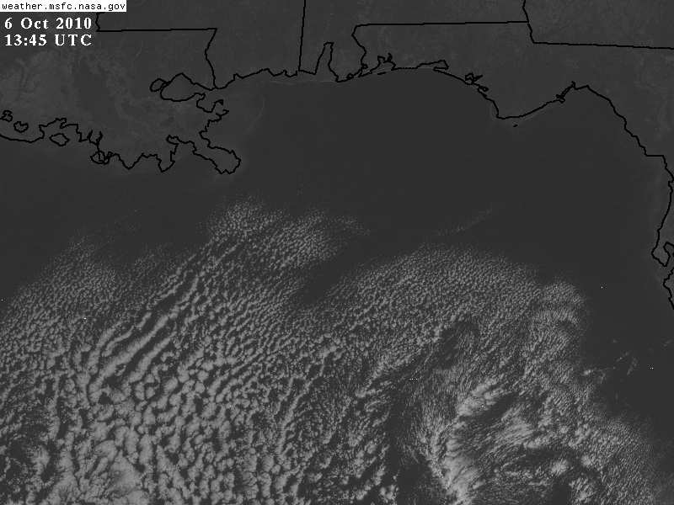
Cloud Element
The smallest individual cloud form that can be resolved in a satellite image.

Slide 37
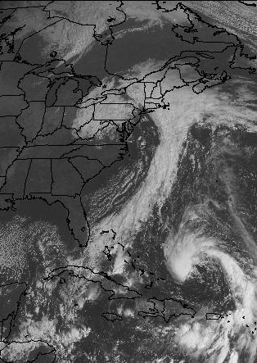
Comma Cloud
A vortex that contains one or more spiral cloud bands that converge toward a common center; shaped like a “comma.”

Slide 38
Texture in Visible Satellite Imagery
Smooth textures—lack of shadows, so associated with flat featureless clouds
➔ stratiform.
Fibrous texture—wispy, can see through it➔cirrus, or the cirrus anvil of a cumulonimbus
“Lumpy” textures—associated with shadowing, which requires vertical development➔cumuliform clouds.

Slide 39
Edge Definition
Fuzzy edge definition:
➔cirrus clouds
➔downwind side of cirrus CB anvils
➔equatorward side of jet stream cirrus band
Sharp edge definition:
➔upwind side of CBs
➔cloud boundaries limited by terrain—fog/stratus
➔poleward side of jet stream cirrus will have an anticyclonically curving sharp edge,

Slide 40
Sharp poleward cloud edge

Slide 41
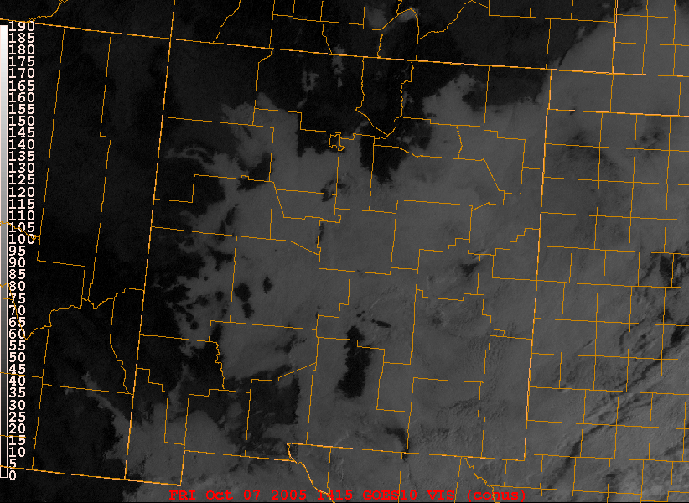
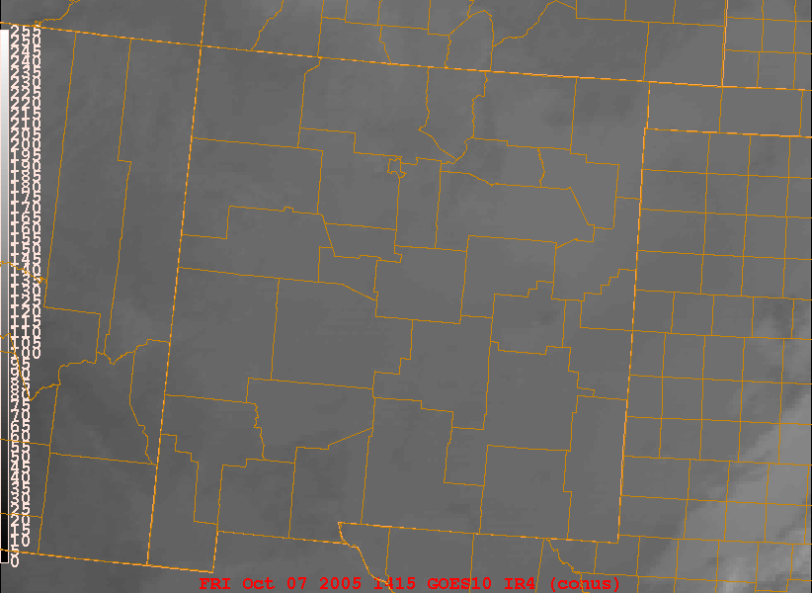
Infrared Images Problems Detecting Fog
Fog Example
Left: Early morning visible image over NM
Right: Same time/location but an IR image
Visible
IR

Slide 42
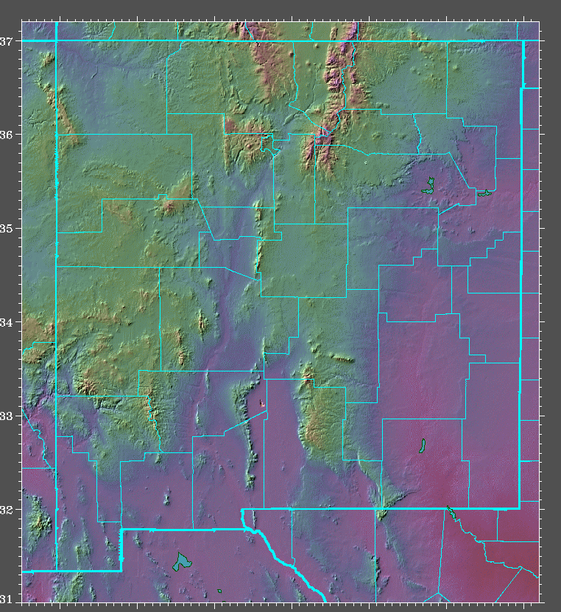
VIS image shows sharp edge of fog because of terrain.
Fog tends to follow the terrain
Elevated peaks clearly evident

Slide 43
Fog in satellite imagery: a special problem for aviation.

Slide 44
Water Vapor Satellite Images

Slide 45
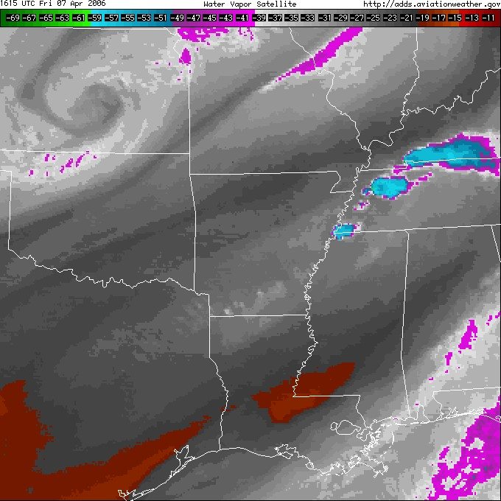
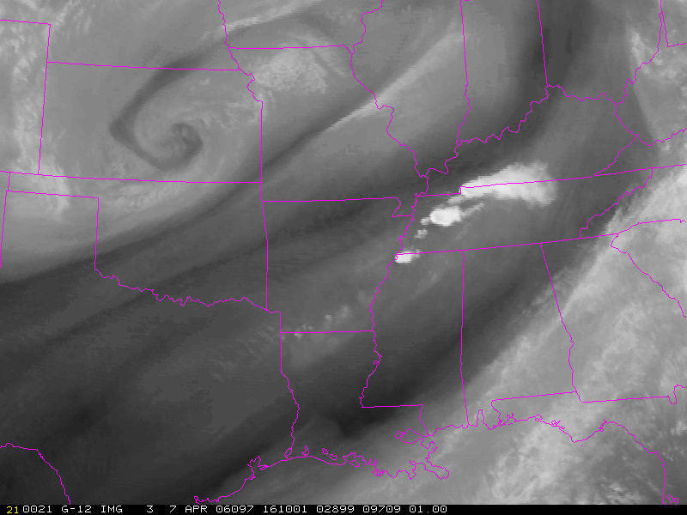
Water Vapor Images
Water vapor images related to distribution of moisture at the top of the troposphere (near 30,000 ft).
Dry regions dark (or colored; frequently red).
White (or colored) clouds.
High clouds are shown, but not low clouds.

Slide 46
Stratiform Characteristics in Sat Imagery

Slide 47
Cumuliform Characteristics

Slide 48
Cirriform Characteristics

Slide 49
Sources of Satellite Images
Available from a large number of sites.
ERAU Satellite Imagery
ADDS – Satellite
Interactive Weather Satellite Imagery Viewers from NASA GHCC
SSEC - Geostationary Satellite Images
NRL Monterey Images with NOGAPS Overlays

