Slide 1
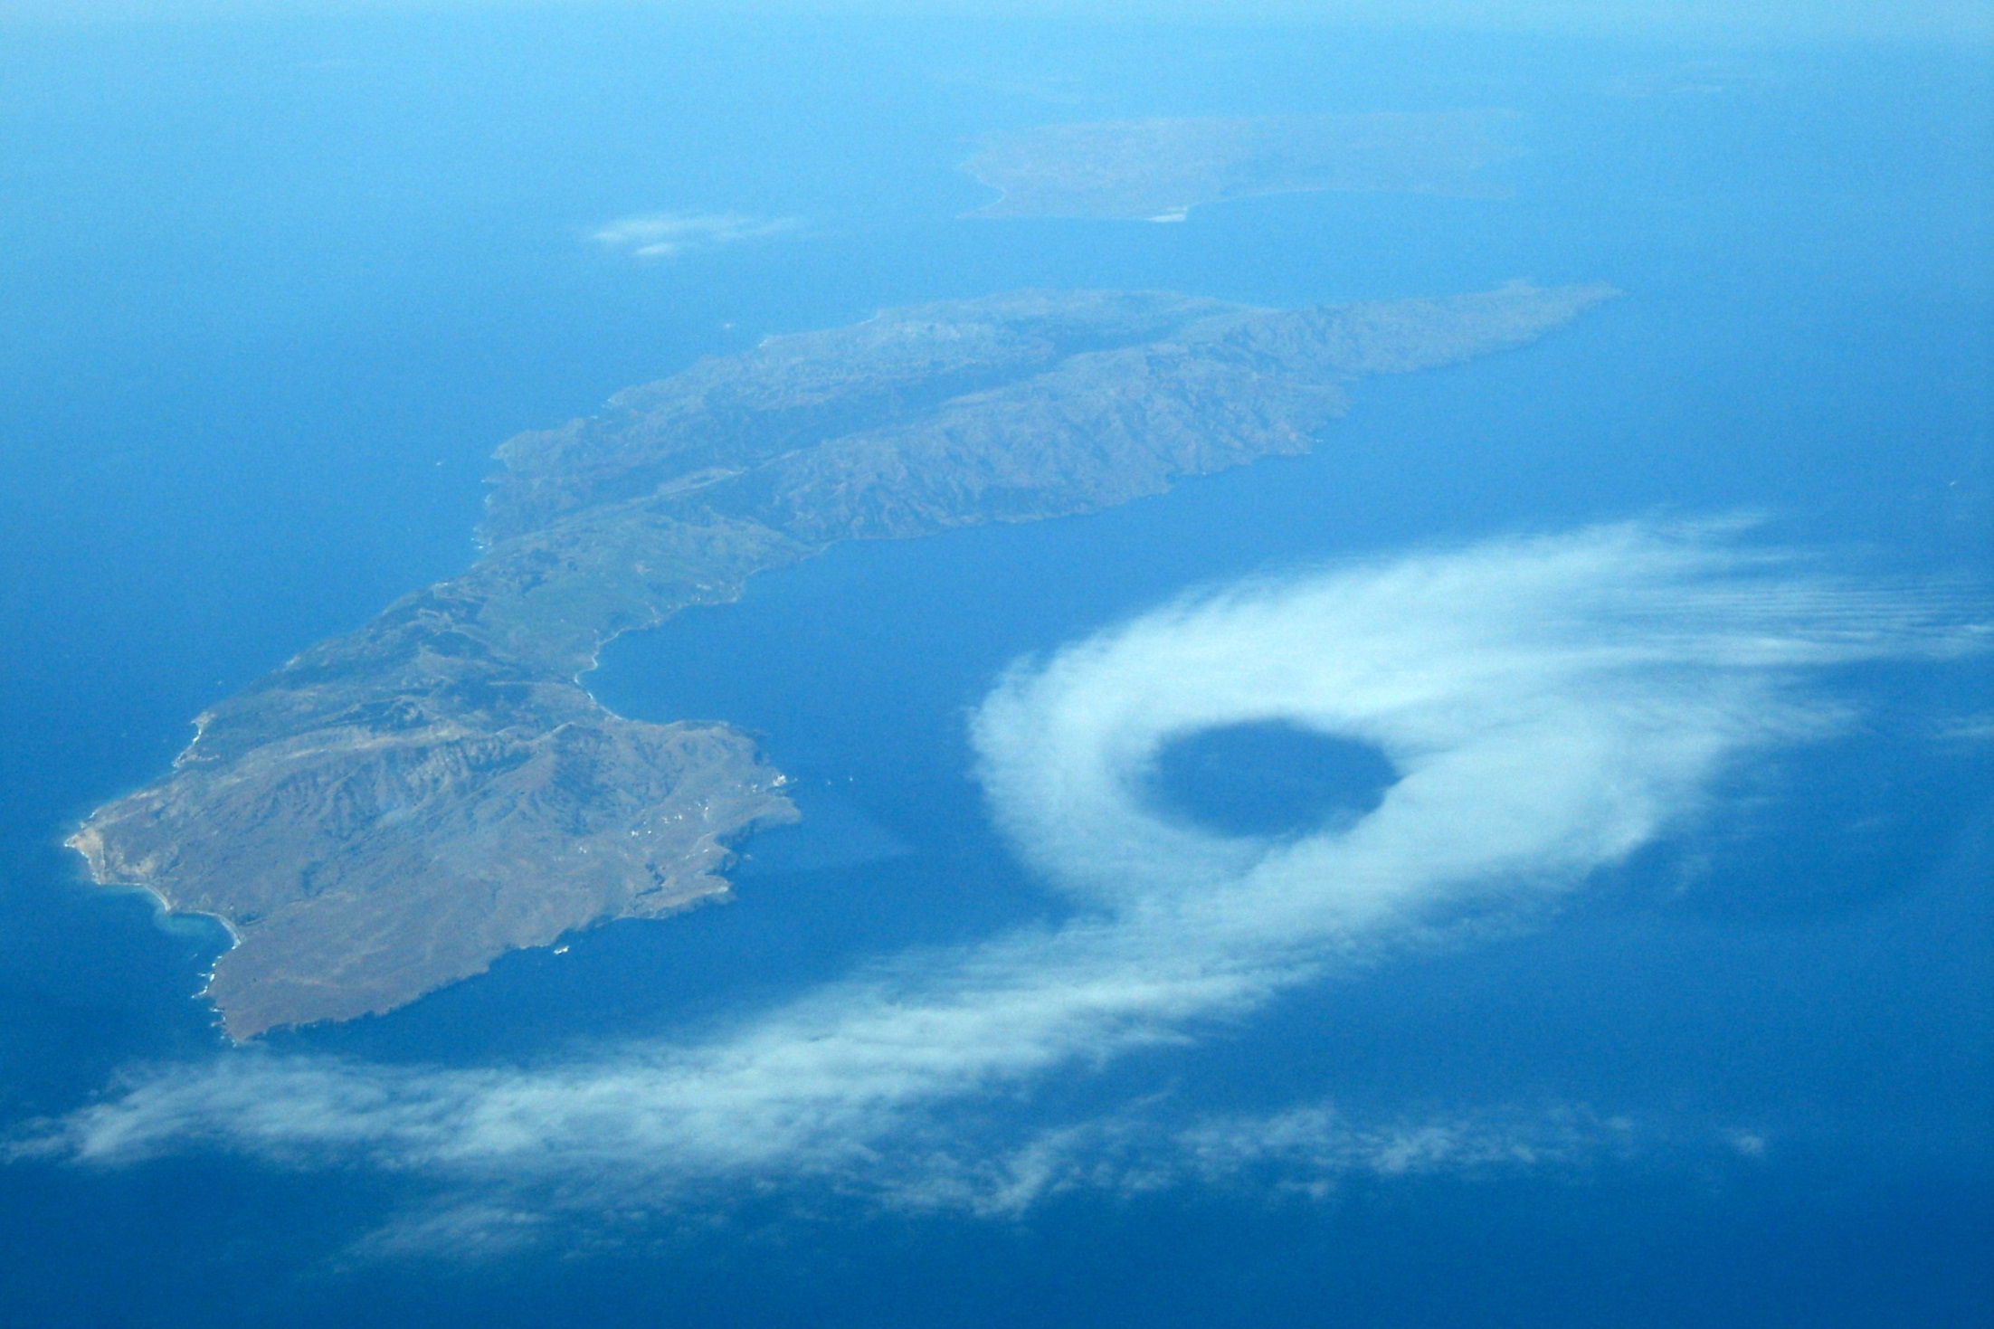
A13L-06. An Analysis of Unique Aerial Photographs of Atmospheric Eddies in Marine Stratocumulus Clouds Downwind of Complex Terrain Along the California Coast
By Bradley M. Muller, Christopher G. Herbster, and Frederick R. Mosher
Embry-Riddle Aeronautical University

Slide 2
Purpose of this talk:
This research will describe two aerial photographs, taken by commercial pilots, of atmospheric eddies in marine stratocumulus clouds, one near Santa Cruz Island, and one near Grover Beach, CA.
Present these unique aerial photographs.
Describe the meteorological context.
Speculate about formation mechanisms based on theoretical literature of eddies.
Discuss implications and questions for modeling.

Slide 3
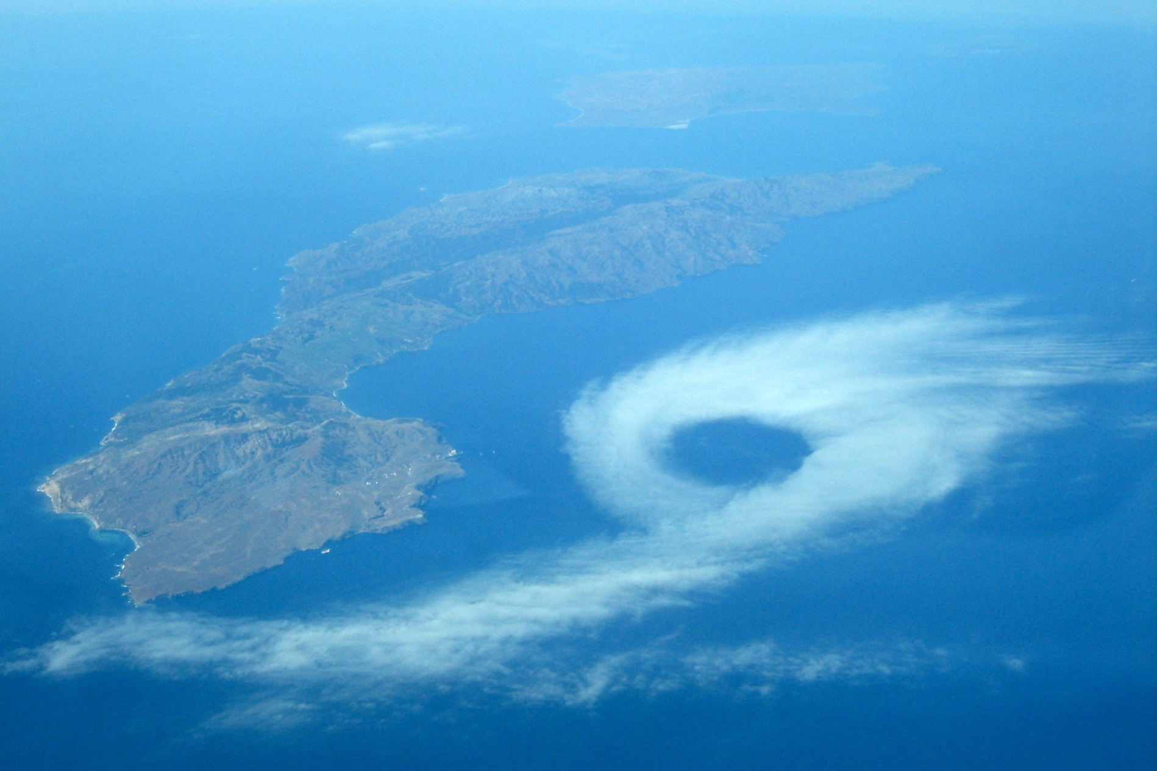
Santa Cruz Island Eddy—July 16, 2006
A pilot flying California coastal routes for Skywest Airlines observed and photographed this cloud formation looking toward the southwest
Photo by “KB” courtesy former ERAU flight instructor and student, Capt. Peter Weiss

Slide 4
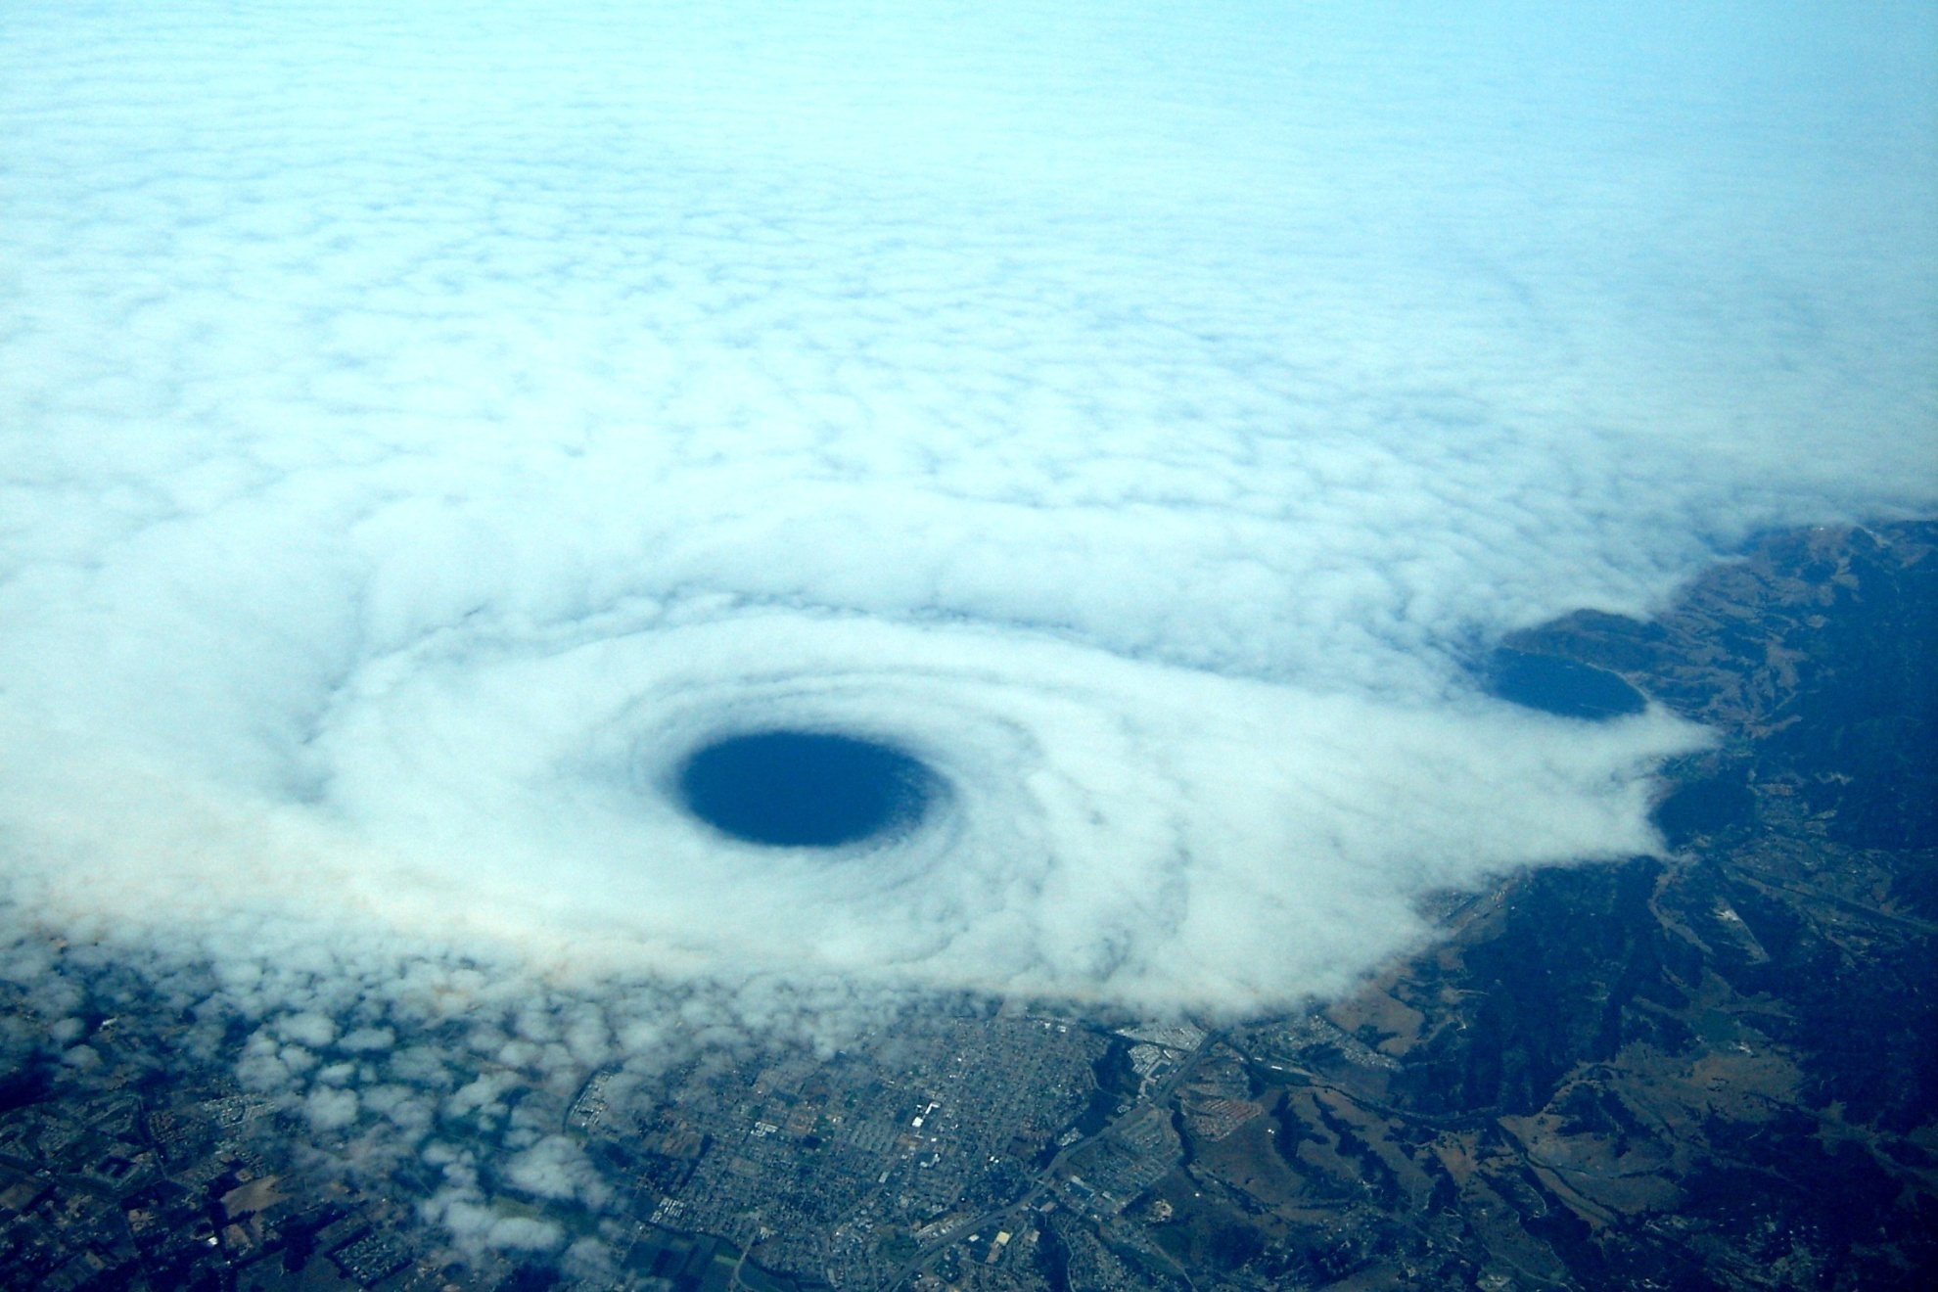
Grover Beach Eddy—Sept. 12, 2006
Again, the pilot flying California coastal routes for Skywest Airlines observed and photographed this cloud formation looking toward the west
Photo by “KB” courtesy former ERAU flight instructor and student, Capt. Peter Weiss

Slide 5
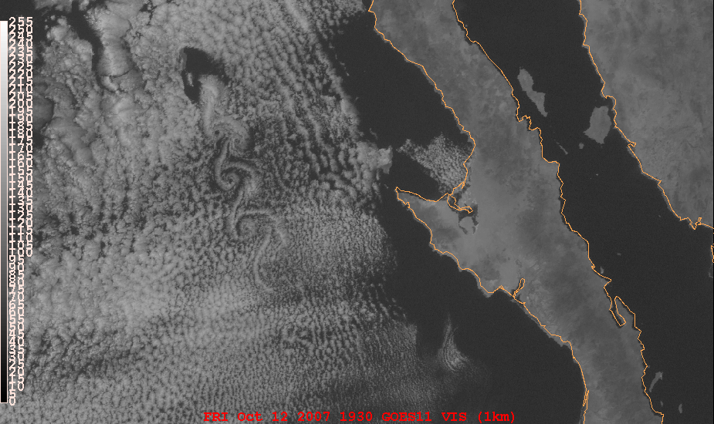
Similar eddies on order of 10’s of km frequently seen in satellite imagery since 1960’s downwind of inversion-penetrating terrain—e.g. Guadalupe Island— “von Karman vortex streets”:

Slide 6
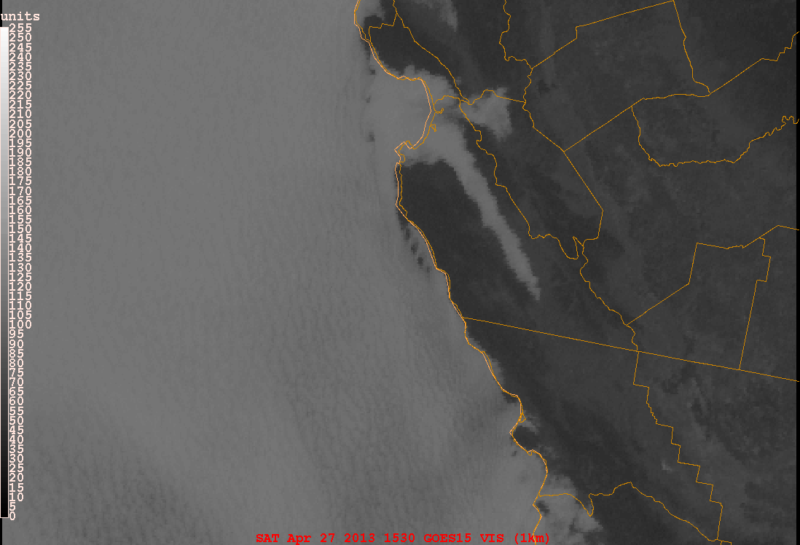
and downwind of headlands:

Slide 7
O[10-100 km] eddies not unusual off CA coast—but photographs of them are.
The photos are unique—to our knowledge, these will be the first close-up aerial photos, taken from an airplane, to appear in publication (Muller et. al. 2013, submitted to Monthly Weather Review).

Slide 8
Eddies in the lee of high terrain have been discussed extensively in theoretical literature (Smolarkiewicz and Rotunno 1989, Smith 1989, Schar and Durran 1997, Epifanio and Rotunno 2005); also have practical implications:
Air pollution transport: hypothesized to play a role in mixing at the coastal margin and have been implicated in cross-inversion fluxes of ozone and momentum (Lester 1985).
Unexpected wind shifts for sailors or pilots, especially landing or taking off at a coastal airport.
Anecdotal reports suggest an environment of strong aircraft turbulence in the lee of islands that produce similar eddies (Bob Baxter, Paul Ruscher, personal communications).
Wake region on lee side of terrain can provide vorticity for “fire whirls” (Forthofer and Goodrick 2011)

Slide 9
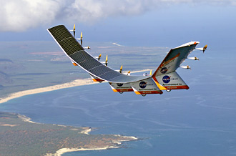
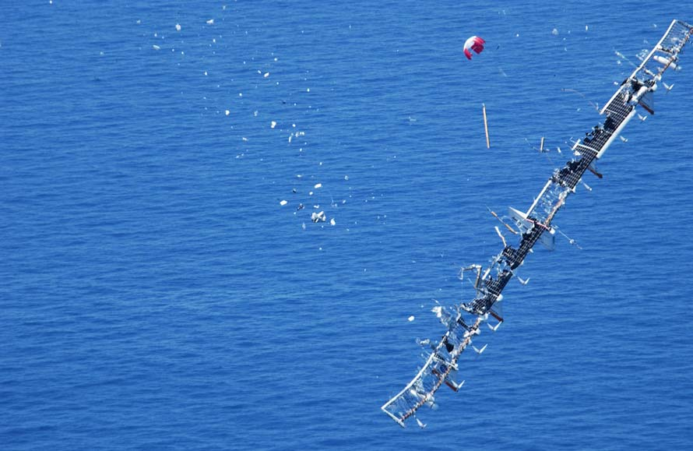
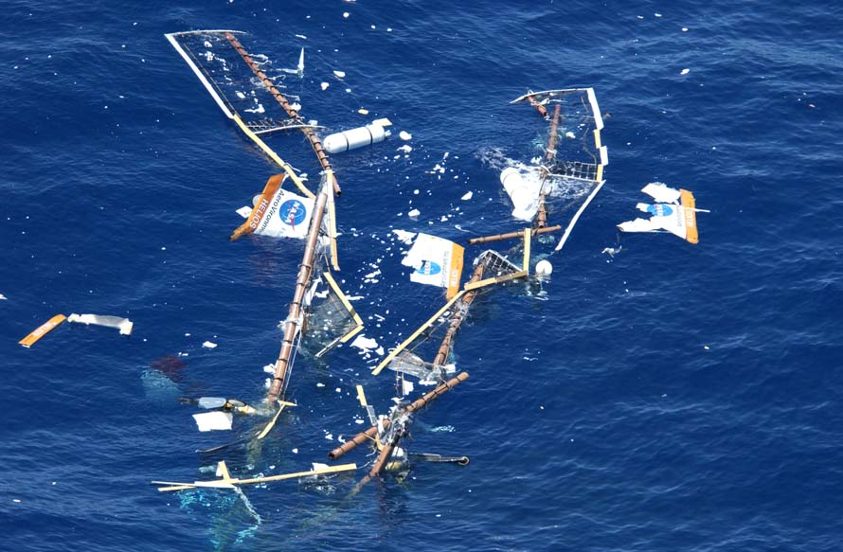
Strong turbulence in the lee of the Hawaiian island of Kauai was documented as a cause of the breakup and crash of NASA’s ultralight unmanned aerial vehicle Helios (Porter et al., 2007).

Slide 10
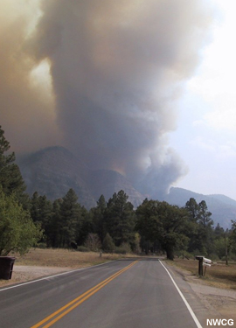
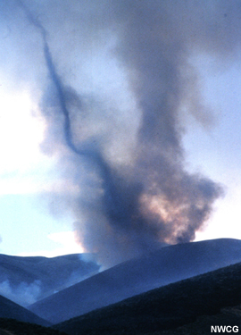
Fire whirls responsible for extreme/dangerous fire behavior.
“The most favorable situation for fire whirls is a fire burning on the slopes or in the canyons on the lee side of a ridge.” –Countryman (1971)

Slide 11
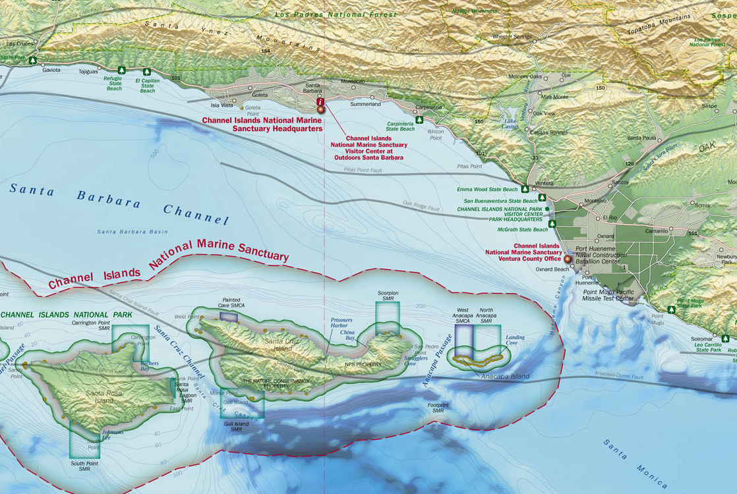
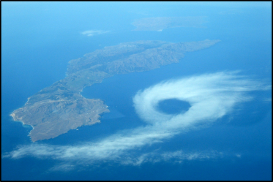
Santa Cruz Island

Slide 12
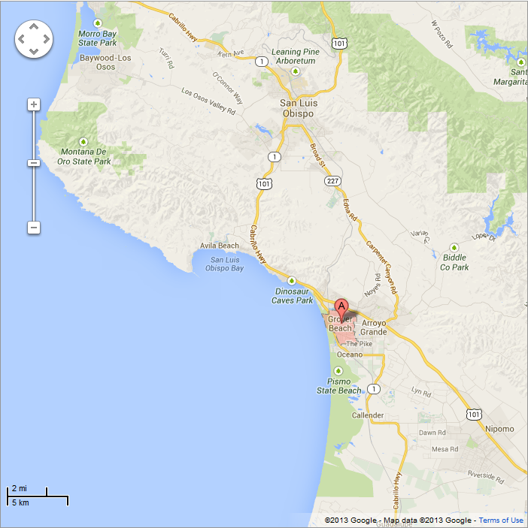

Grover Beach

Slide 13
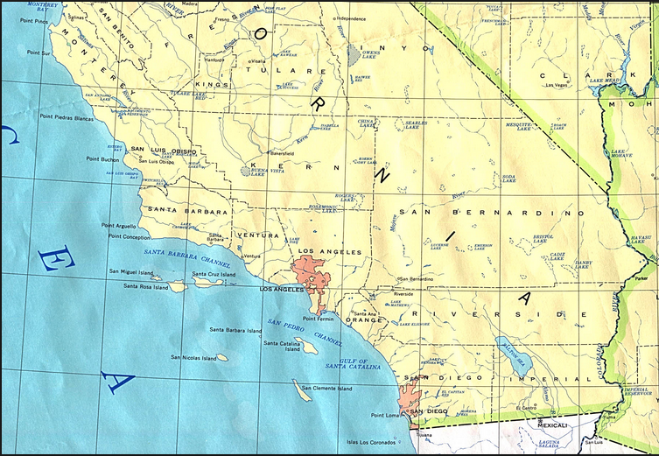
Grover Beach
Santa Cruz Island

Slide 14
Description of Santa Cruz Island Eddy, July 16, 2006
Occurred downwind (north side) of Santa Cruz Island in southeasterly flow.
Peak is roughly 550 m and penetrated the base (293 m at San Diego KNKX) of a strong inversion topping the marine atmospheric boundary layer (MABL) but not through its top (795 m at KNKX).
Vandenberg (KVBG) sounding not available.

Slide 15
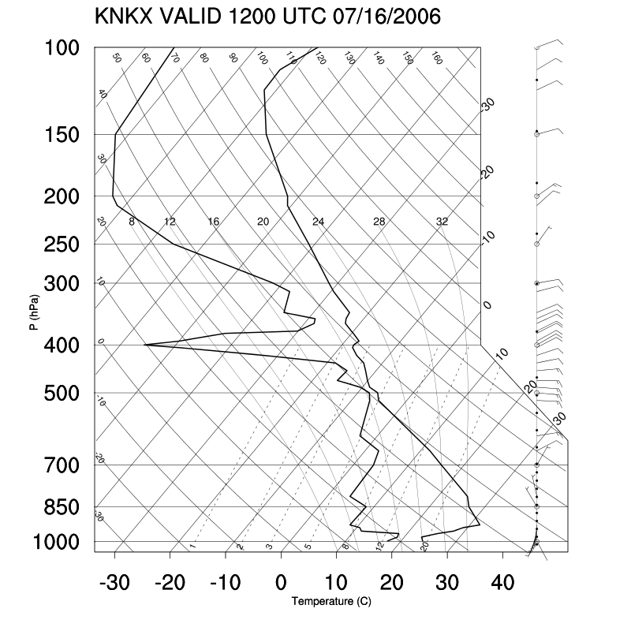
Note 10 deg C inversion on San Diego sounding:
ERAU Applied Meteorology

Slide 16


Froude number estimates used formulation for a continuously stratified atmosphere; low values usually mean very stable atmosphere.
U = upstream wind speed
h = mountain height
N = Brunt-Vaisala (buoyancy) frequency
Actual soundings used, despite lack of proximity, because the gridded analysis does not resolve the sharp temperature inversions actually present.

Slide 17
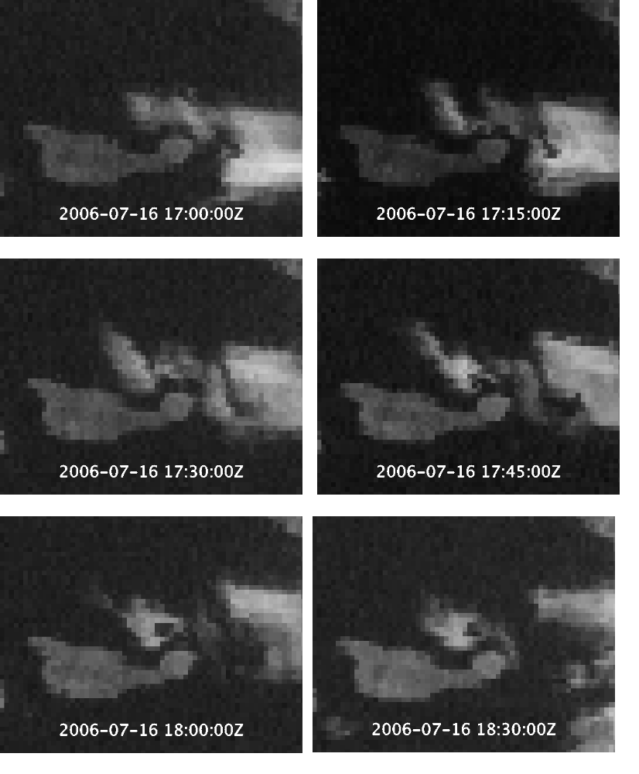
Sinking dry inversion-layer air creates lee clearing
Clear air wraps laterally into forming eddy
Cloudy air encircles dry air forming cloud-free eye
Impossible to unambiguously determine formation mechanism.

Slide 18
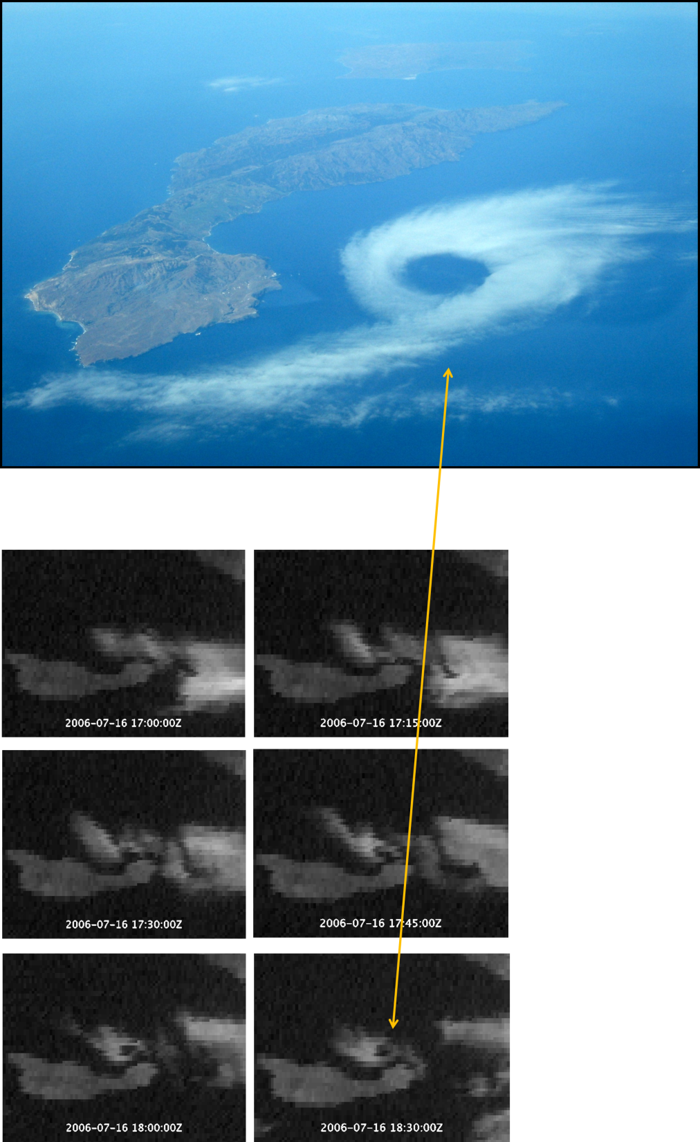
Satellite imagery showed southeasterly flow past east flank of island.
Photo was taken 18:26 UTC (11:26 PDT).
Matches with 18:30 UTC GOES image.
Froude numbers in MABL ~1—transcritical conditions.
Froude numbers within inversion estimated at 0.29 to 0.45, consistent with Smolarkiewicz and Rotunno’s (1989) theoretical results on eddy formation in low Froude number flow.

Slide 19
In absence of high resolution data or model simulation it is impossible to determine formation mechanism.
Lateral shear between southeasterly flow past island and “return flow” in wake region➔cyclonic vertical vorticity in MABL.
Differential downslope motion in the flow in lee of island➔tilting of horizontal vorticity into vertical similar to Smolarkiewicz and Rotunno (1989).

Slide 20
Description and analysis of Grover Beach eddy—Sept. 12, 2006
Photo by “KB” courtesy former ERAU flight instructor and student, Capt. Peter Weiss

Slide 21
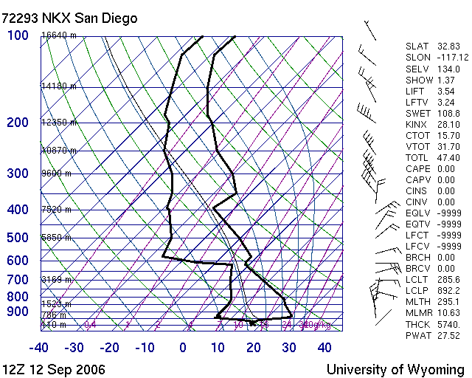
San Diego sounding—very strong subsidence inversion.

Slide 22
Froude number estimates for Grover Beach eddy averaged from Oakland and San Diego soundings (Vandenberg not available).
Froude numbers within inversion estimated at 0.29 to 0.45, consistent with Smolarkiewicz and Rotunno’s (1989) and others’ theoretical results on eddy formation in low Froude number flow.

Slide 23
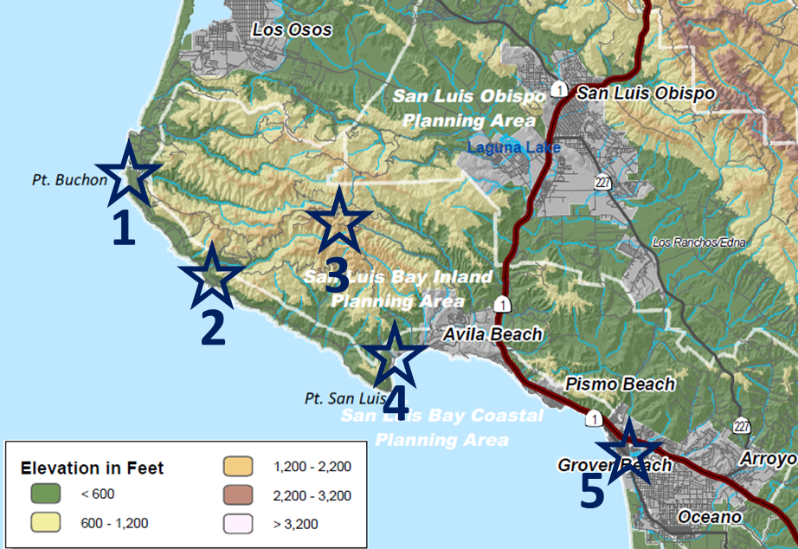

Inversion-penetrating terrain that produced the eddy with special observation locations plotted.
Pt. Buchon—PG&E
76 m met. Tower—PG&E Diablo Canyon Nuclear Power Plant
Davis Peak (550m)—PG&E
Center for Marine Sciences Pier—Cal Poly
Grover Beach station—San Luis Obispo County Air Pollution Control District

Slide 24
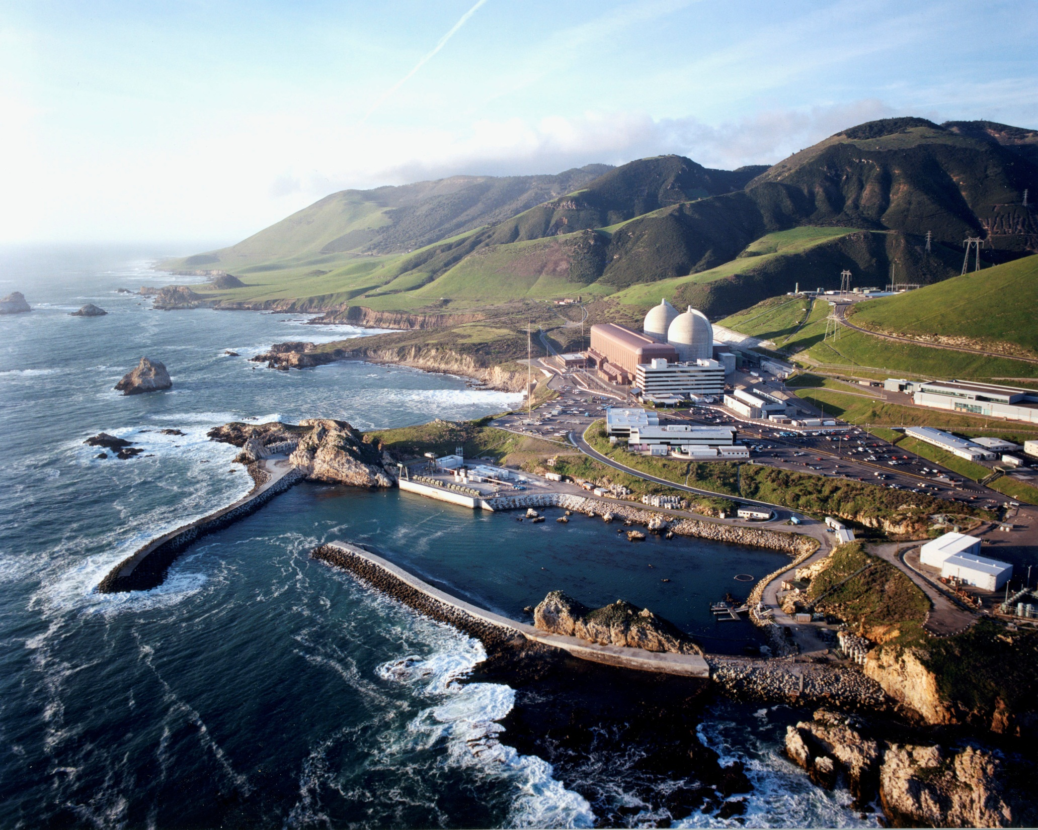
76 m METEOROLOGICAL TOWER
DIABLO CANYON NUCLEAR POWER PLANT

Slide 25
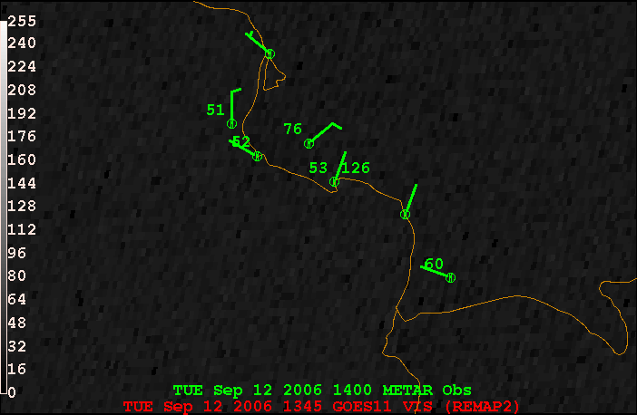
Satellite animation—Grover Beach eddy
Note: Temperatures are in degrees F

Slide 26
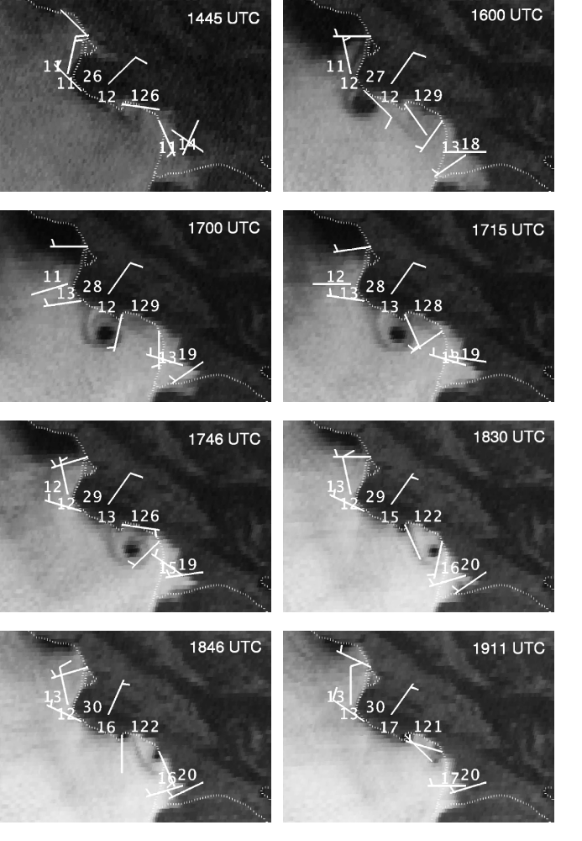
Steady, warm northeasterly inversion layer winds at Davis Peak, characteristic of Santa Ana-type winds above shallow Marine Atmospheric Boundary Layer (MABL).
Wind reversals or influence as eddy passes three stations.
Answers question posed by Young and Zawislak (2006) as to whether the vortex is just an inversion layer feature or extends down to the surface.
Eddy is present at the top of the MABL at the inversion as seen in the clouds, and also extends down to the surface as reflected in wind measurements.

Slide 27
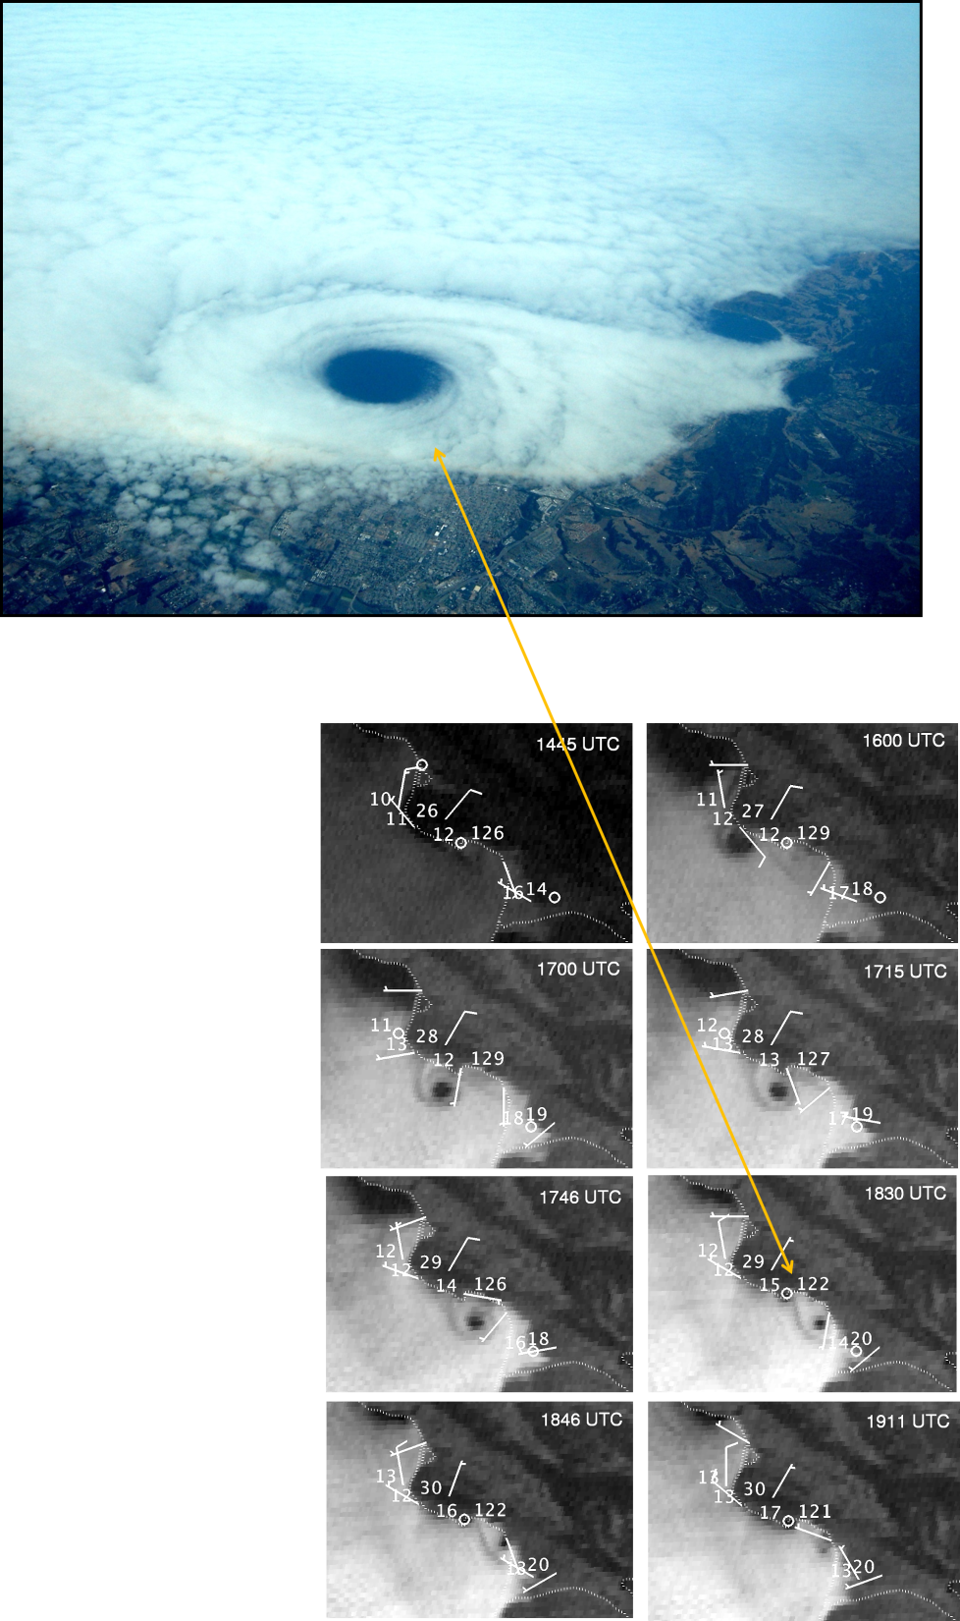
1830 UTC GOES image is best match with eddy photograph—just prior to causing nearly 180º wind reversal at Grover Beach station.

Slide 28
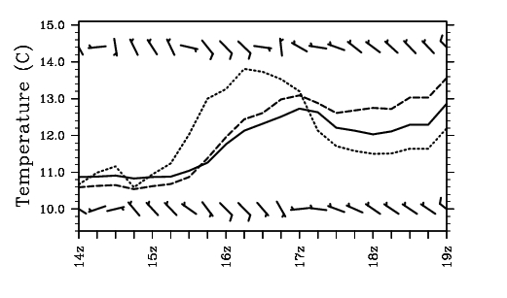
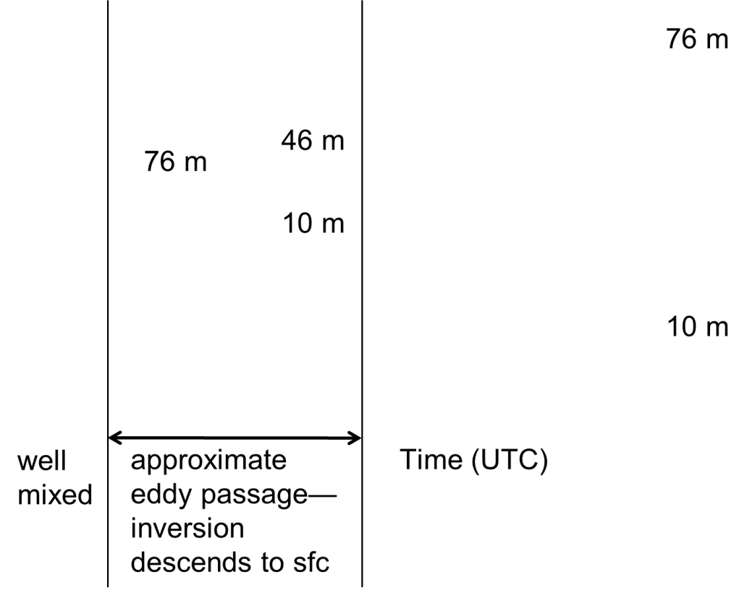
Meteogram from PG&E’s 76 m meteorological tower during eddy passage.
Dotted curve is temperature (ºC) from 76 m, dashed curve is from 46 m, and the solid curve is from 10 m above ground level (AGL).
Top row of winds is from 76 m and the bottom row is from 10 m AGL. Half barbs indicate approximately 2.5 ms⁻¹ and whole barbs approximately 5 ms⁻¹. Time is in UTC.
Temperatures show that there is a temperature increase on the back side of the eddy during its formation with the inversion descending to the surface, suggesting warm core eddy formation.
During the eddy passage:
Temperature trends at 76 m lead those at 10 m by about 45 minutes.
Cyclonic wind shift at 76 m leads that at 10 m by 15 minutes.
Thus, time series suggests that the eddy is leaning forward with height.

Slide 29
In absence of high resolution data or model simulation it is impossible to determine formation mechanism.
Lateral shear between southeasterly flow past headland and “return flow” in wake region➔cyclonic vertical vorticity in MABL?
Differential downslope motion in the flow in lee of headland➔tilting of baroclinically-generated horizontal vorticity into vertical similar to Smolarkiewicz and Rotunno (1989)?
Tilting of horizontal vorticity due to shear between MABL and inversion layer air?
A high resolution model simulation is needed to determine the answer.

Slide 30
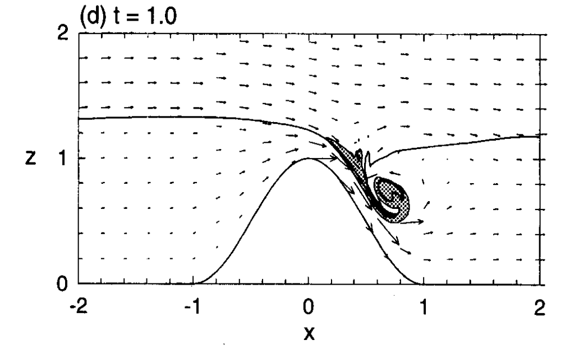
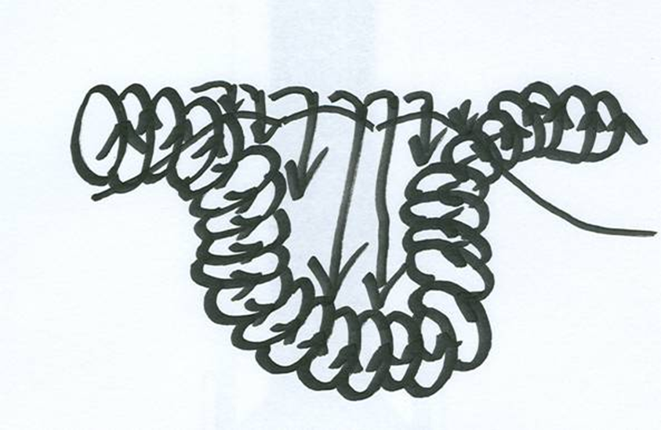
Possible formation mechanism—tilting of “backward rolling” (negative) horizontal vorticity into the vertical.
Figure 3 d from Rotunno and Smolarkiewicz 1995. Negative horizontal vorticity (i.e., rotation around a horizontal axis) generated baroclinically along sloping isentropic surfaces, which results in a “backward” (with respect to the mean flow) rolling or overturning motion as the fast moving surface flow undercuts the slower flow above it.

Slide 31
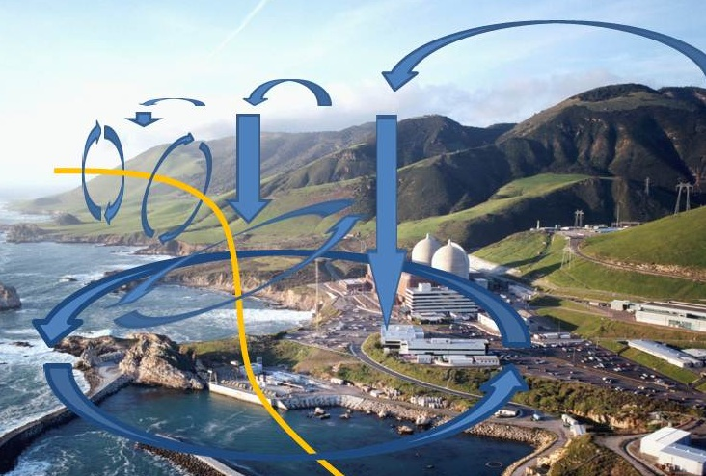

Slide 32
Implications and questions for numerical modeling:
Not possible to determine eddy formation mechanisms without a high resolution model simulation.
Not easy to generate the apparently delicate balance of conditions required to produce these transient features—initial conditions from gridded data do not resolve sharp inversion and shallow marine atmospheric boundary layer well.
Our initial attempts at 500 m resolution WRF model simulations so far did not show clear evidence of transient spinning vortices.
Visible swirls in automated streamlines of model output don’t necessarily mean there is a spinning vortex, especially on sloping iso-surfaces.

Slide 33
What iso-surfaces are best for representing the data in complex terrain?
Is model vertical resolution adequate to resolve horizontal vorticity and mountain wave or rotor-like features?
Time steps must be very short with high vertical resolution so as not to trigger violations of CFL condition with strong vertical motions—very CPU intensive.
At the time and space scales needed to study this phenomenon, distances of kilometers and times of minutes become important—for example we had to calculate how long it took the GOES satellite to scan to the latitude of the Grover Beach eddy in order to match 1 and 2 minute resolution data with the satellite images. Errors in the satellite image navigation can be up to 2 km.

Slide 34
Predictablility
Doyle et al. (2011) state that predictability of topographically-forced mountain wave and associated features may be limited.
If von Karman-like eddies depend on accurate prediction of mountain wave-like flows, then they may themselves be difficult to predict.

Slide 35
References
Countryman, C. M., 1971: Fire whirls...why, when, and where,
USDA Forest Service Pacific Southwest Research Station, Berkeley, CA.
Doyle, J. D., and Coauthors, 2011: An intercomparison of T-REX mountain-wave simulations and implications for mesoscale predictability. Mon. Wea. Rev., 139, 2811–2831.
Epifanio, C. C. and R. Rotunno, 2005: The dynamics of orographic wake formation in flows with upstream blocking. J. Atmos. Sci., 62, 3127–3150.
Lester, P. F., 1985: Studies of the marine inversion over the San Francisco Bay area. A summary of the work of Albert Miller, 1961–1978. Bull. Amer. Meteor. Soc.,66, 1396–1402.
Muller, B. M., C. G. Herbster, and F. R. Mosher, 2014: Unique aerial photographs of eddy circulations in marine stratocumulus clouds. Submitted to Monthly Weather Review.
Porter, J. N., D. Stevens, K. Roe, S. Kono, D. Kress and E. Lau, 2007: Wind environment in the lee of Kauai Island, Hawaii during trade wind conditions: weather setting for the Helios mishap. Bound.-Layer Meteor. 123, 463-480.
Schär, C., and D.R. Durran, 1997: Vortex formation and vortex shedding in continuously stratified flows past isolated topography. J. Atmos. Sci., 54, 534-554.
Smith, R. B., 1989: Comment on “Low Froude number flow past three-dimensional obstacles. Part I: Baroclinically generated lee vortices.” J. Atmos. Sci., 46, 3611-3613.
Rotunno, R., and P. K. Smolarkiewicz, 1995: Vorticity generation in the shallow-water equations as applied to hydraulic jumps. J. Atmos. Sci., 52, 320-330.
Smolarkiewicz, P. K., and R. Rotunno, 1989: Low Froude number flow past three-dimensional obstacles. Part I: Baroclinically generated lee vortices. J. Atmos. Sci., 46, 1154–1164.
Young, G.S., and J. Zawislak, 2006: An observational study of vortex spacing in island wake vortex streets. Mon. Wea. Rev., 134, 2285-2294.

