Slide 1
Creating Multispectral Imagery in LINUX Using MCIDAS-V
Subtitle

Slide 2
Introduction
The legacy GOES-Imager radiometer (still active on GOES-15 and previous satellites) had 5 channels (also known as “bands”), including one visible channel at 0.65μm. The new generation of GOES satellites (16 and 17) uses the Advanced Baseline Imager (ABI) radiometer with 16 total channels that include two visible channels, a 0.64 μm channel and a 0.47 μm channel.
To our eyes, 0.47 μm light is seen as blue, and 0.64 μm is red.
Individual channels measure radiance representing albedo (reflectivity) in that wavelength band, and are displayed in terms of grey shades, not the actual colors.
Albedo in VIS channels can be expressed in percent with 0% being no reflectivity (black) and 100% being total reflectivity (white).
It can also be expressed in “brightness counts” of radiance, with 0 being black and either 255 or 1023 being white (i.e. we may have 2⁸=256 different radiance values or 2¹⁰=1024 different radiance values and hence, grey shades)

Slide 3
This VIS image at 0.65 μm shows albedo in %, displayed as grey shades:

Slide 4
This VIS image at 0.65 μm shows albedo in terms of radiances expressed in brightness counts from 0 to 255, displayed as grey shades:

Slide 5
How We See Color (see following slide)
Your eyes perceive light through receptor cells in your retina called cones and rods.
Rods are more sensitive and therefore help you see better in dim light but do not perceive color. This is why you often cannot distinguish colors in low-light scenes.
Cone cells perceive colors; some are more sensitive to the reddish wavelengths, some to greenish wavelengths, and some to bluish wavelengths.
In light, red, green, and blue (RGB) are the primary colors—other colors can be formed from combinations of those three with differing intensities.

Slide 7
How we see satellite scenes in color on a computer screen
On a computer screen, colors are formed via pixels composed of three dots, red, blue, and green, of varying intensities.
To create a true color satellite image you need a red channel, a blue channel, and a green channel, to provide information from a scene on the intensities of each of the three primary light colors.
Information about the individual intensities of each color are displayed in the computer pixels via the red, green, and blue dots from which we can form all the colors that the cones in our eyes perceive.
However, there *is no green channel* on the GOES ABI!!
Instead, we use the 0.86 μm near IR “veggie” channel as a surrogate for the green channel.

Slide 8
Radiation reflected from opaque objects is the part of the incident radiation that is not absorbed by the object.
Going back to our relationship
$a_{λ}+ r_{λ}+t_{λ}=1$
In an “opaque” object like a land surface with vegetation, there is no transmissivity, only absorption or reflectivity, therefore
$a_{λ}+ r_{λ}=1$ ➔ ${ r}_{λ}=1 −a_{λ}$ In words, this means that whatever radiation incident on an object that is not absorbed is reflected. We don’t see the absorbed radiation—we see the reflected radiation.

Slide 9
Vegetation looks green because it absorbs blue and red wavelengths, but reflects more of the green wavelengths.

Slide 10
It turns out that vegetation reflects even more radiation in the near IR wavelength at 0.86 μm than it does green light. This is why we can use ABI Channel 3 as a surrogate for green, but it actually has to be “toned down” in the mix between the three different channels to get an image that does not look too green.

Slide 11
In other words, channels at 0.86 μm receive a strong response from vegetation, just as channels that measure green wavelengths, do, and therefore we can use the 0.86 μm ABI Channel 3 information to substitute for the non-existent green channel on the ABI.
Note that the Japanese Himawari satellite, which is essentially a knock-off of the U.S. GOES-R series satellites (but was launched well before GOES-16) does have a green channel at 0.51 μm.

Slide 12
In the following exercise you will build a full color (but not a *true* color) image using ABI Channels 1, 2, and 3 for blue, red, and green in the RGB scheme, even though Channel 3 is not actually a green channel.
Start by rebooting your computer to linux—upon restart, hit a key➔this provides a menu on which you will scroll up to the top choice, Red Hat Enterprise Linux Workstation.
(In reality, it may not matter which version of Linux you use!)
Then use your regular university login id (but use lower case!) and password. Your login id must be entered in lower case. The password also is case sensitive, and should be entered just as you type it in Windows.

Slide 13
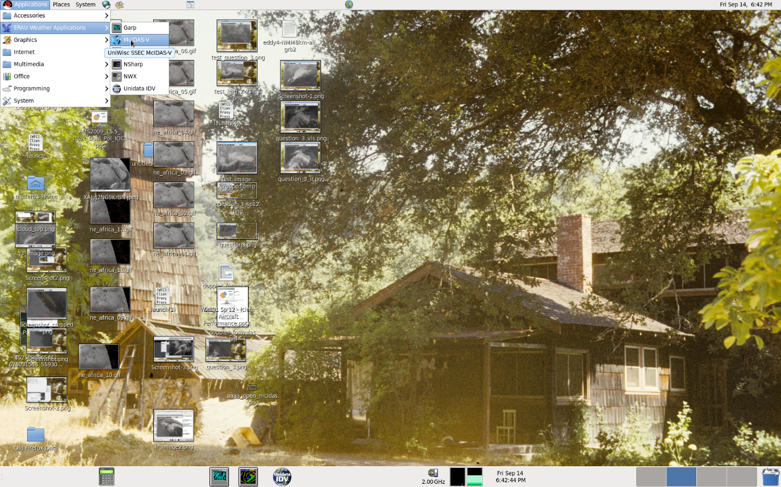
Open MCIDAS-V
In LINUX, go to upper left corner of screen and click on
➔Applications➔ERAU Weather Applications➔McIDAS-V

Slide 14
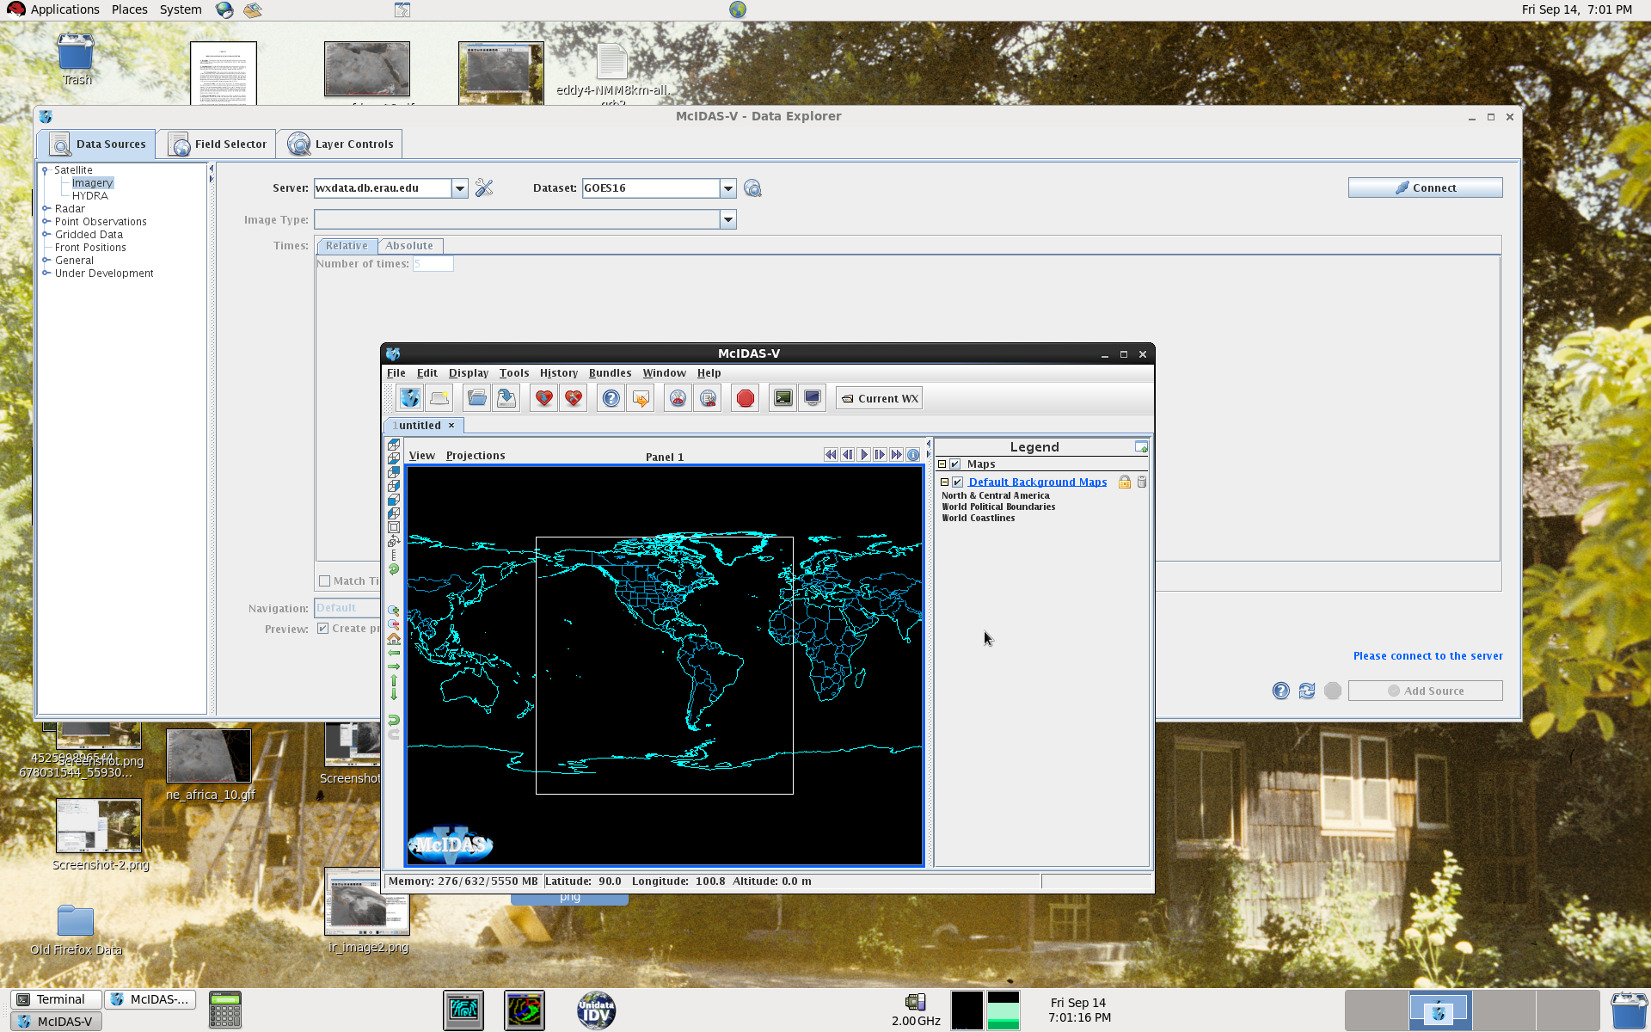
Opening McIDAS-V
You should get a McIDAS-V window and a McIDAS-V Data Explorer window:

Slide 15
Point to Satellite Data
Click on the “Data Sources” tab of the Data Explorer window.
If it is not already expanded, click on the little circle to the left of “Satellite”, then select “Imagery”.
In the “Server” textbox replace the existing text with wxdata.db.erau.edu
Click in the “Dataset” textbox which will open a popup window called “Add Remote Dataset”
Enter the text GOES16 in the “Dataset” field.
Click the “Verify and Add Server” button (lower left; if you typed something wrong the textbox background will be light red and there will be an error message telling you something is wrong).
Click the “Connect” button to the upper right of the Data Explorer window.

Slide 17
Select Data
Now the “Image Type” chooser should be populated.
Select CONUSC01 NOAAPort GOES-16 CONUS 0.47 μm and under “Times:” click on the “Absolute” tab to pic a specific time or the “Relative” tab to get the most recent time. The channel selected is the GOES-16 blue visible “aerosol” channel, that is, GOES-16 ABI Channel 1.
For this exercise it will go faster if you just select one image time rather than trying to download several times.
Select a time that has full daylight over the CONUS, then click the “Add Source” button to the lower right of the Data Explorer window.
Go back to the Data Sources tab and repeat for Channels 2 (0.64 μm [red]—if you are using the “Relative” tab it will default to the same time as the original image; if using the “Absolute” tab, always be sure to select the same time) and 3 (0.86 μm [near IR “veggie” surrogate for green).

Slide 20
Divide Your Display Window Into 4 Panels
Now go to the McIDAS-V Window. Note that it may be hidden behind other windows—you can bring it forward by clicking the appropriate icon on the lower left of your screen, or just manually drag and drop windows until you find it.
On the McIDAS-V Window click File➔New Display Window➔Map Display➔Four Panels
This opens a second McIDAS-V Window with four map panels instead of one; you can close the original one to get rid of a little bit of clutter on your Desktop.

Slide 22
Display Different Channel Data in Different Panels
Visible color is composed of the primary colors of light: blue, red, and green. With the blue and red, and the near IR which has high reflectance from vegetation as “green” you can make color imagery.
Click on the upper left panel in the McIDAS-V window to activate it, then go to the Data Explorer window and click on the Field Selector tab. There should be 3 different channels worth of data, so select CONUSC1, i.e., CONUS Channel 1.
In the Fields panel, click on the little circle to the left of “Band 1”, then select “Scaled counts”; once it has loaded click on the “Create Display” button at the bottom.
This should create a black and white grey-scale image of the Channel 1 visible data. This is your “blue” channel.
You can resize the window if desired, make it full screen, etc. and use the scroll wheel to zoom in and out. The arrow keys can help you navigate within an image.

Slide 23
Display Different Channel Data in Different Panels (cont’d)
Now click in the upper right hand panel.
Go to the Data Explorer Window, click the Field Selector tab, and select Channel 2 data.
Again expand Band 2 by clicking on the little circle, select Scaled counts, and click Create Display.
This is your “red” visible channel 2.

Slide 24
Display Different Channel Data in Different Panels (cont’d)
Now click in the lower lefthand panel.
Go to the Data Explorer Window, click the Field Selector tab, and select Channel 3 data.
Again expand Band 3 by clicking on the little circle, select Scaled counts, and click Create Display.
This is your “green” created by using the near IR channel 3. Notice it is slightly brighter than the other two. Vegetation actually reflects more strongly in this part of the spectrum than it does green visible light.

Slide 26
Display Different Channel Data in Different Panels (cont’d)
Now click in the lower righthand panel.
Go to the Data Explorer Window, click the Field Selector tab, and click “Formulas” on the lefthand side under “Data Sources”.
In the “Fields” panel, click the little circle next to “Imagery” then select “Three Color (RGB) Image (Auto-scale)”
A “Field Selector” Window opens in which you will put each channel data into its appropriate color.
In the lefthand “Field: red” click the circle next to Channel 2, then click the circle to expand Band 2, and select Scaled counts. Use Channel 3 for green and again select Scaled counts, and on the right use Channel 1 for blue and select Scaled counts. Now click the “OK” button.

Slide 29
Changing Colors
You now have a color image based on the red, blue and veggie channels (as a surrogate for green)!
Now go to the “Layer Controls” tab on the Data Explorer window.
The “Gamma” function controls the brightness of all three colors, either together or individually. It is inversely proportional to brightness. E.g., decreasing all from 1.0 to 0.5 brightens up the image but leaves the color proportions the same. Changing only one at a time brightens or darkens that color only.
Try different combinations on your own!

