Slide 1
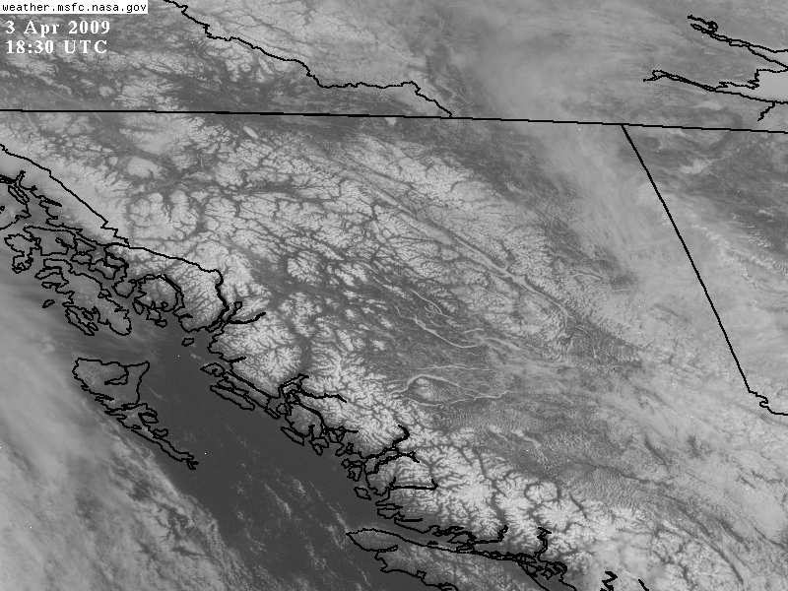
Geographic Features in Satellite Imagery

Slide 2
Features Require Contrast
Geographical features best seen in cloud-free VIS imagery during daylight hours. Can also be seen in cloud-free IR imagery when there is a spatial temperature difference that makes them show up.
Features show up when there is contrast in the imagery.
Contrast in VIS magery is due to albedo differences of different surfaces.
Contrast in IR imagery is due to temperature differences (could also be due to emissivity differences, but we will ignore those).

Slide 3
A Note on “Visible” Channels
For geostationary satellites ≤ GOES-15, “visible” refers to 0.65µm (red) channels.
For GOES-16/17+ we will use “visible” to refer to the 0.64µm (red) channels.
While there is a blue “visible” 0.47µm channel as well, it has a slightly hazier look due to greater molecular and particle scattering of blue light.
Red is a “cleaner” window for geographic applications.

Slide 4
Visible—Contrast Due to Albedo
Albedo is relative brightness of a surface based on how reflective it is, usually referring to electromagnetic radiation in the visible part of the spectrum--depends on physical characteristics such as composition, color, vegetation or ground cover, land use, presence or absence of snow and ice.
For albedos of common cloud and land surfaces, see the following two tables. For example, dry, sandy soil has an albedo range of 25-45%. Ocean surfaces have an albedo of 7-9%.

Slide 5
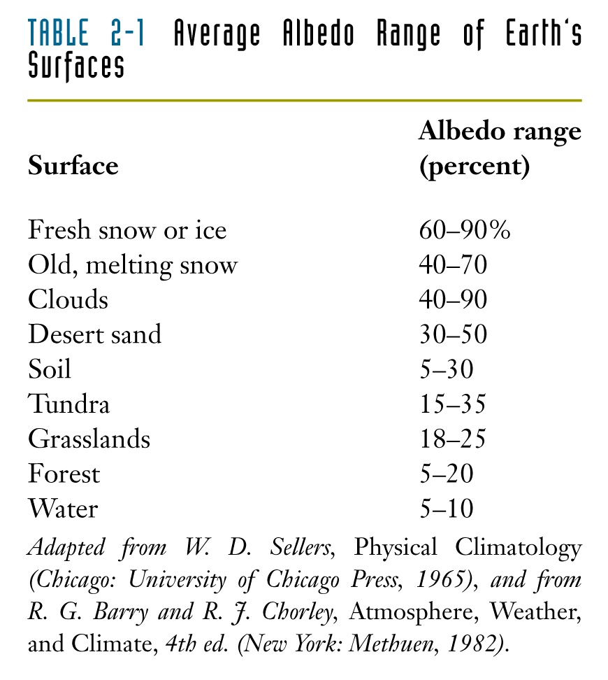
From http://www.sonoma.edu/users/f/freidel/global/372lec2images.htm

Slide 6
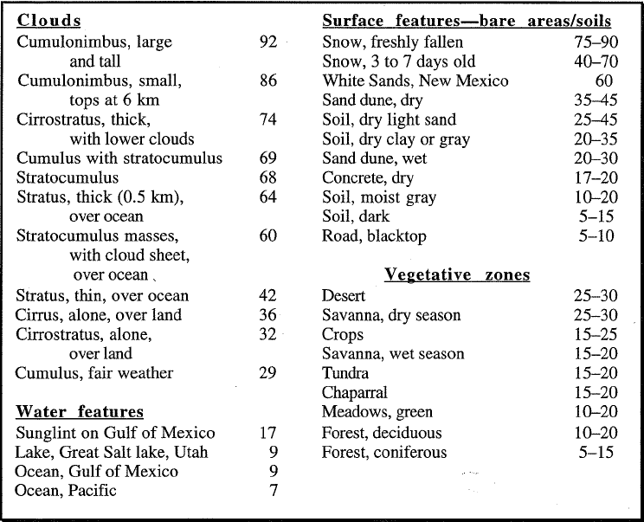
Albedo of Common Surfaces

Slide 7
Note: Resolution Defined by Field-of-View
Features that are smaller than the resolution of the visible satellite channel cannot be seen. The ≤GOES-15 visible channel has a nominal resolution of 1 km.
GOES-16/17 red channel has a nominal resolution of ½ km (blue is 1 km).
The satellite field of view contains one average brightness over the entire area of a pixel.

Slide 8
Links to GOES-East and –West VIS
GOES-East Visible
GOES-West Visible

Slide 9
Coastal Features in VIS
Ocean almost always looks darker than land owing to its very low albedo. Therefore, coastlines are among the most easily identifiable geographic features in satellite imagery. Land surfaces will typically appear somewhat lighter than the adjacent ocean.

Slide 10
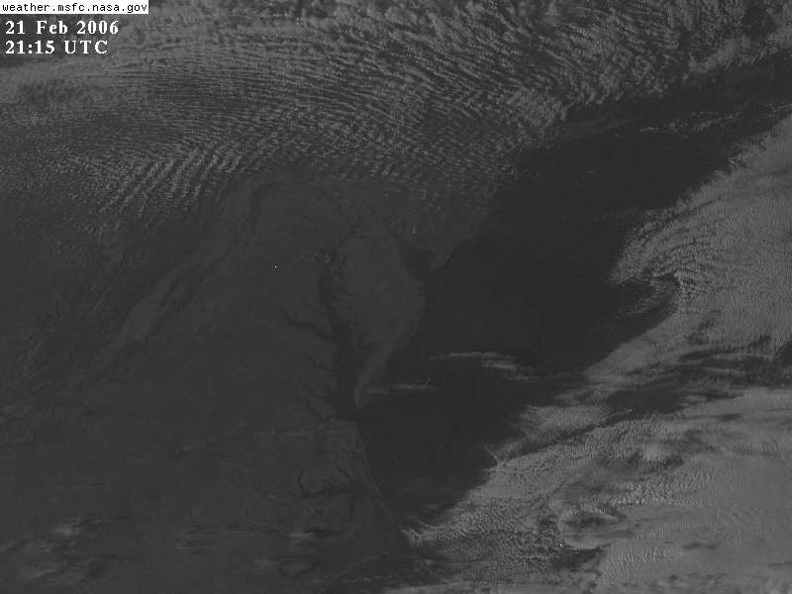

Slide 11
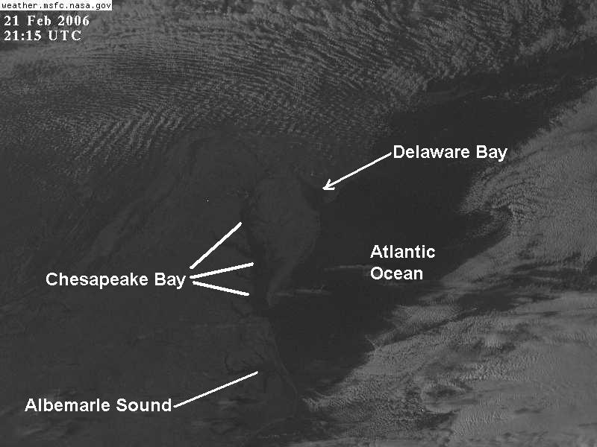

Slide 12
Inland Water Features
Lakes and Rivers also show up well on satellite imagery in cloud-free areas.
Some rivers and lakes are too small to show up on visible satellite imagery. Keep in mind that the nominal resolution of the GOES visible channels is ½ or 1 km, and that is the highest resolution it can achieve at the satellite subpoint. Locations not directly under the satellite will have even lower resolution.
Even though a river may be less than 1 km or ½ km across, it may still show up in the satellite imagery. The low albedo of the river itself combined with the low albedo of vegetation and dark soil in the fertile floodplain around the river often enables it to be clearly identifiable as a long, narrow, winding, dark feature in the visible (see St. John's River in the following images).

Slide 13
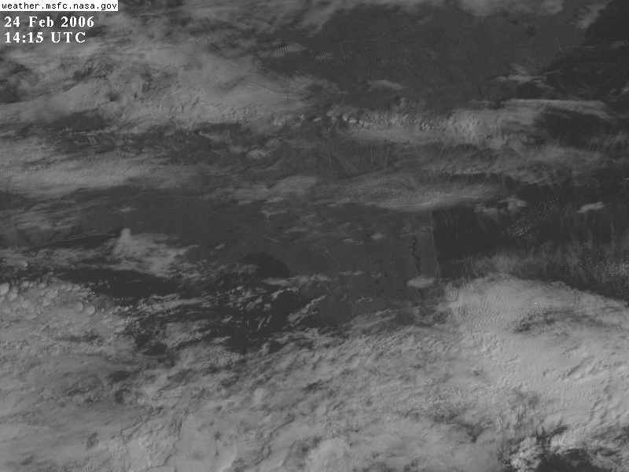

Slide 14
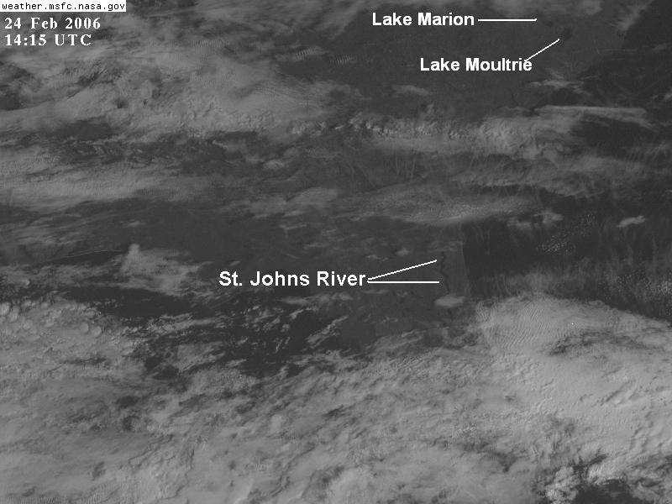

Slide 15
Indications of Terrain
Heavily vegetated and wooded areas have low albedo and look dark on satellite imagery. Since mountainous regions often are heavily forested, they often look darker than surrounding areas on visible satellite imagery.

Slide 16
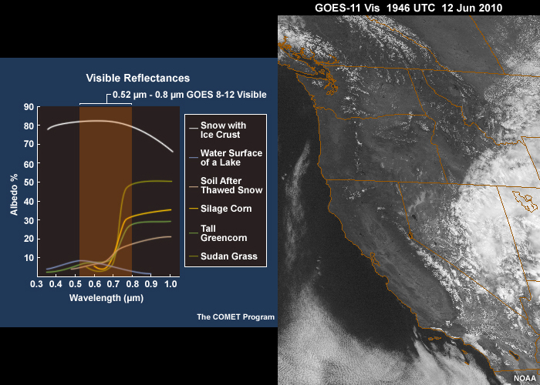

Slide 17
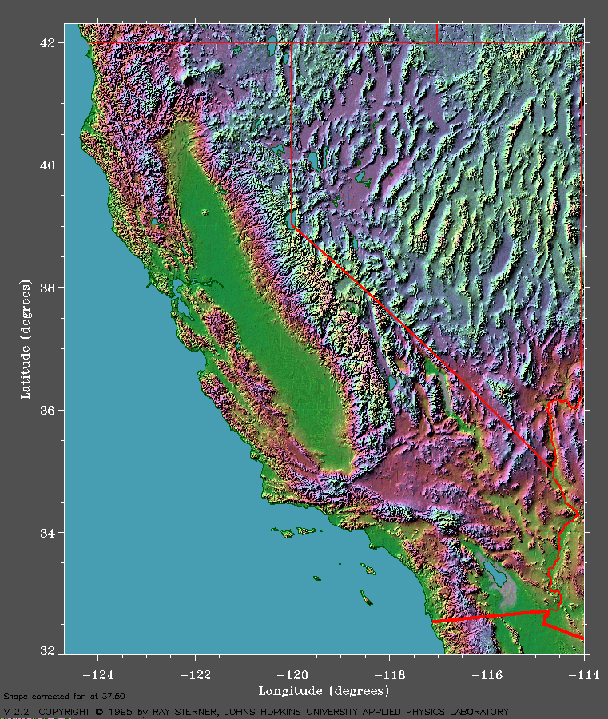

Slide 18
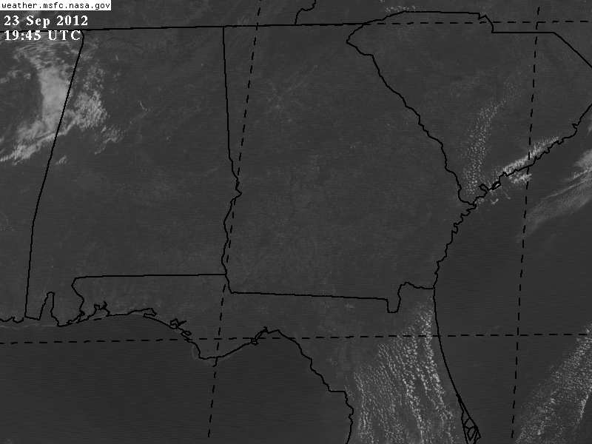
Land Surface Albedo Differences

Slide 19
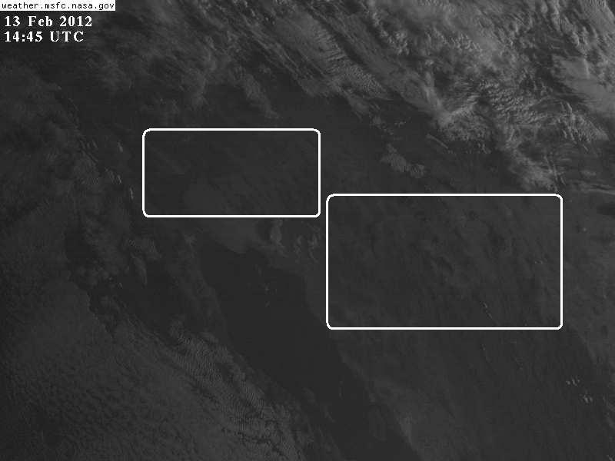
Albedo Varies with Time of Day—Low Sun Angle is Darker—Below: early morning

Slide 20
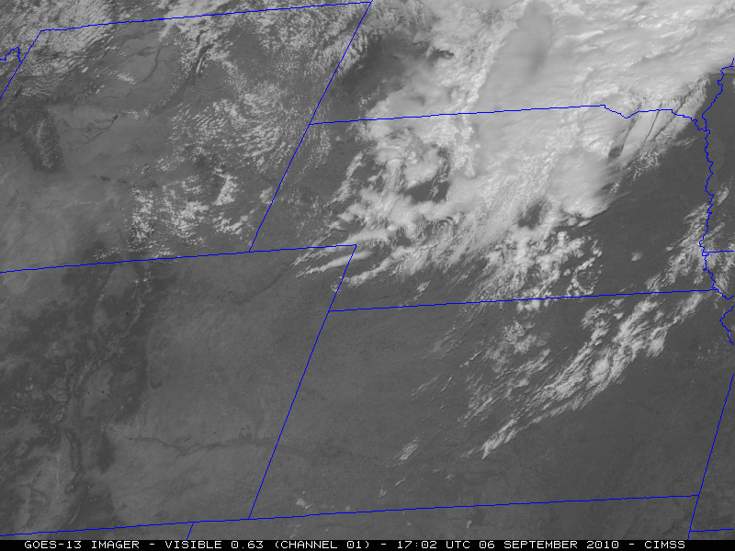

Slide 21
Snow Surfaces-High But Varying Albedo
Mountainous snow features show “dendritic” (branch-like) pattern due to shapes of ridge-tops.
Non-mountainous snow features show considerable albedo variations—look sort of patchy (trees, melting, fields, etc).
Ice-covered snow uniformly bright.

Slide 22
Dendritic Mountain-top Snow and Ice

Slide 23
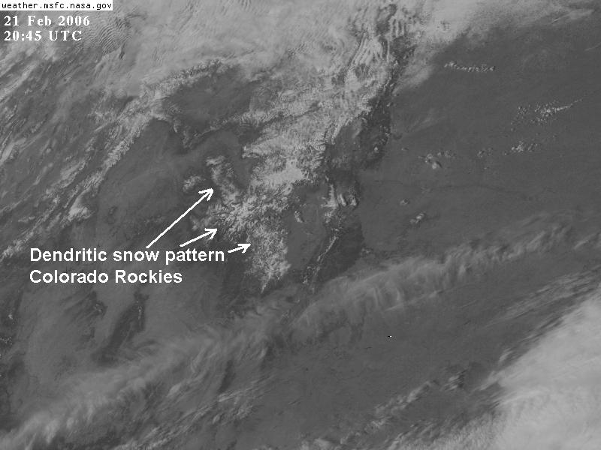

Slide 24
Non-mountainous Snow Patterns

Slide 25
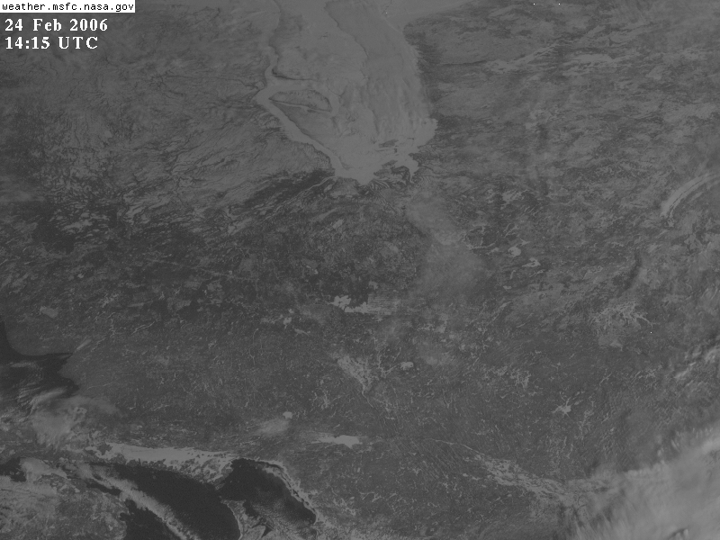

Slide 26
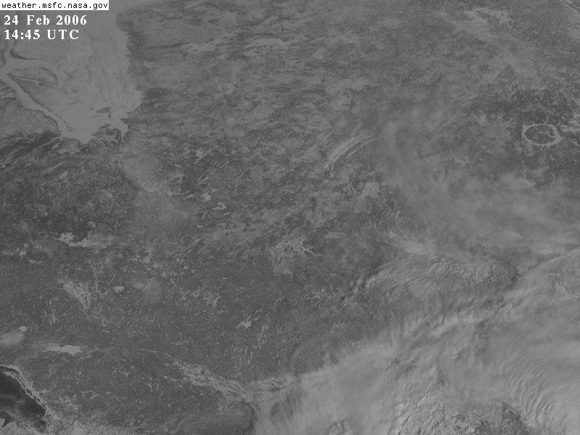

Slide 27
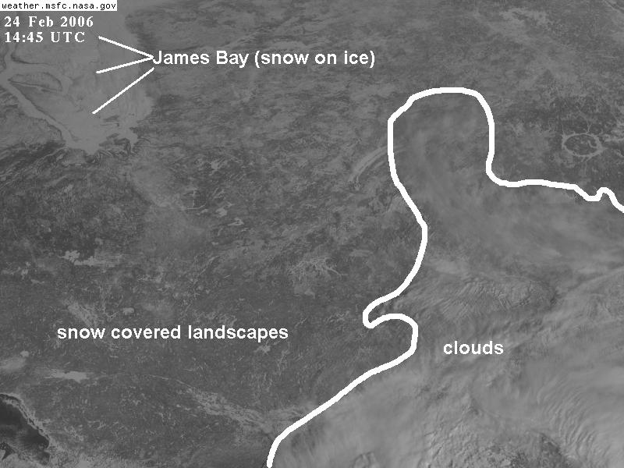

Slide 28
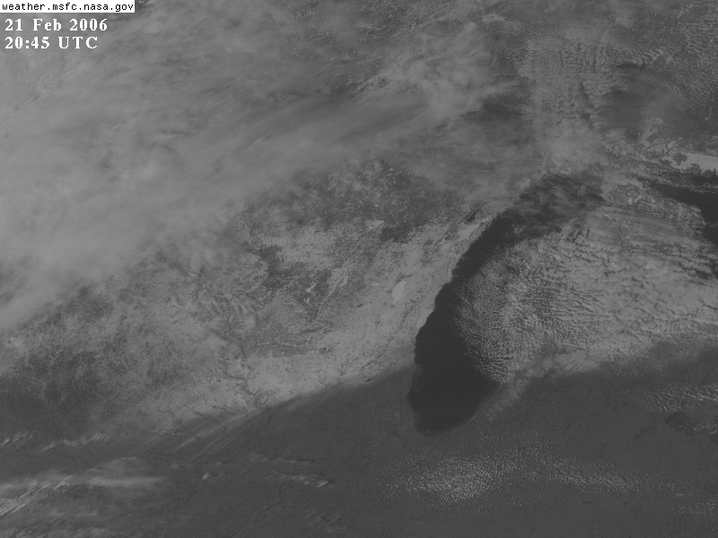

Slide 29
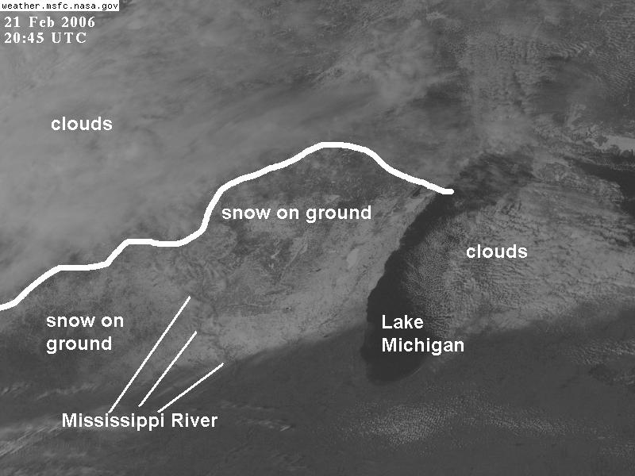

Slide 30
IR Imagery—Contrast Due to Temperature Differences
In IR, warm temperatures are shown as dark, and cool temperatures are shown as light.
Grey shade differences indicate temperature differences.
Geographic features only show up if there is a temperature difference between one surface and another (or if there is an emissivity difference—we will ignore those and assume that the surfaces are emitting like a blackbody, i.e., with 100% efficiency for their temperature).
Land/water show up best (when there is a temperature difference).
In theory, the urban heat-island effect can show up in satellite imagery. In practice, I never notice it in geostationary imagery—perhaps it shows up in polar orbiting IR images (see text➔CD-ROM).

Slide 31
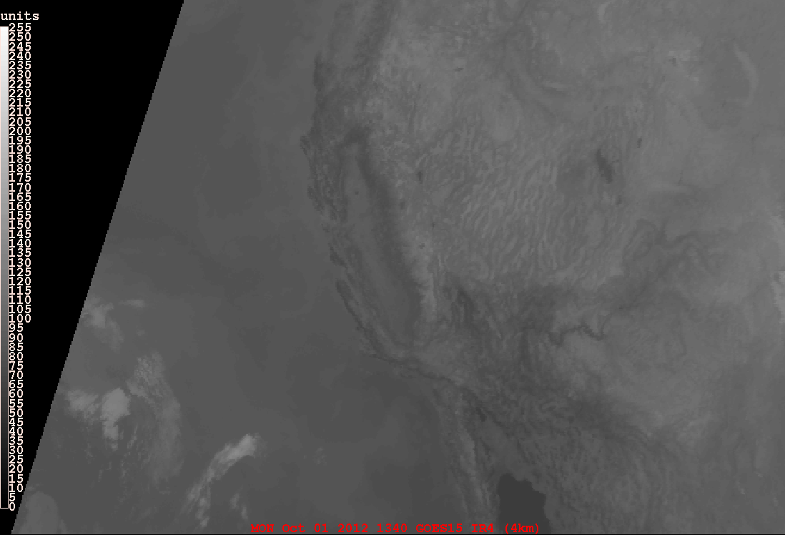
IR image of Western United States.

Slide 32
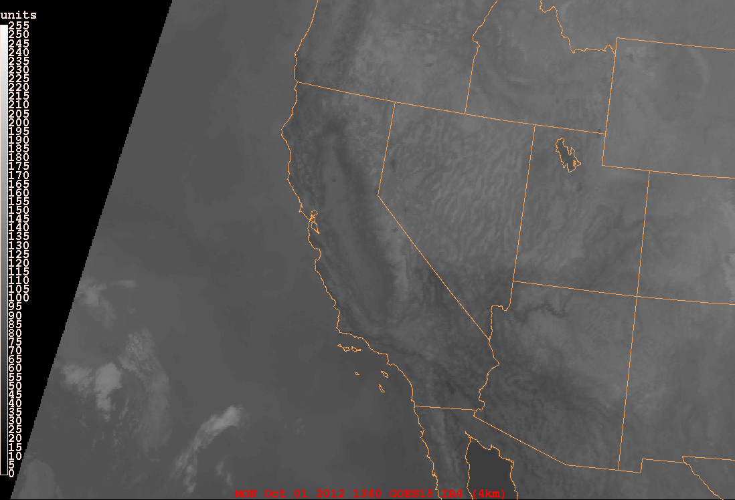
IR image of Western United States with map.

Slide 33
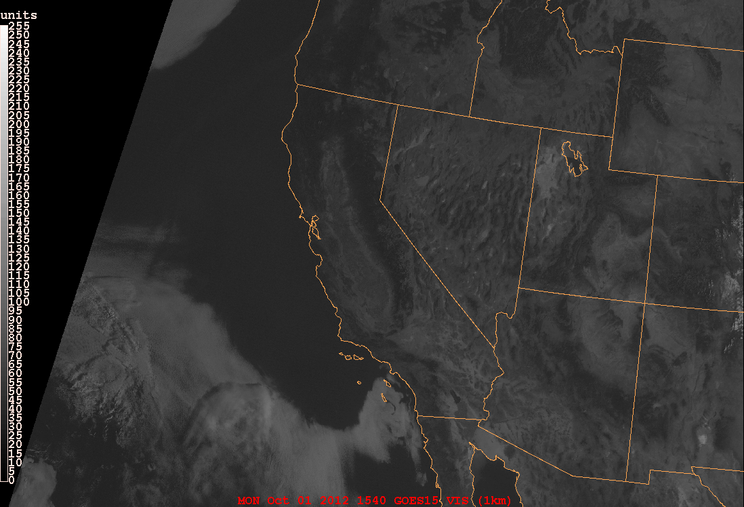
Visible image of Western United States with map.

Slide 34
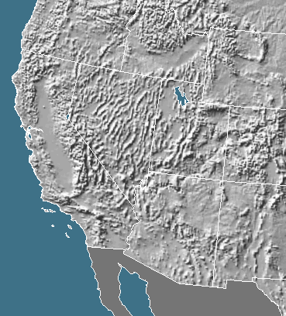
Terrain of the Western United States—the similarity with patterns in IR and visible imagery is obvious.
Copyright 1995 Ray Sterner, Johns Hopkins University Applied Physics Laboratory.

Slide 35
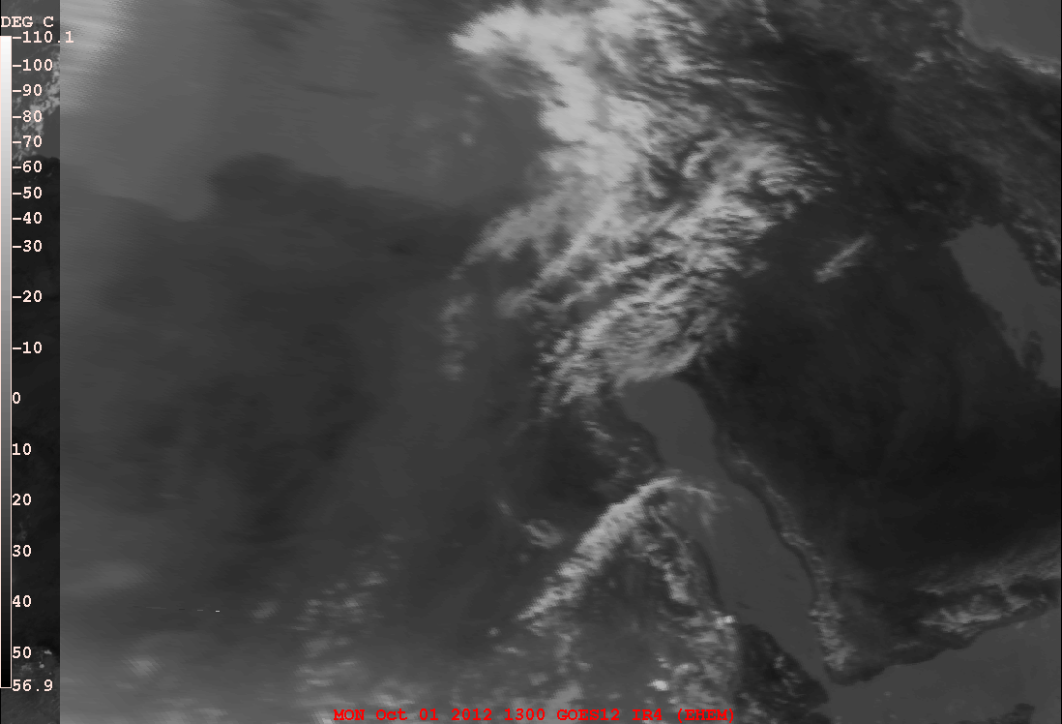
IR image of Middle East and northeastern Africa.

Slide 36
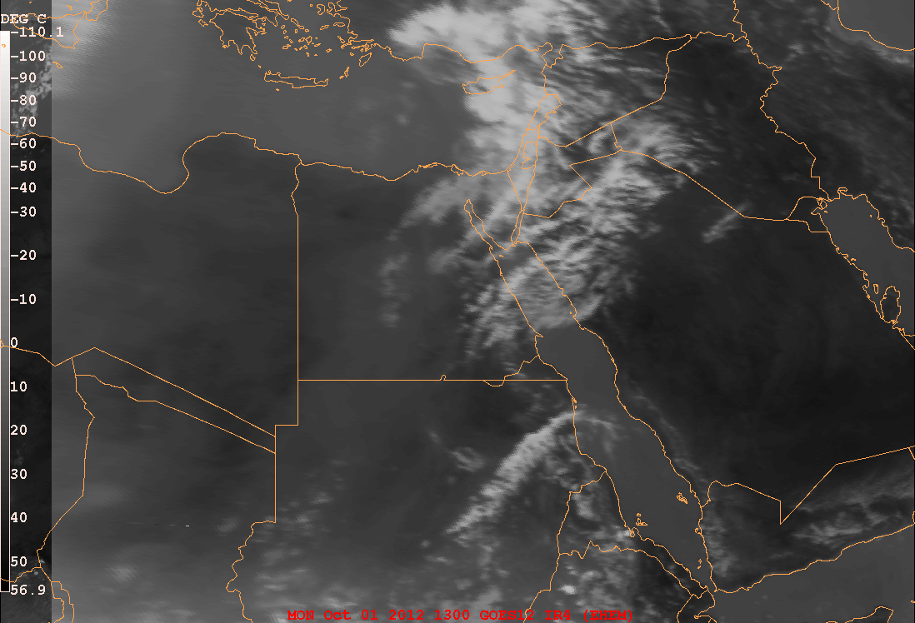
IR image of Middle East and northeastern Africa.

Slide 37
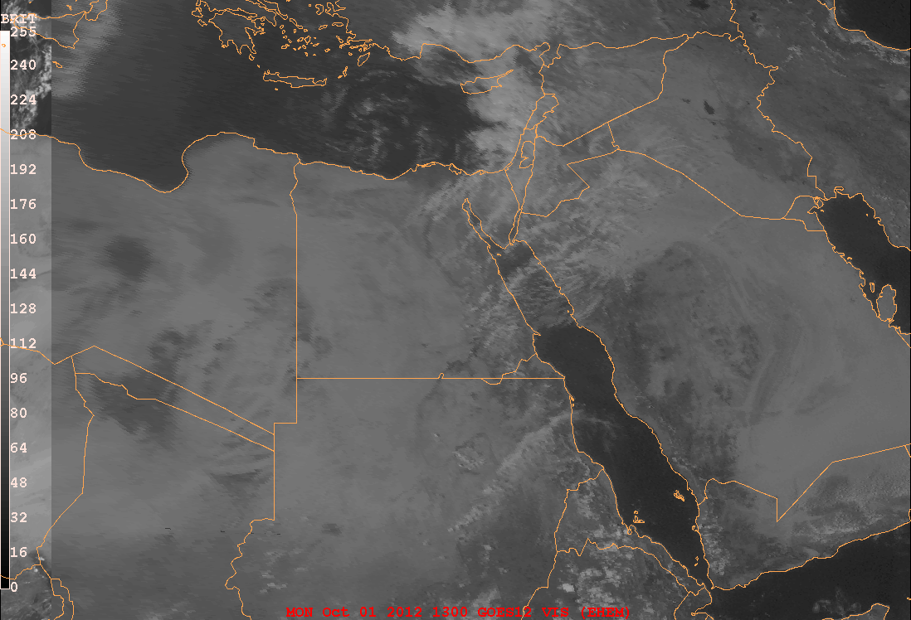
Turkey
Syria
Iran
Lebanon
Iraq
Jordan
Israel
Kuwait
Libya
Egypt
Saudi Arabia
Sudan
Chad
Eritrea
Yemen
Ethiopia
Djibouti
Visible image of Middle East and northeastern Africa.

