Slide 1
MPAR—Multifunction Phased Array Radar
Part II—Future of Wx Radar

Slide 2
Background
Research indicates NEXRAD improved tornado warning lead time from ~7 minutes to ~13 minutes currently.
NEXRAD is believed to have reduced tornado fatalities by 45%.
NEXRAD is nearing end of its 20-year engineering design lifespan.
Options range from refurbishment to extend life of existing hardware to “wholesale” upgrades to multi-function or multi-mission phased array radar (MPAR).

Slide 3
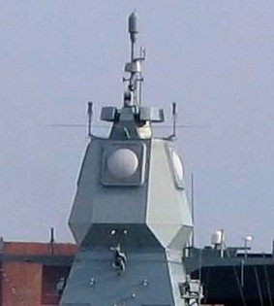
History of Phased Array
Phased array antenna transmissions were first used in 1905!
Phased array radar with a rapidly steerable beam was invented by Luis Alvarez, Nobel laureate, during World War II for use in “ground controlled approach” to help land aircraft.
Navy has used phased array radar for at least three decades due to its ability with rapid beam scanning and control, but not for weather.

Slide 4
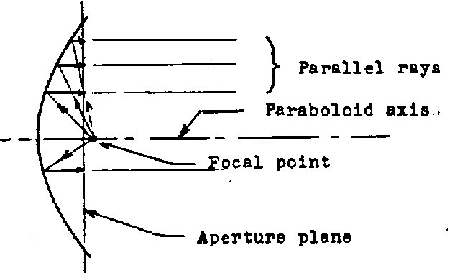
Conventional Radar: Beam Formation and Steering
In a conventional radar such as NEXRAD, beam formation is made by a parabolic antenna.
Beam steering is accomplished by physically turning the antenna to scan around the horizon.

Slide 5
What is Phased Array Radar?
Phased array antenna contains many small transmitting elements that can each transmit microwave signal independently, and uses principles of constructive or destructive interference between signals from all transmitters.

Slide 6
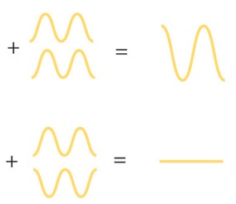
Wave theory: waves can reinforce (constructive interference)or cancel each other (destructive interference).

Slide 7
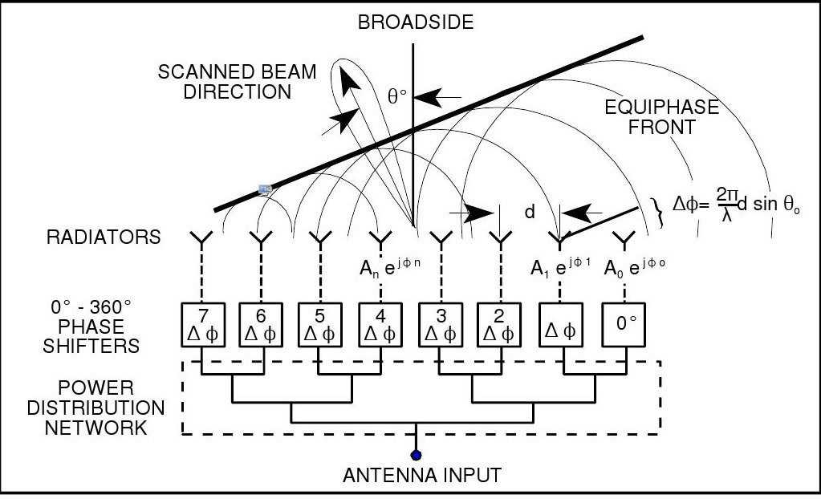
Beam steering and formation accomplished through constructive/destructive interference.
They form a beam by staggering the phases, i.e. the begin-time, of the transmitting elements:

Slide 8
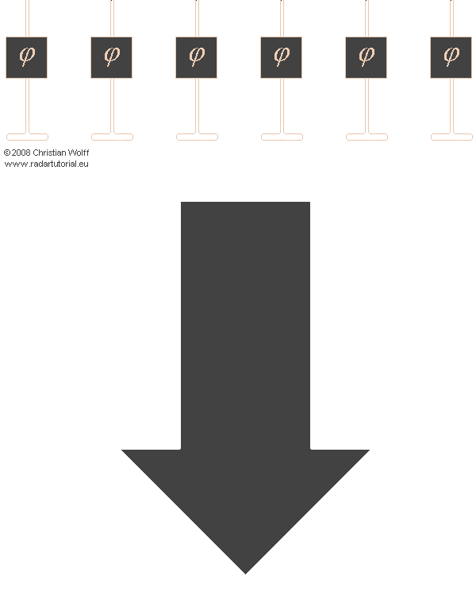
Changing beam direction through phase-shifting.

Slide 9
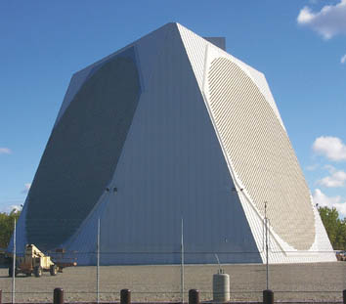
Each face covers about 90 degrees, so the radar must have four faces to make a 360 sweep.

Slide 10
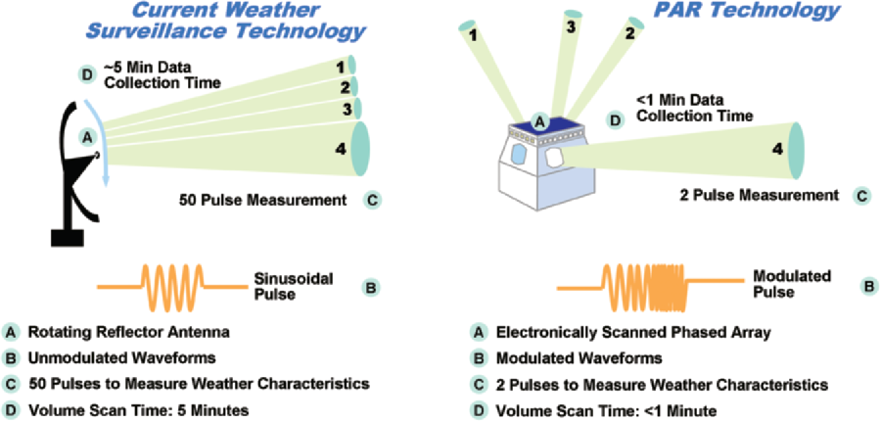

Slide 11
Multifunction Phased Array Radar

Slide 12
NSSL Slides on Multifunction Phased Array Radar
The following slides are taken from this National Severe Storms Lab presentation:
Research on Potential Improvements with Phased Array Radar--Dr. Pamela Heinselman, NSSL

Slide 13
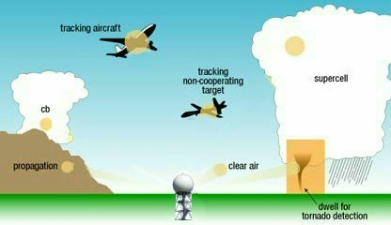
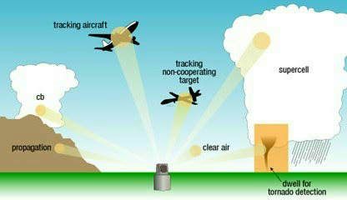
Why Phased Array Radar?
Conventional scanning
Everywhere
Sequential
Adaptive scanning
Areas of interest only
Arbitrary
Goal: Faster Updates
Courtesy of Chris Curtis

Slide 14
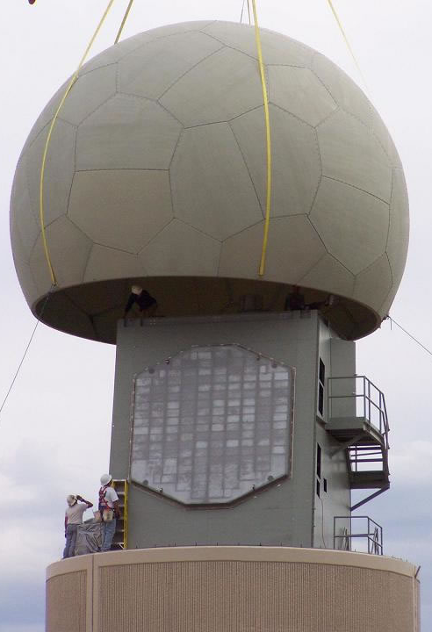
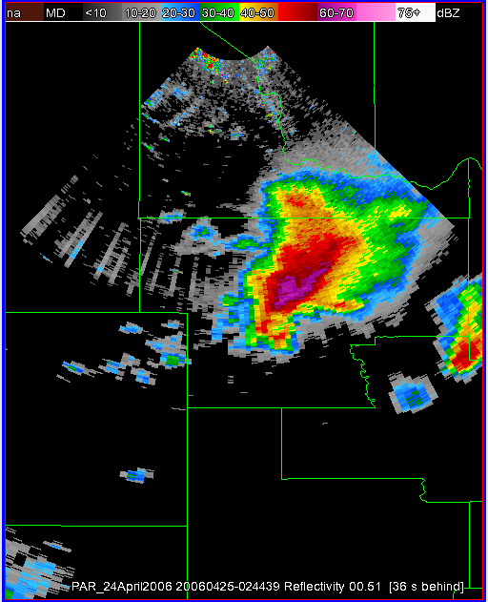
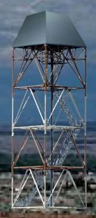
Characteristics of NWRT PAR
High-Temporal Resolution Data
Ultimate Goal Specs ≥ Current Requirements
Current Setup
90°
2.1°
2.1°
1.5°
90° Sector Scan
Characteristics Similar to WSR-88D
Wavelength: PAR = 9.4 cm / WSR-88D = ~10 cm (S-band)
Range Resolution: PAR = 240 km / WSR-88D = 250 km

Slide 15
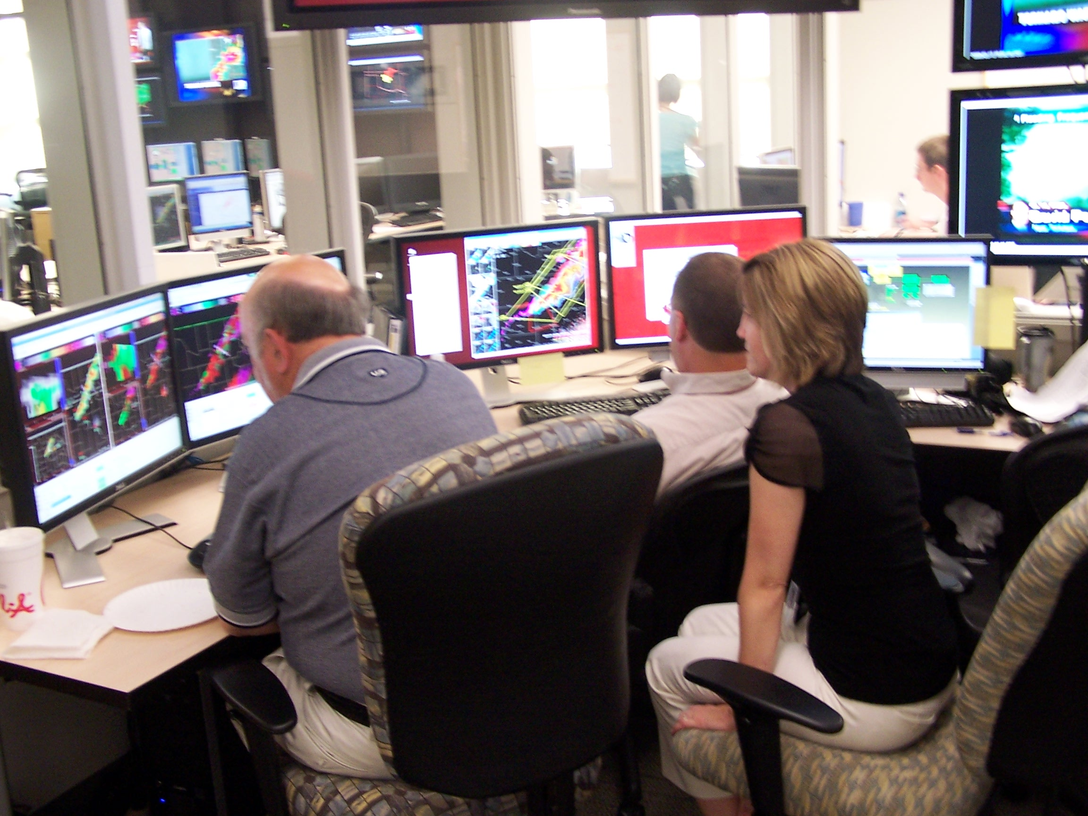
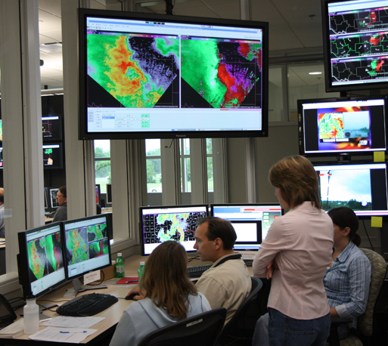
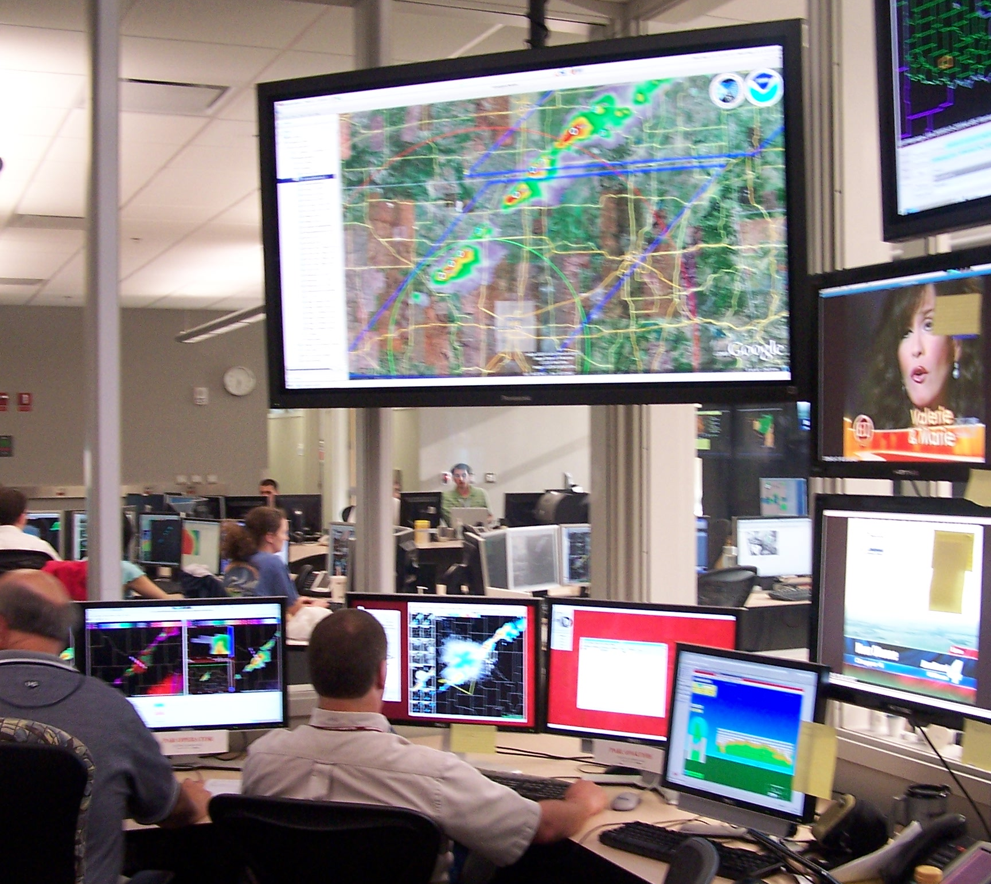
PARISE
Phased-Array Radar Innovative Sensing Experiments
To develop:
High-temporal resolution,
phenomenon-based scanning strategies
To evaluate: Strengths and limitations of PAR data
in the warning decision process
Challenges of using PAR data in a
pseudo-operational environment
Impact of scanning strategies on depiction of severe storms
To improve: Warning operations
Understanding of severe storm processes
Photos by James Murnan

Slide 16
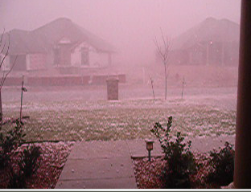
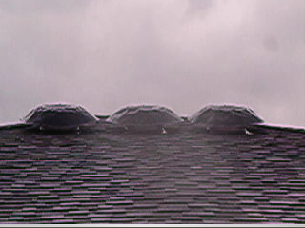
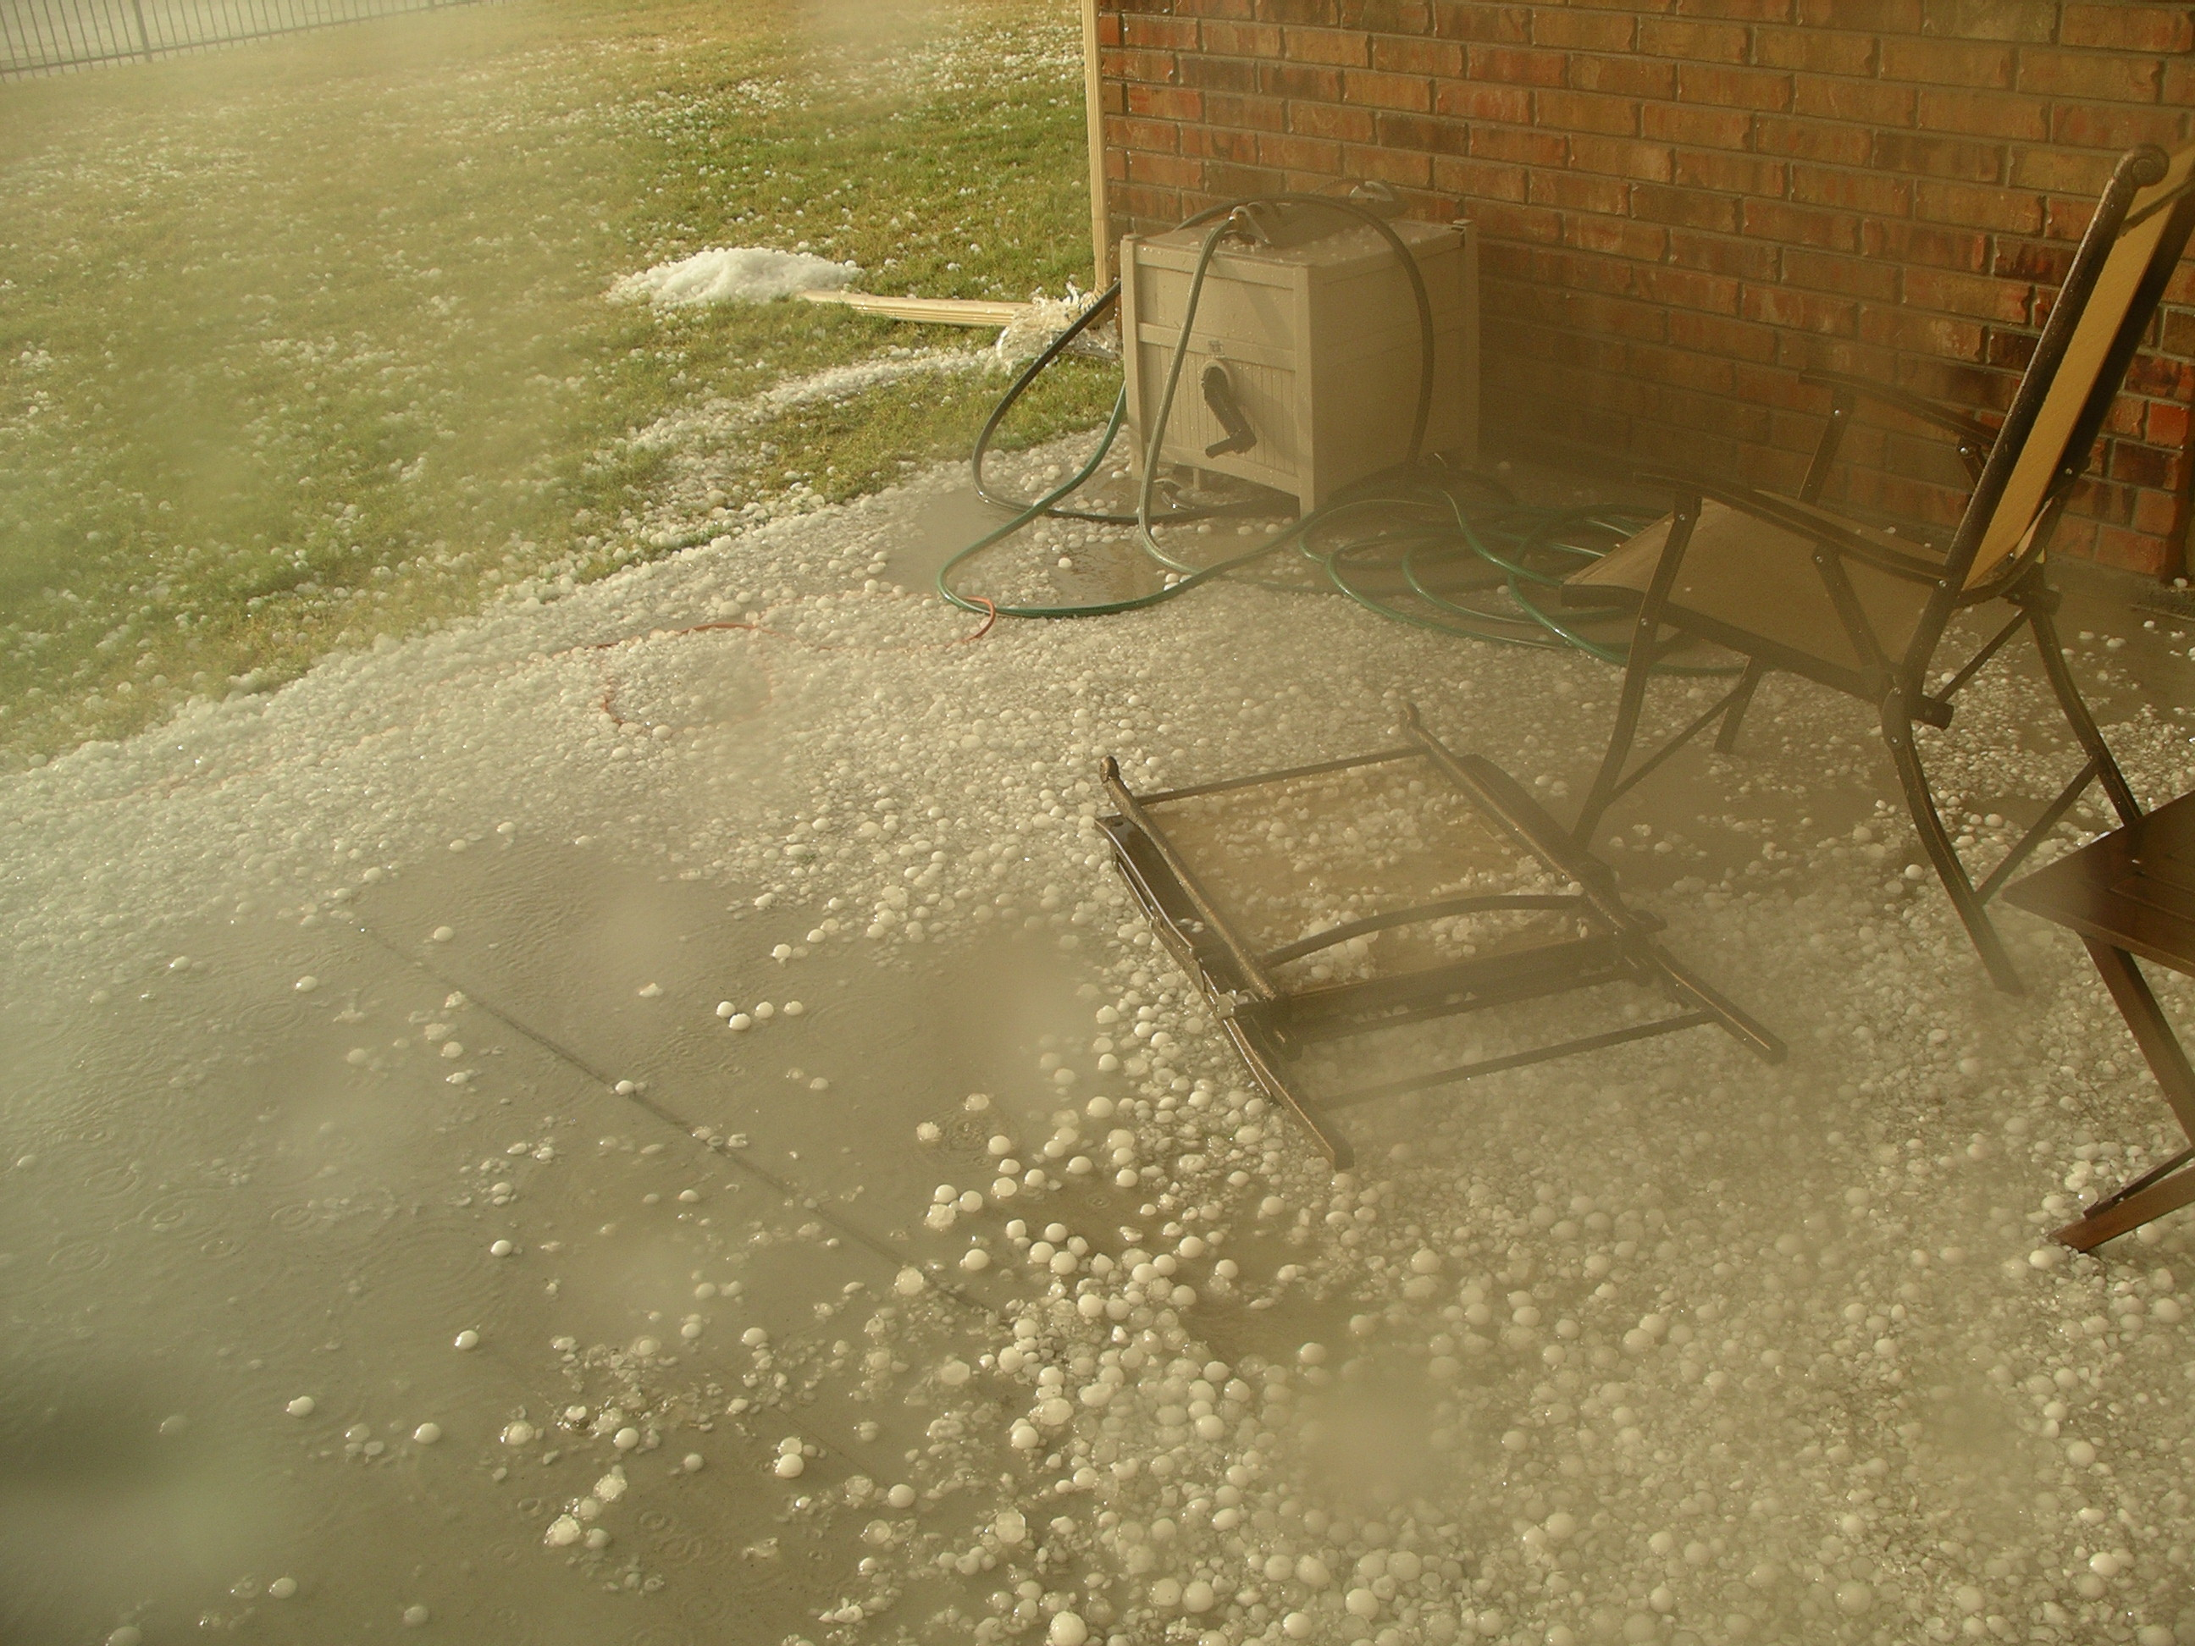
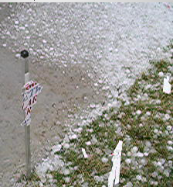
Impacts of Hail Storms
5 November 2008, Norman, OK
© Carl Wood
Notes:
EF0 65-85 mph wind speeds
EF5 > 200 mph wind speeds
Enterprise, KS, 14 fatalities, $256 million in damages

Slide 17
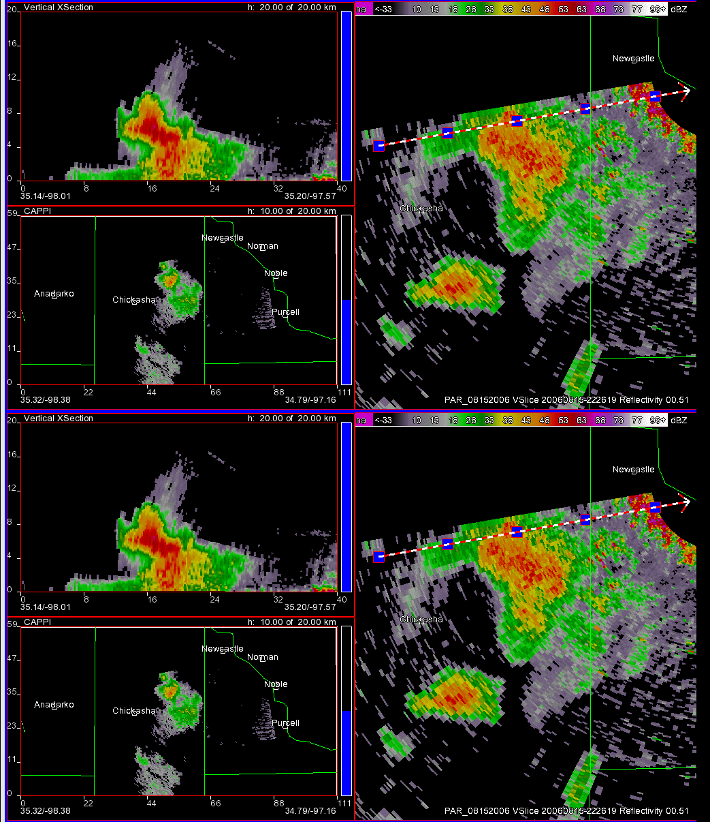
Hail Storm: 26 s Updates
15 August 2006
26-s updates
0.5° elevation
PAR reflectivity cross-section 31 elevation scans
10-km altitude
Approximated WSR-88D Reflectivity cross-section 31 elevation scans
5-min updates
0.5° elevation
10-km altitude

Slide 18
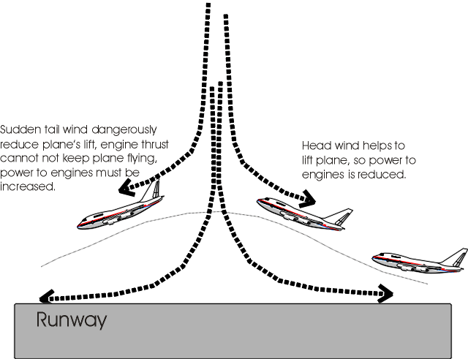
Impact of Microburst on Aircraft
Microburst Downdraft
Sudden tail wind reduces plane’s lift, engine thrust cannot keep plane flying.
Head wind helps to lift plane, reduces power to engines
Courtesy, University of Wisconsin
Notes:
1985 Delta Airlines crash killed 137 people near DFW airport.

Slide 19
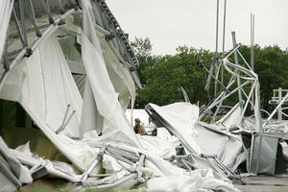
Impact of Microburst on Dallas Cowboys Practice Facility
3 May 2009
©Tony Guitierrez

Slide 20
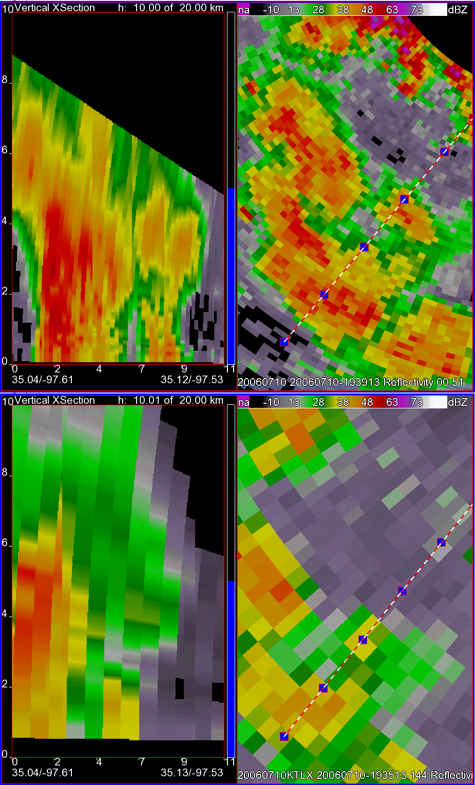
Microburst: 34 s Updates
10 July 2006
Reflectivity
Strategy yields fast update times by using beam multiplexing
  NWRT PAR
    90 deg sector
    34 s updates
  NEXRAD
    Conventional scan
    4.1 min updates
NWRT PAR
KTLX

Slide 21
Forecaster Evaluation
Reflectivity
“High temporal resolution of PAR allowed me to identify near-ground-level severe winds which were considerably under-played by KTLX (27 kt vs 57 kt).”
NWRT PAR
“You can diagnose better what’s going on so you can have more confidence in issuing or not issuing warnings.”
“Rapid updates will help get the warning out period. We have many missed pulse storm hail and wind warnings.”
KTLX

Slide 22
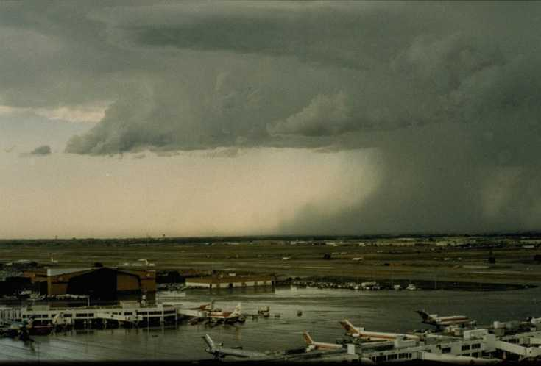
Wet Microburst Study
Four days from July and August 2007-2008
These days qualify as “microburst days” as defined by Atkins and Wakimoto (1991)
25 storms were analyzed, 10 were microbursts
  Reflectivity
  Divergence
©NCAR
Courtesy Steve Irwin and Travis Smith
Notes:
22

Slide 23
Lead time Comparison
N = 8
N = 6
Notes:
Statistics are from 10 storms. KTLX 6 of 10 had precursors; PAR 8 of 10 had precursors.
23

Slide 24
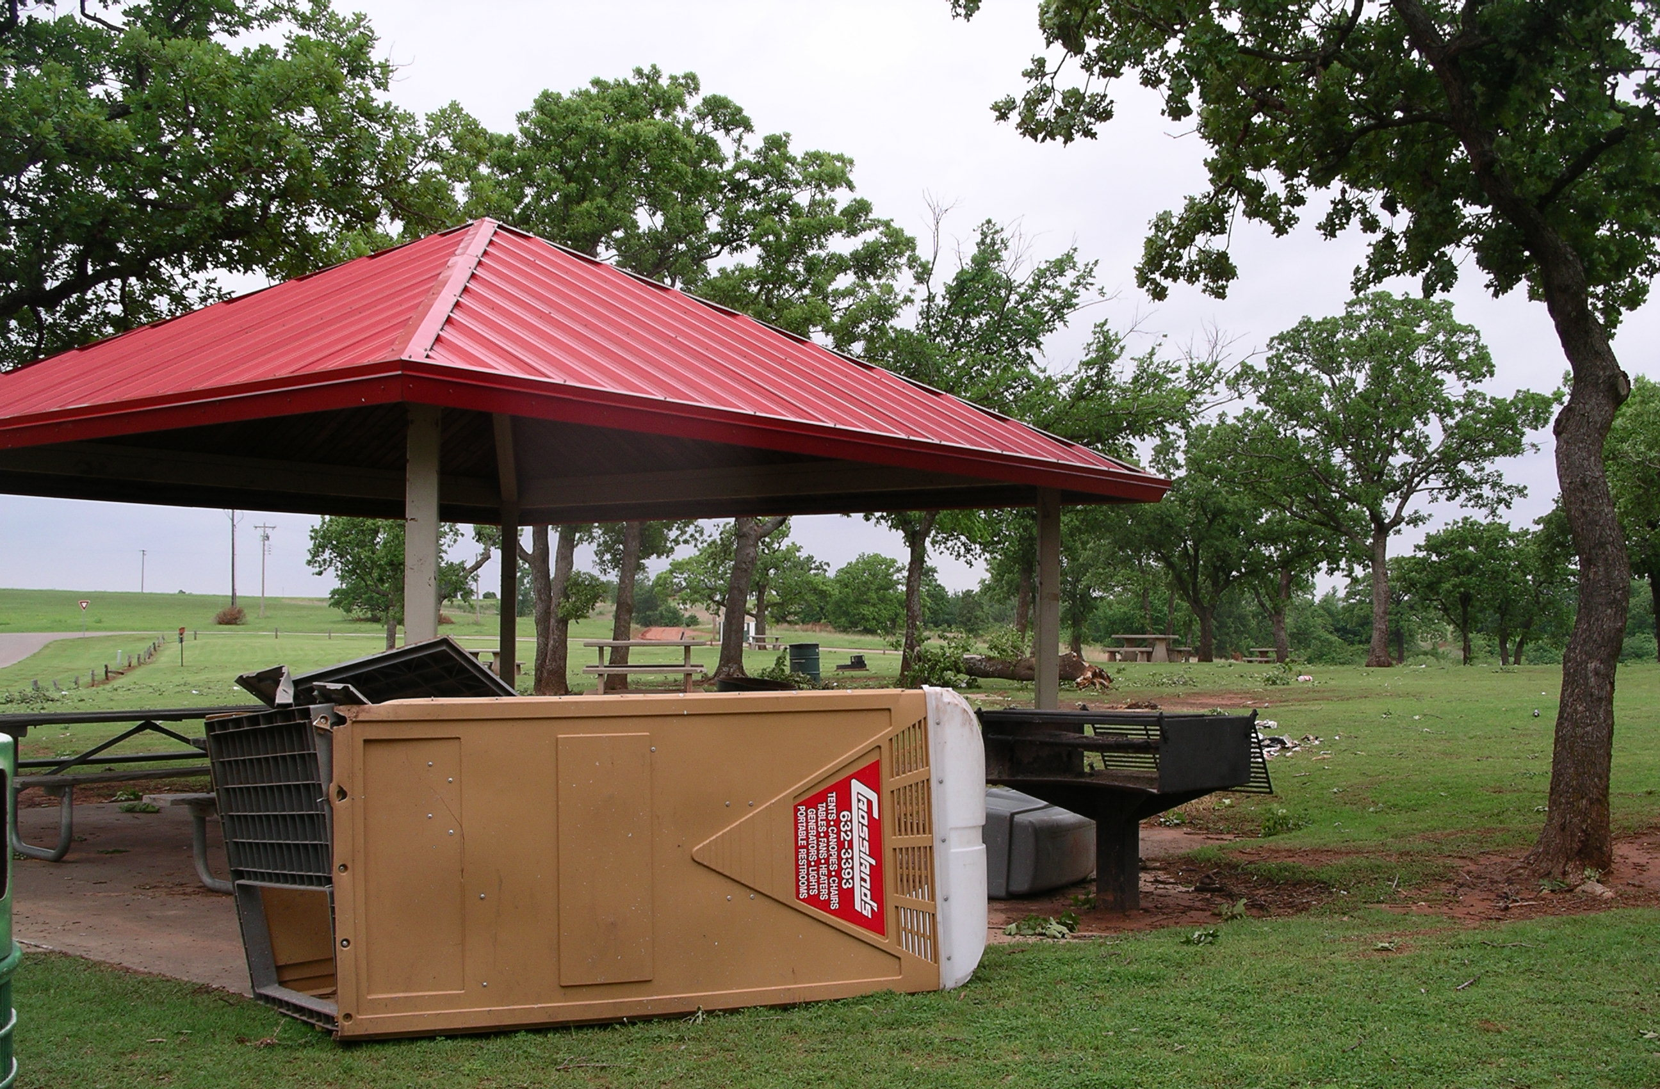
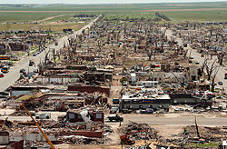
Impacts of Tornados
EF0 damage
13 May 2009, SE Oklahoma City
EF5 damage
5 May 2007, Enterprise, KS
© Heinselman
Source: Wikipedia
Notes:
EF0 65-85 mph wind speeds
EF5 > 200 mph wind speeds
Enterprise, KS, 14 fatalities, $256 million in damages

Slide 25
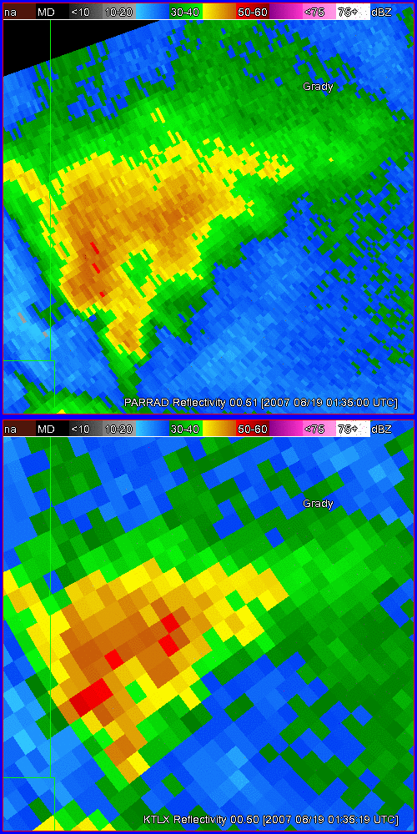
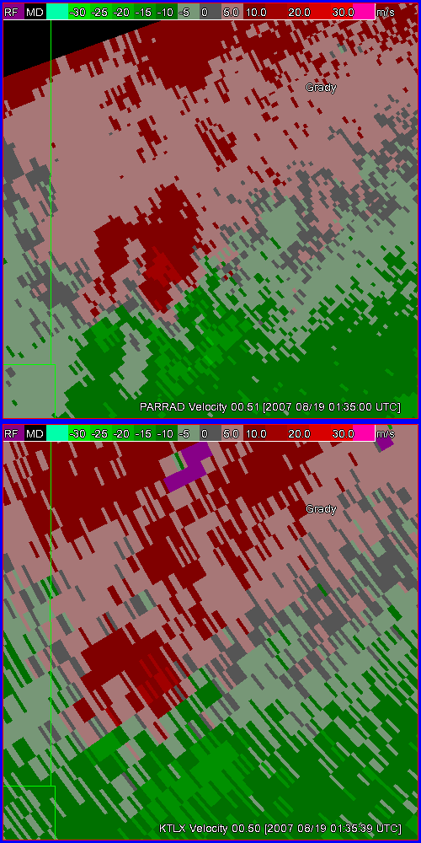
Tornadic Supercell: 43 s Updates
Strategy yields fast update times by concentrating on a sector and using beam multiplexing
  NWRT PAR
    60 deg sector
    43 s updates
  NEXRAD
    Conventional scan
    4.1 min updates
Reflectivity
Doppler Velocity
NWRT PAR
KTLX
19 Aug 2007

Slide 26
Forecaster Evaluation
Reflectivity
Doppler Velocity
“Superior to KTLX for identifying mini-supercell features.”
NWRT PAR
“Rapid updates at the 0.5° tilt were critical in this case; rotation and TVS features were very fast moving and very fast to evolve.”
“Allowed the tornado warning to be issued 3 – 4 min before the signature appeared on 88D, and with higher confidence.”
KTLX
19 Aug 2007
Notes:
26
Unfair comparison in terms of spatial resolution in reflectivity, but focus here is on temporal sampling and velocity signatures.

Slide 27
Key Findings
PAR Data Had Major Impact on Warning Decision Process
High-temporal resolution showed continuity of significant, transient features, making them easier to identify
Continuity of features led to greater confidence
Note: No questions asked about confidence
Warnings were issued earlier, increasing lead time over conventional radars
Sampson & LaDue

Slide 28
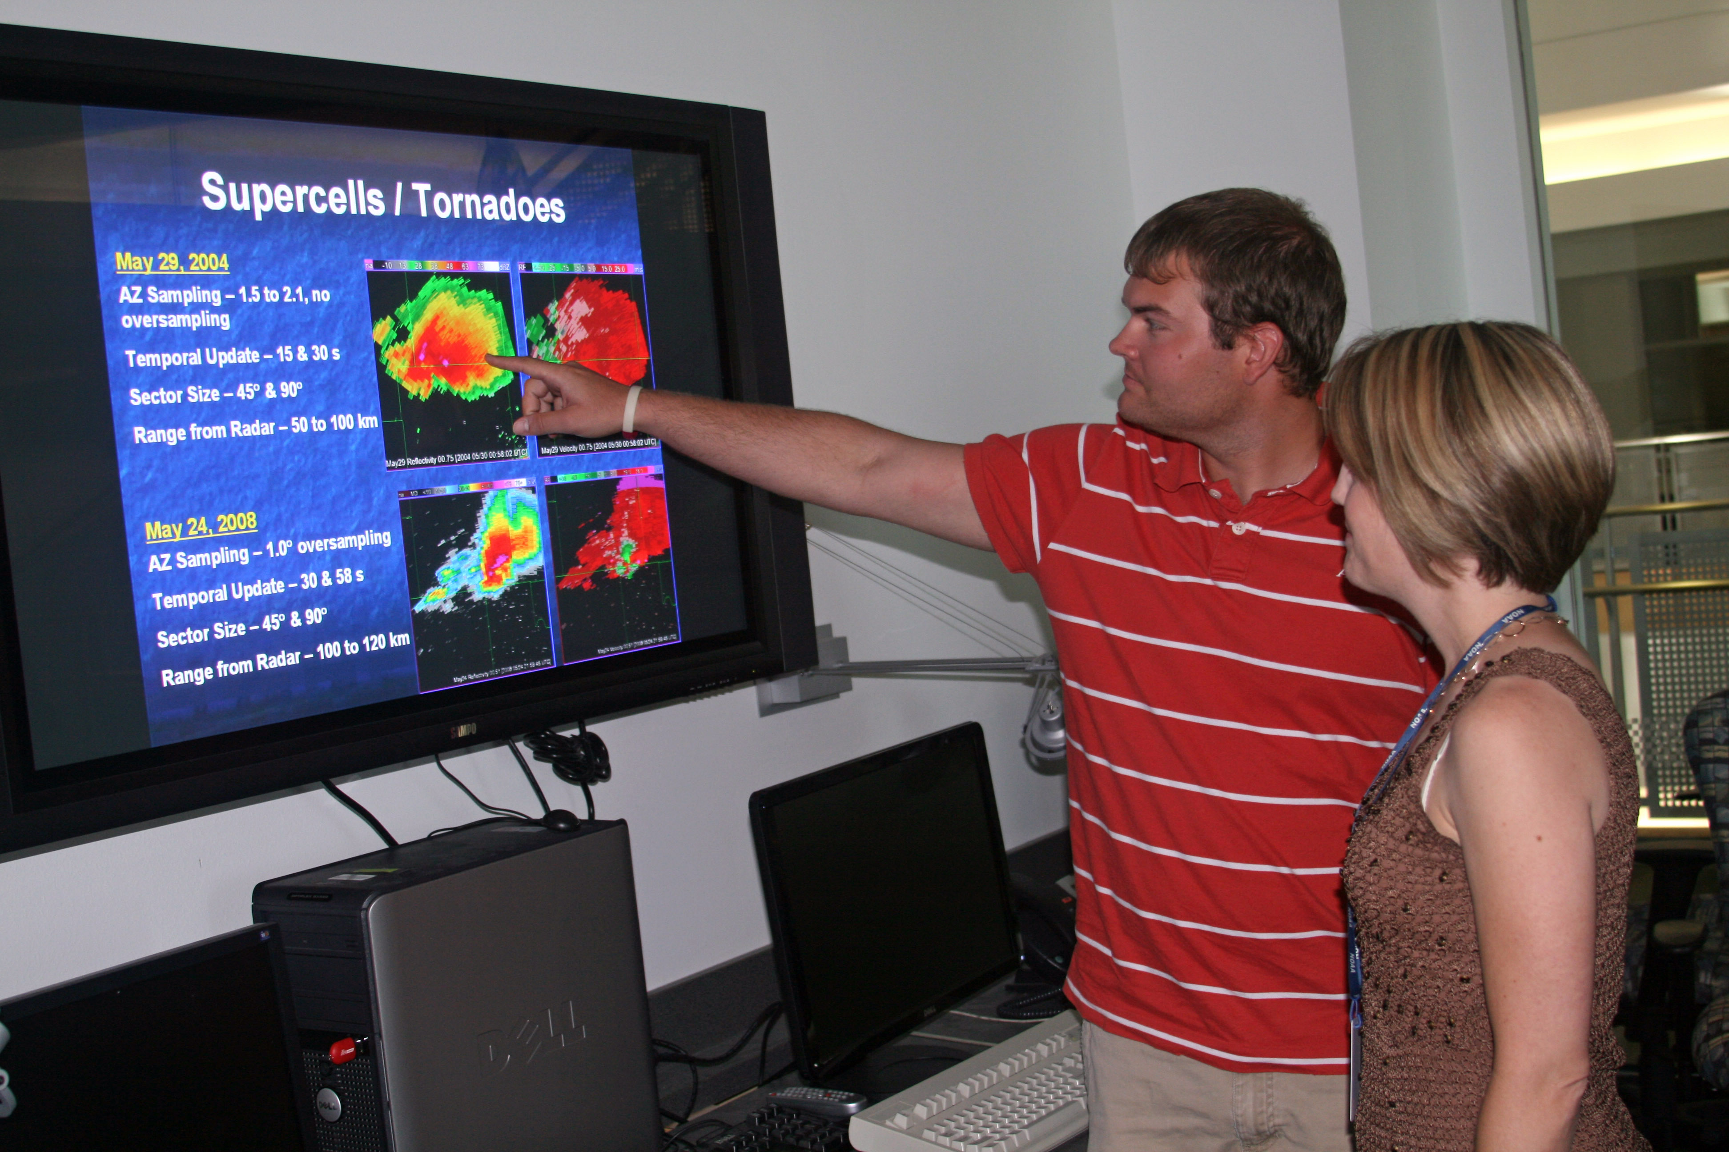
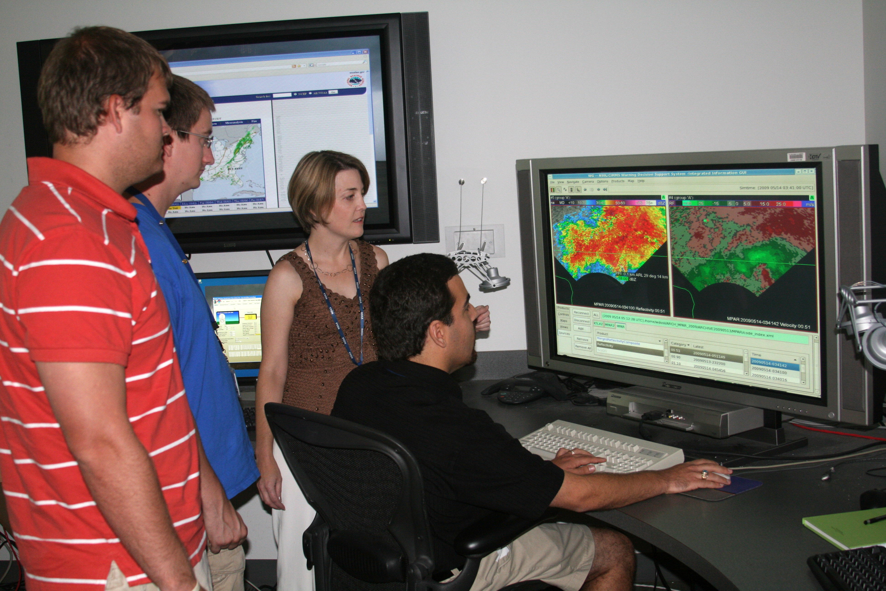
Current Storm-scale Research
Courtesy James Murnan
Courtesy James Murnan
Rick Hluchan, MS
Adam Smith, PhD
Jen Newman, MS
Evolution of a tornadic supercell and its environment sampled by the PAR and Oklahoma City Micronet
The impact of elevation scan spacing on observations of heat bursts sampled by the NWRT PAR
Impact of high-temporal resolution sampling on depiction and tracking of significant circulations

