Slide 1
Bird Rings

Slide 2
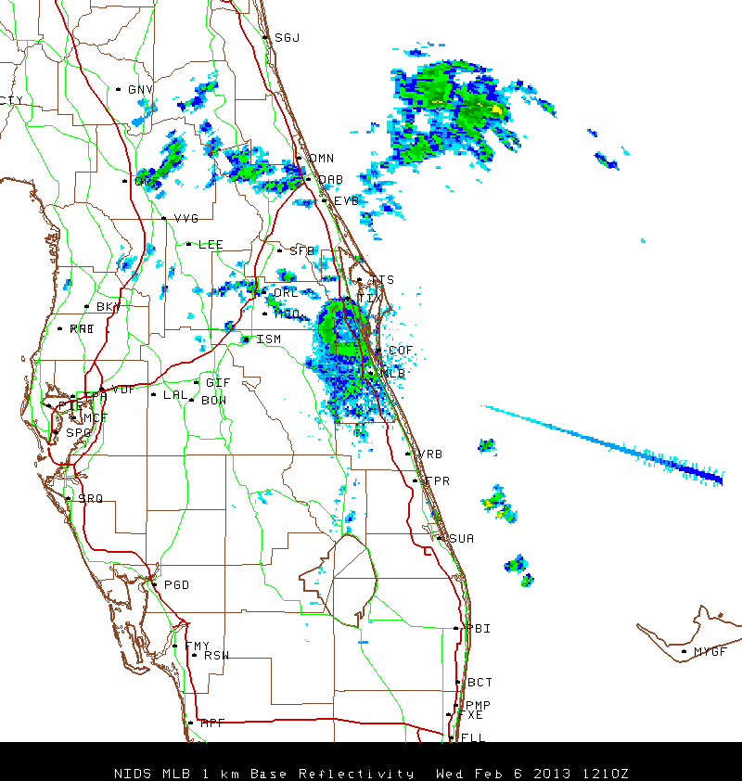
Radar at Sunrise Feb. 6, 2013 12:10Z

Slide 3
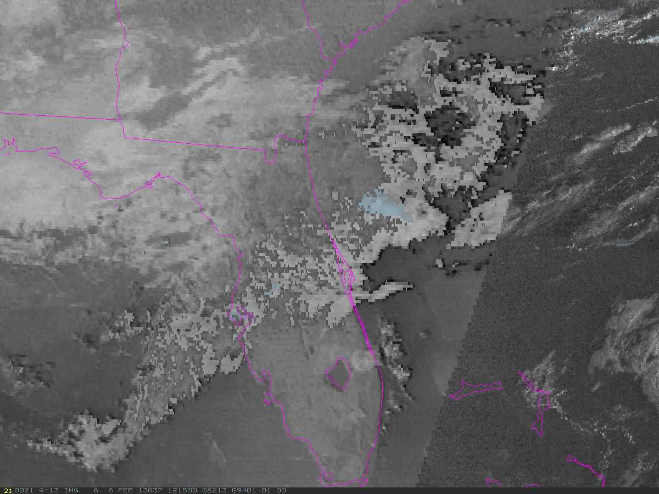
Satellite Feb. 6, 12:15Z

Slide 4
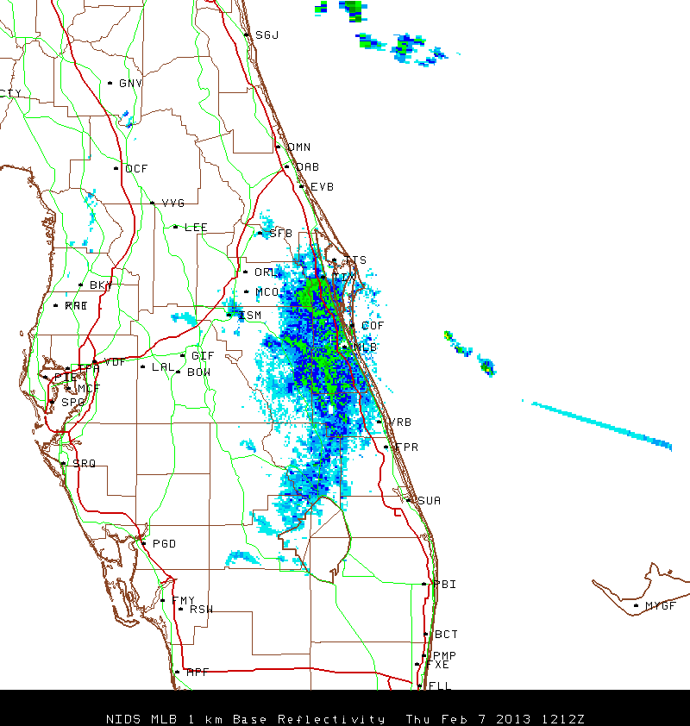
Radar Feb. 7, 2013 12:12Z

Slide 5
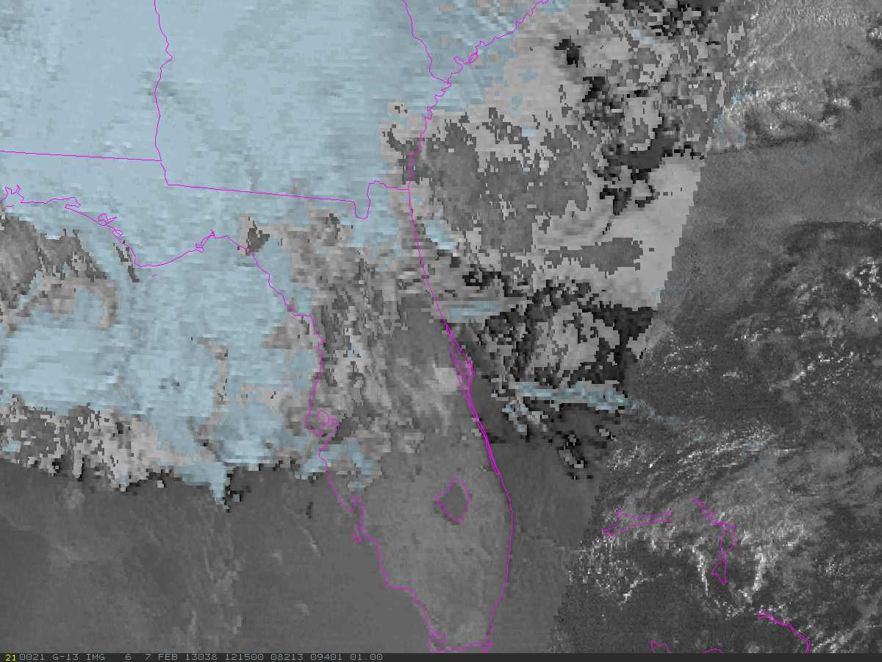
Satellite Feb. 7 12:15Z

Slide 6
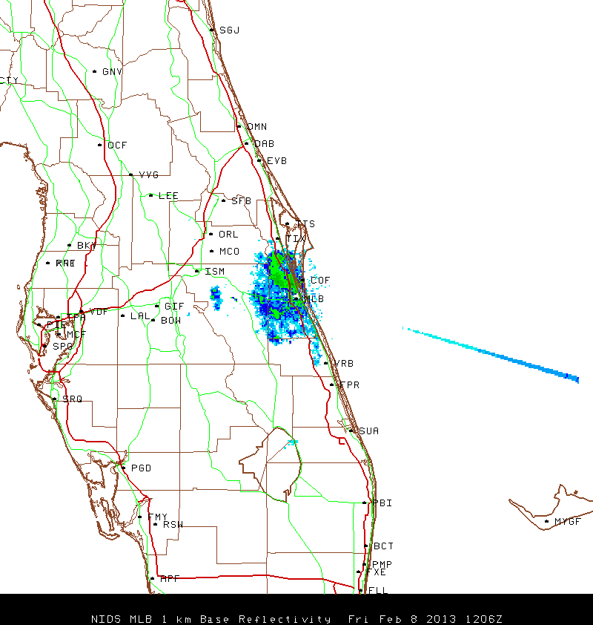
Feb. 8, 12:06Z

Slide 7
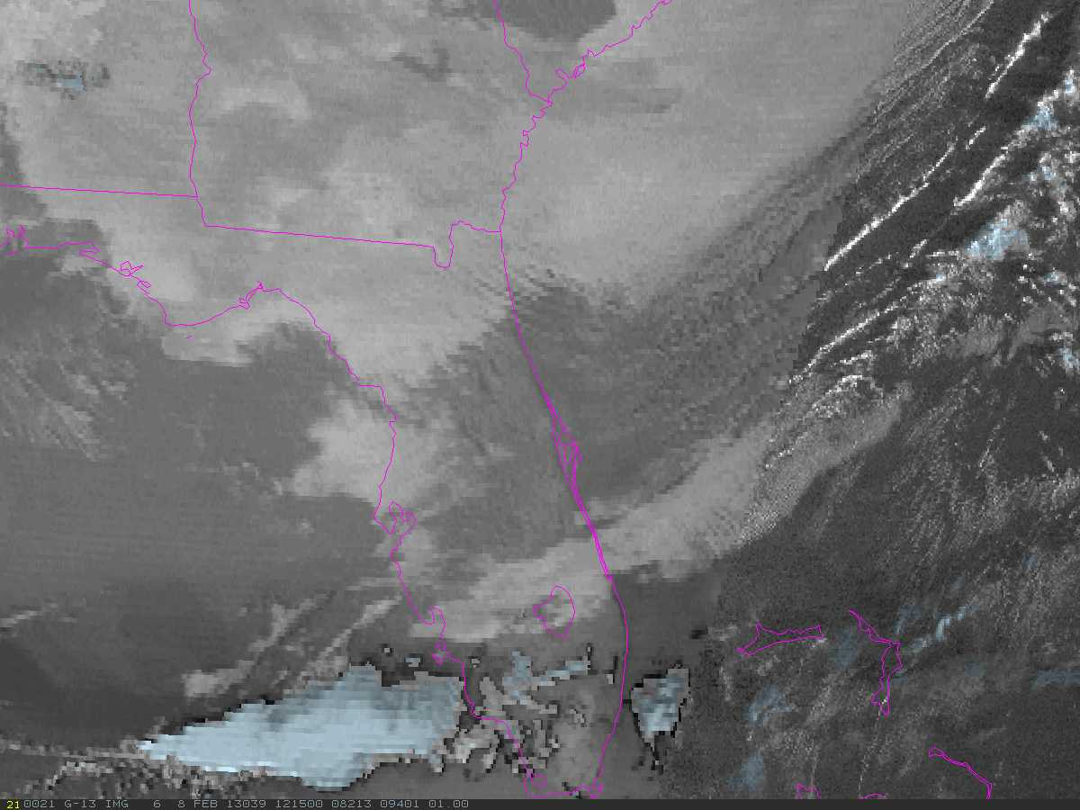
Feb 8 12:15Z

Slide 8
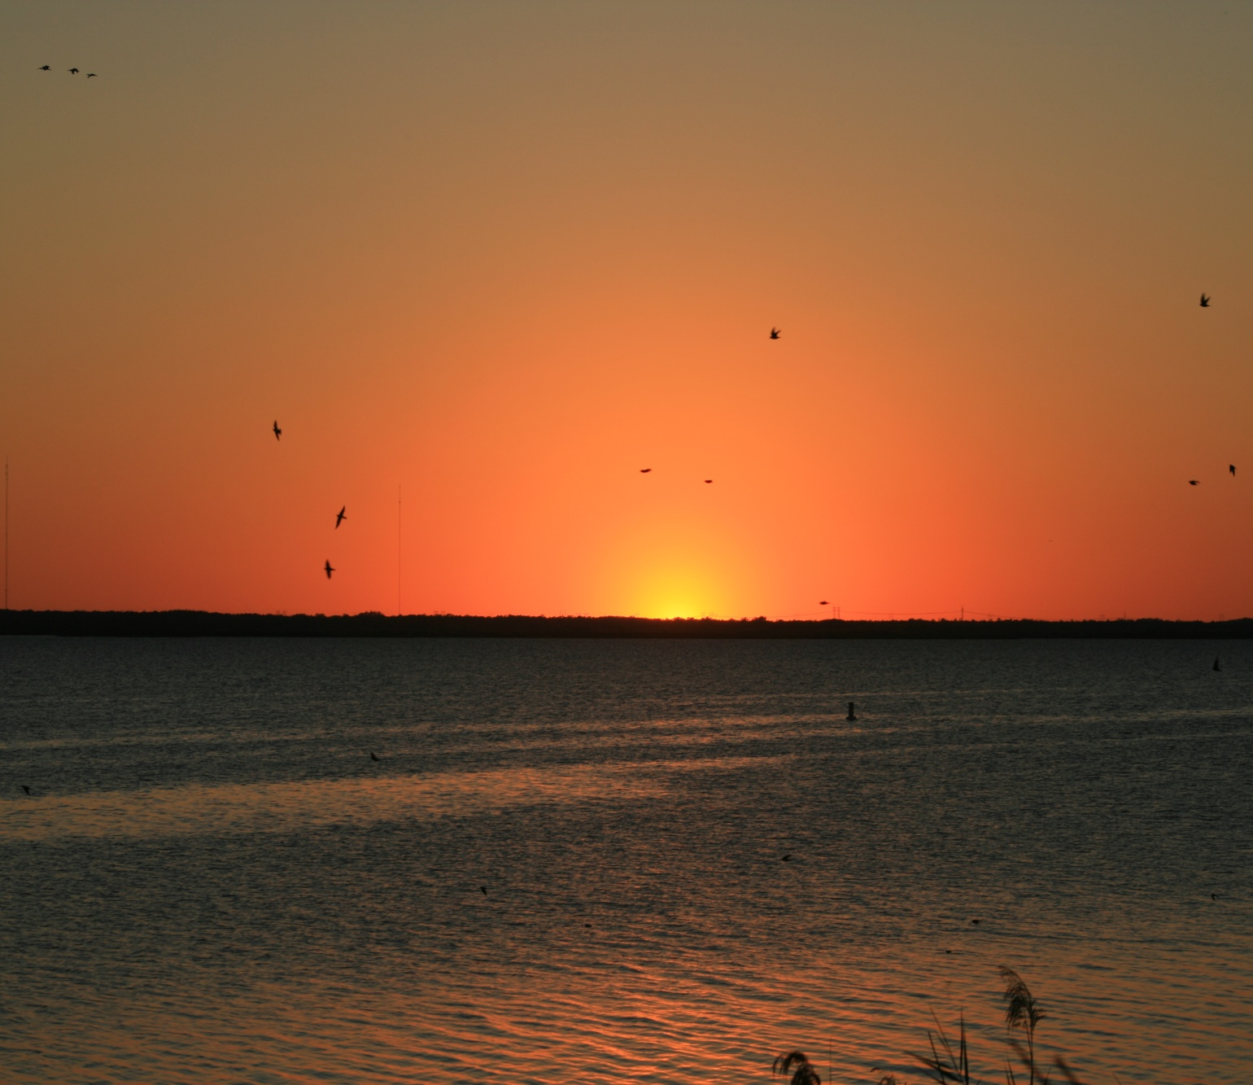
Evening of Feb 8 at Center of Ring

Slide 9
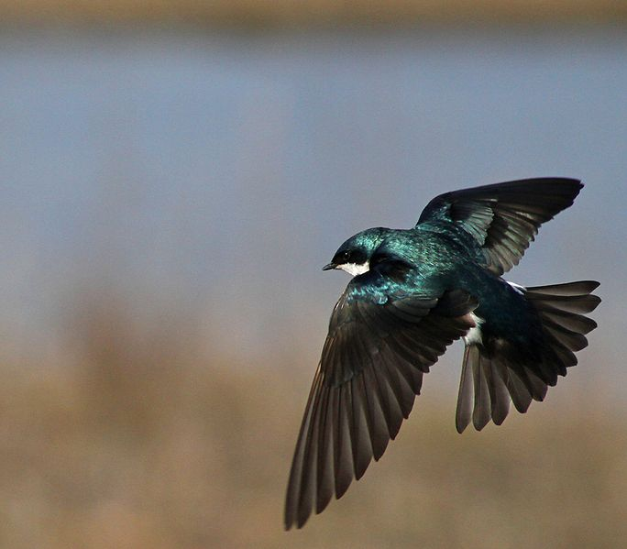
Thousands of Tree Swallows

