Slide 1
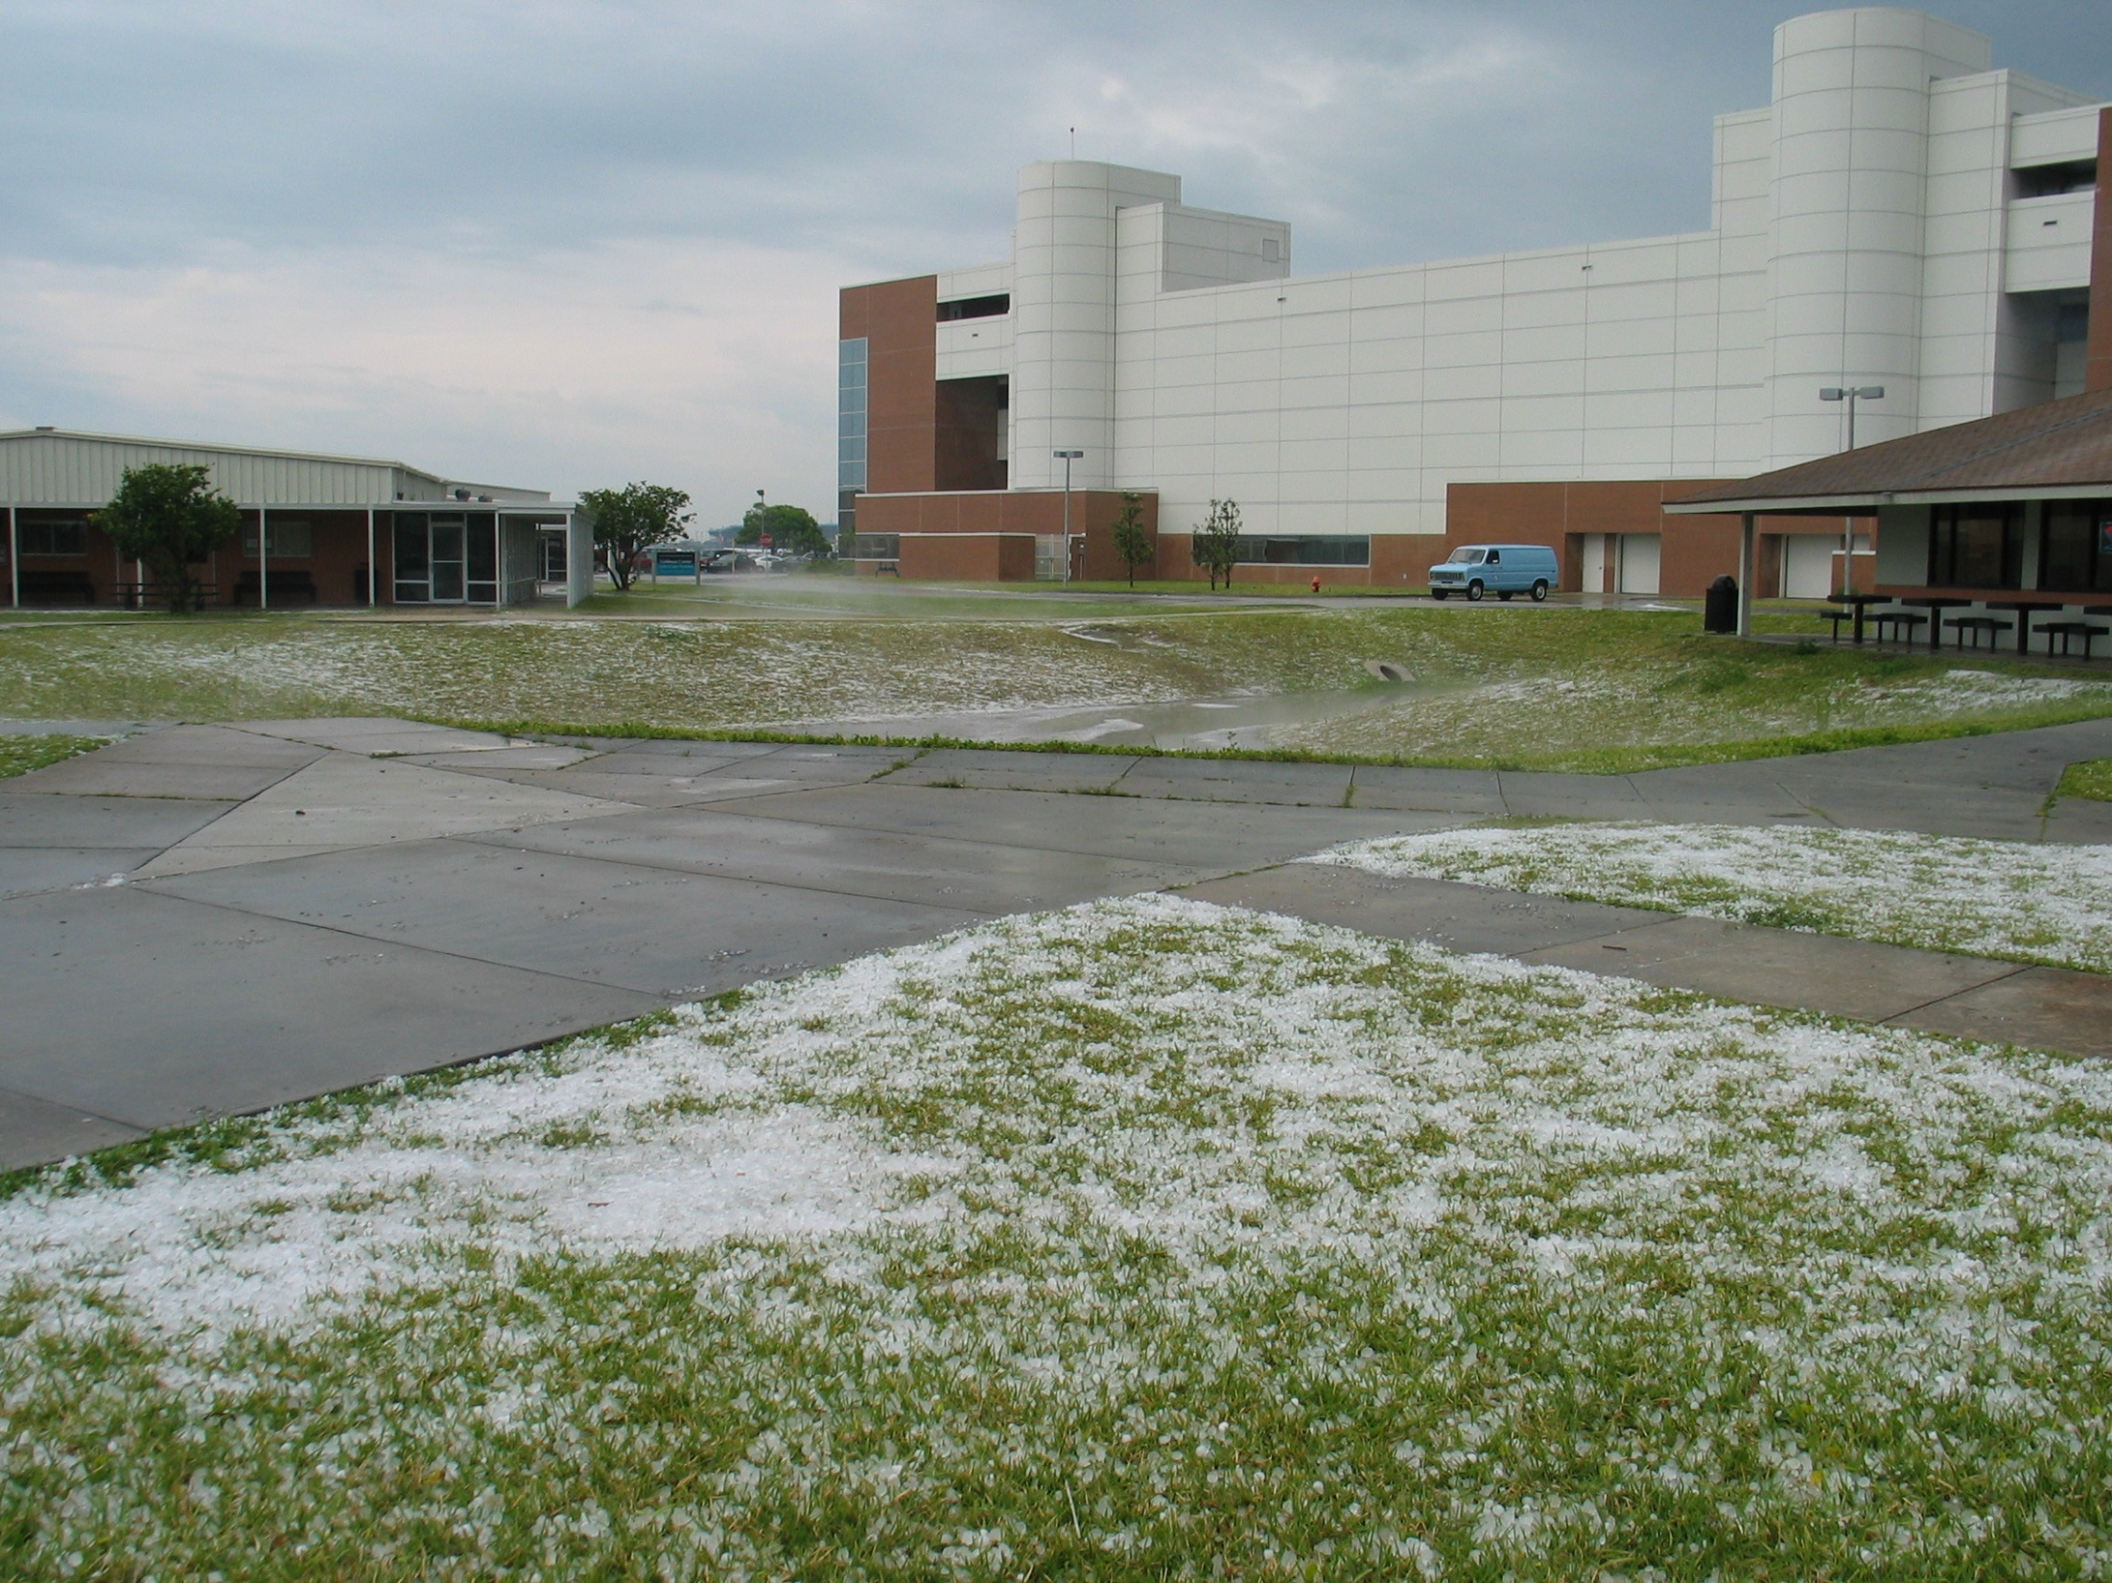
The May 4 2005 Hailstorm

Slide 10
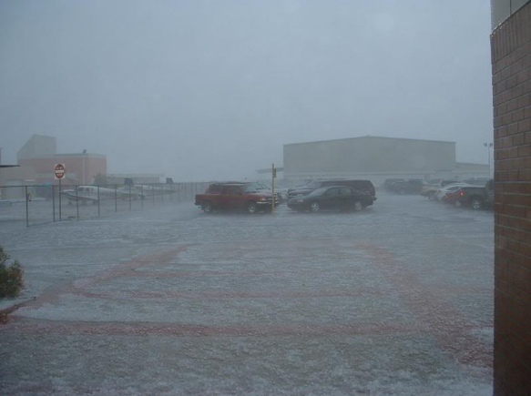

Slide 15
Holy #%*@! Let’s see…I know I’ve got Allstate’s number here somewhere…

Slide 16
A Meteorologist’s
Badge of Honor

Slide 17
Holy #%*@! Let’s see…I know I’ve got Allstate’s number here somewhere…

Slide 18
5/4/2005 | 1.75 | DAYTONA BEACH | VOLUSIA | FL | GOLF BALL HAIL AT MASON AND US1. (MLB)
5/4/2005 | 1.50 | DAYTONA BEACH | VOLUSIA | FL | AT LEAST 50 PLANES AND HUNDREDS OF CARS DAMAGED ON CAMPUS OF EMBRY-RIDDLE AERONAUTICAL UNIVERSITY IN THE PERIOD OF ABOUT 1 MINUTE.SIZE RANGED FROM MARBLE TO PING-PONG B (MLB)
5/4/2005 | 1.00 | DAYTONA BEACH | VOLUSIA | FL | QUARTER-SIZE HAIL NORTH SIDE OF DAYTONA BEACH. (MLB)

Slide 21
Then, a strange pall settled across the runway…

Slide 24
But wait…what’s that on the runway?

Slide 25
An airplane emerges from the fog…

Slide 27
Holy #%*@! Let’s see…I know I’ve got Allstate’s number here somewhere…

Slide 28
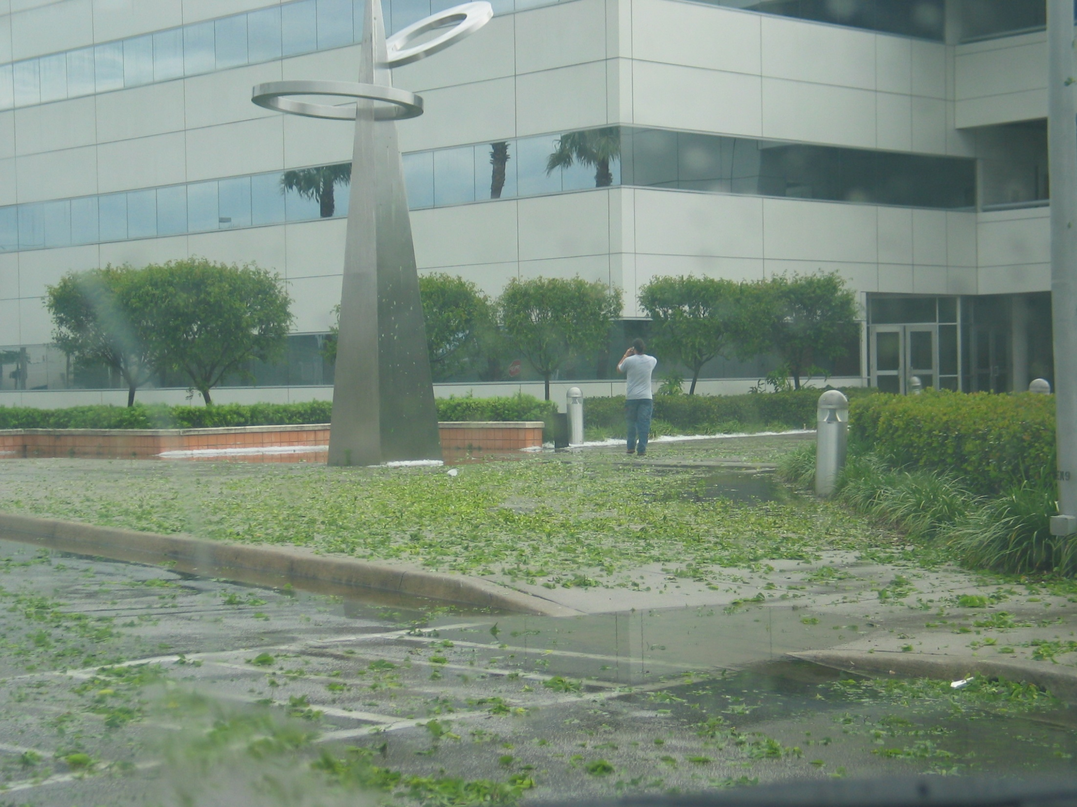
Thanks to the following for providing pictures:
Rob Haley
Randy Barry
Randy Griffith

