Slide 1
Wind Turbines in Nexrad imagery
tall towers + beam superrefraction ➔ wind turbine “clutter”

Slide 2
Weather Radar issues from wind turbine clutter
Can obscure/be confused with precipitation echoes in real-time interpretation.
Contaminate quantitative precipitation accumulation products unless filtered out.
Can cause bias in Doppler wind velocity estimates due to moving blades.

Slide 3
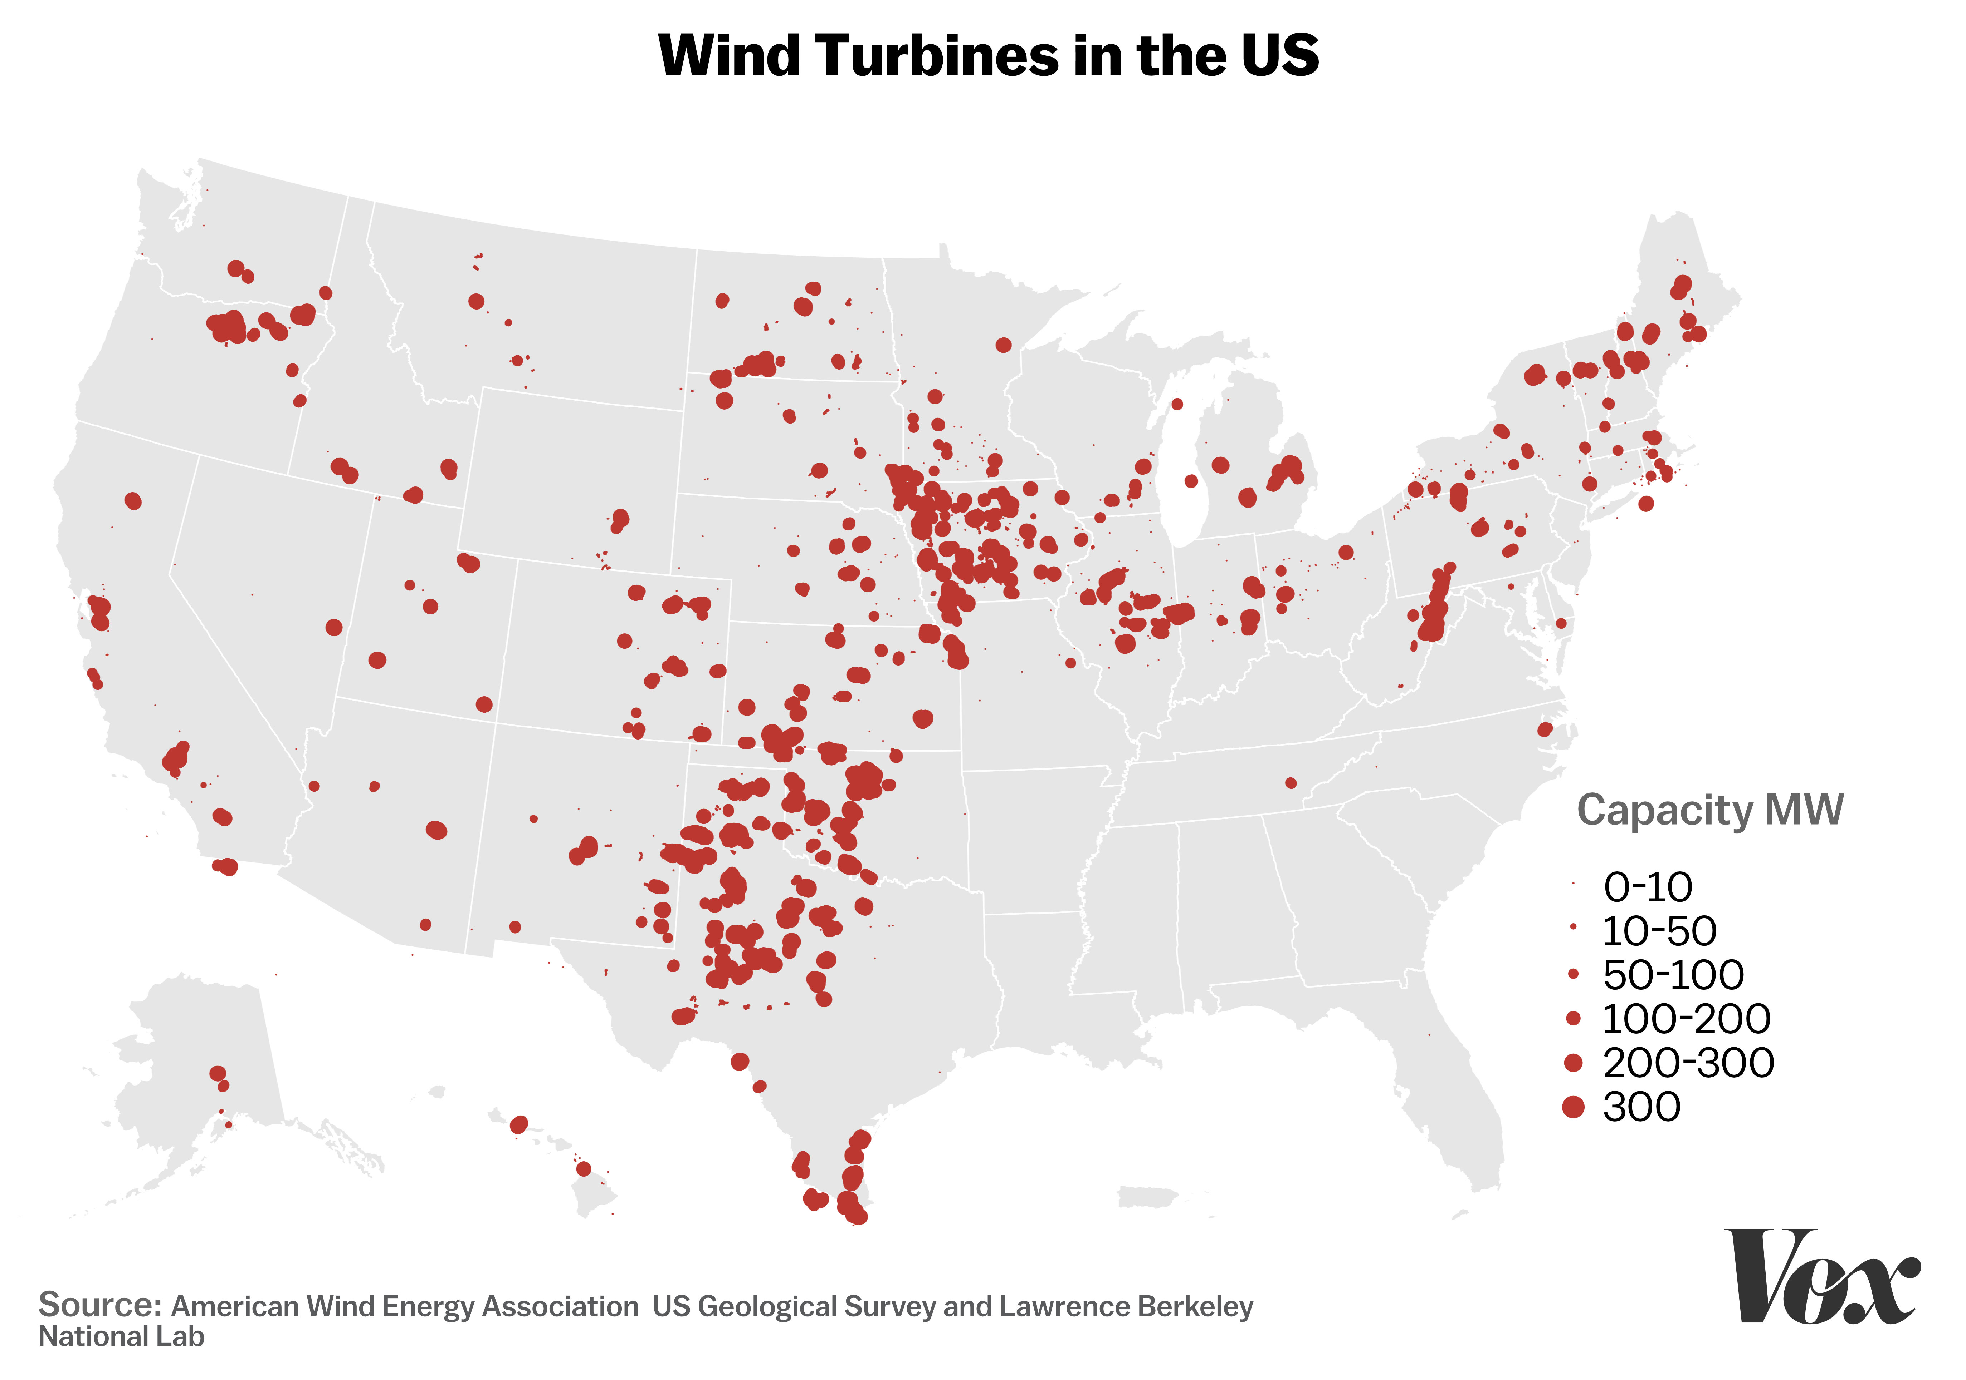
Wind Generating capacity Has proliferated in the U.S. in recent decades – Wind generating Capacity as of 2017:

Slide 4
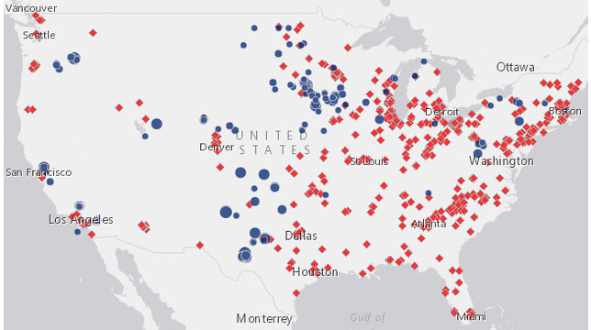
Recent decades have seen unprecedented development of wind “farms” in the U.S. (Blue circles below)

Slide 5
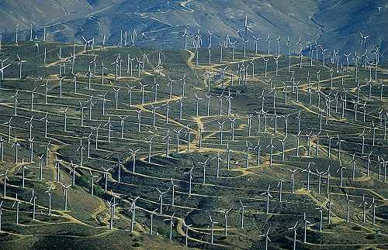
Wind Farms are groups of wind turbine towers designed to generate substantial amounts of electricity

Slide 6
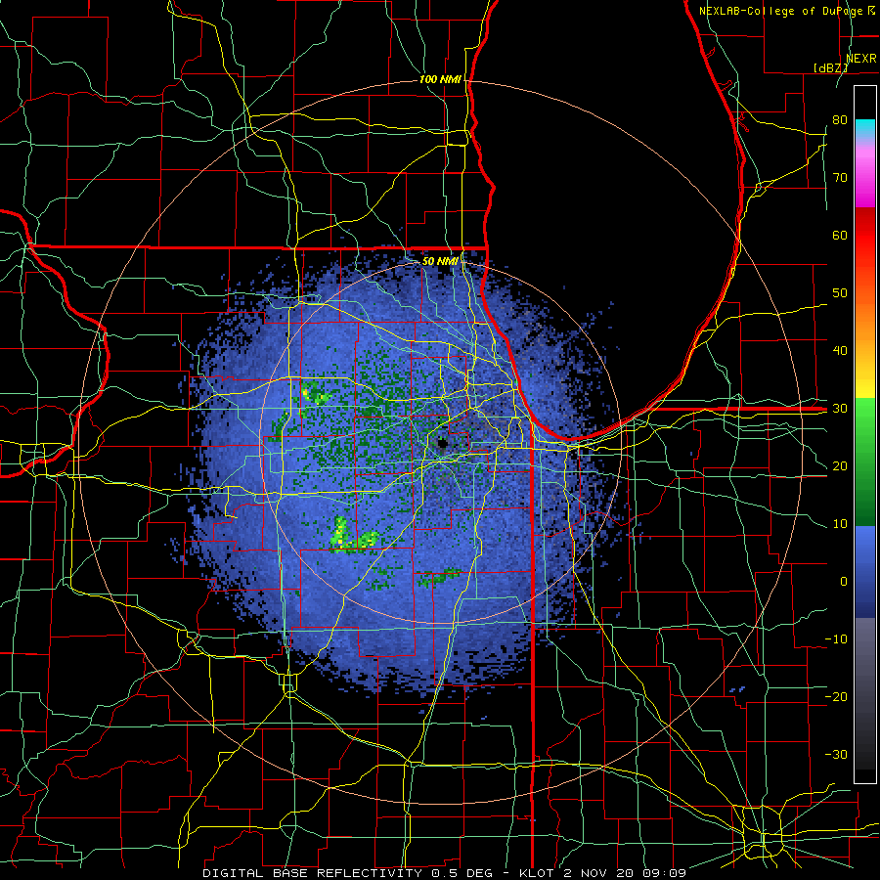
Wind turbines are tall; when they stick up into the nexrad beam they have radar reflectivity and produce echoes: KLOT (Chicago, il)

Slide 7
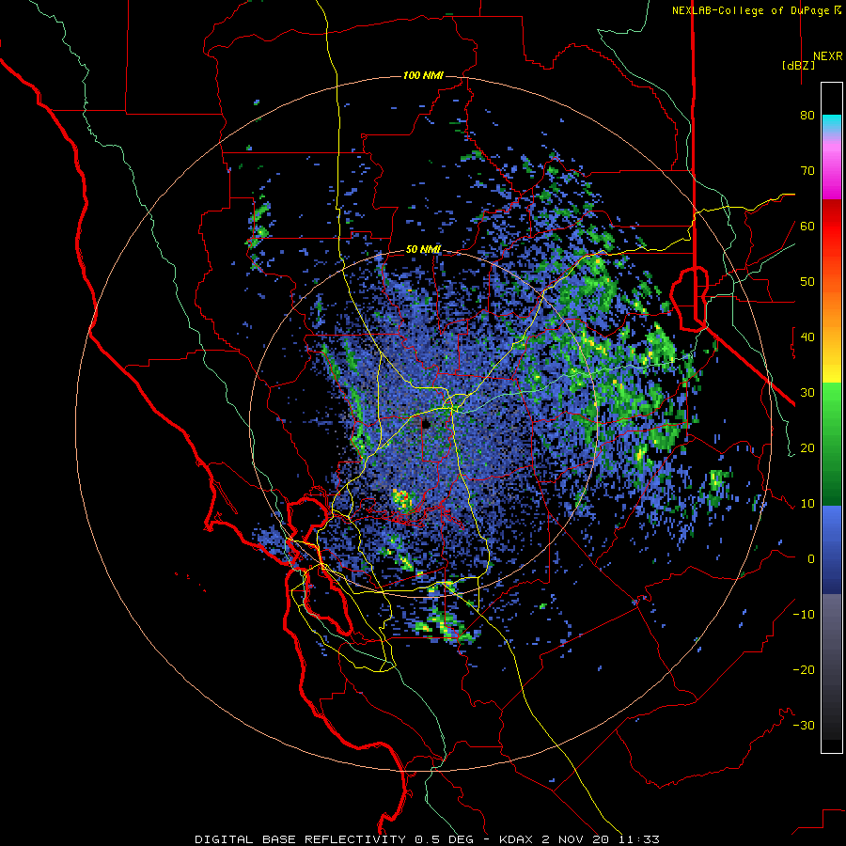
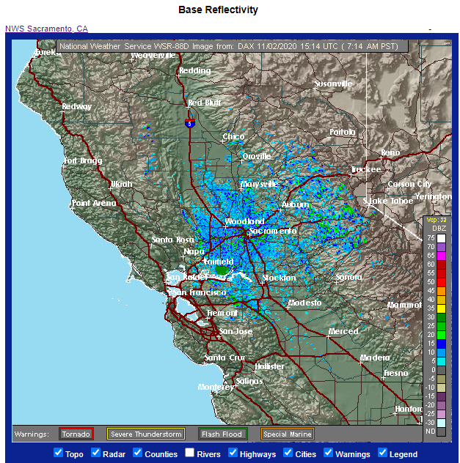
Wind turbines produce persistent stationary echoes of high reflectivity:
Above: Wind farm echoes near Fairfield, CA. Right: NWS view showing terrain.

Slide 8
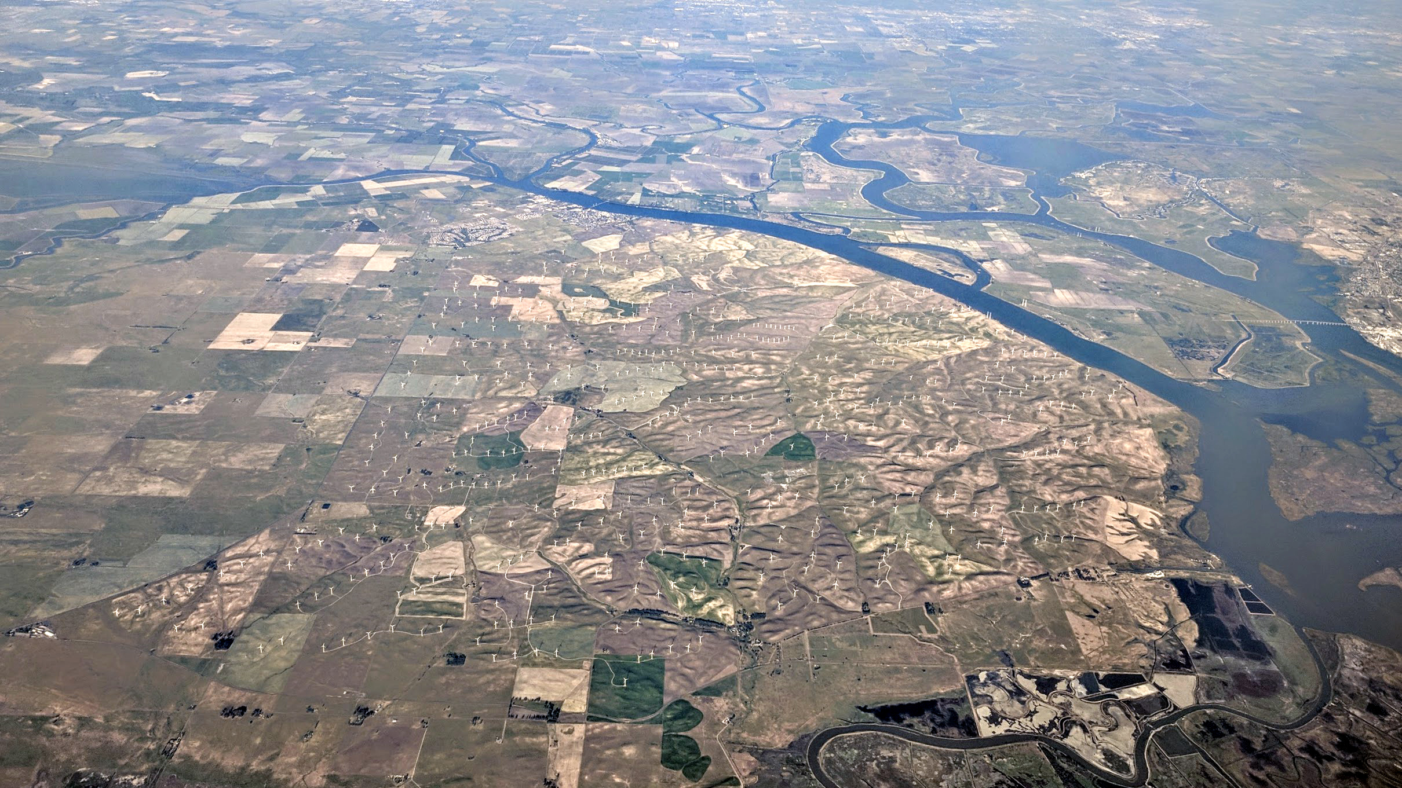
Shiloh Wind farm in the Montezuma hills, near Fairfield, California
By Dicklyon - Own work, CC BY-SA 4.0, https://commons.wikimedia.org/w/index.php?curid=69167676

Slide 9
Note: Wind turbine clutter more common early in the morning when there are radiation temperature inversions
Recall that when superrefraction is occurring the beam is bent down closer to the ground than in Standard Refraction.
Superrefraction occurs when
  There is a temperature inversion.
    Radiation inversions
    Subsidence inversions
  Moisture decreases with height.
    Subsidence inversion
See next slide from NWS Milwaukee.

Slide 10
Atmospheric Refraction
The radar assumes the beam is undergoing standard refraction. The beam height will be misrepresented under super/sub-refractive conditions.
Subrefraction
Standard Refraction
Superrefraction
Max cores may be displayed
at wrong heights
Superrefraction: The beam refracts more than standard. The beam height is lower than
the radar indicates.
Subrefraction: The beam refracts less than standard. The beam height is higher than the radar indicates. Beam can overshoot developing storms.

Slide 11
Google earth can be used to confirm the suspected location of wind turbine “clutter”
See HW 8 in Module 11.

Slide 12
The end

