Slide 1
Accessing and Using AWIPS II for windows (a work in progress!)
NWS Meteorological display software

Slide 2
AWIPS II from unidata
Unidata is a community organization of the University Corporation for Atmospheric research (of which ERAU is a member).
Unidata by their own description “is a diverse community of education and research institutions with the common goal of sharing geoscience data and the tools to access and visualize that data.”
Unidata has provided a Windows version of AWIPS II, the Advanced Weather Interactive Processing System II.
AWIPS was used by the National Weather Service to display data, look at numerical weather prediction models, and help them make their forecasts.
AWIPS II is an updated version of that NWS software.
ERAU has obtained and is providing access to this software.

Slide 3
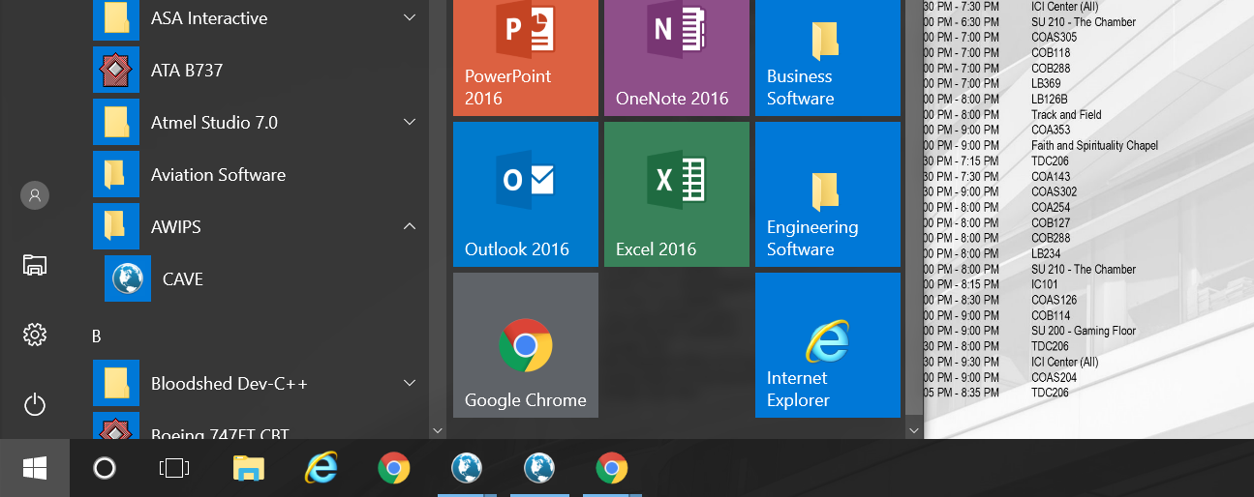
Access AWIPS in windows—Select “CAVE”

Slide 4
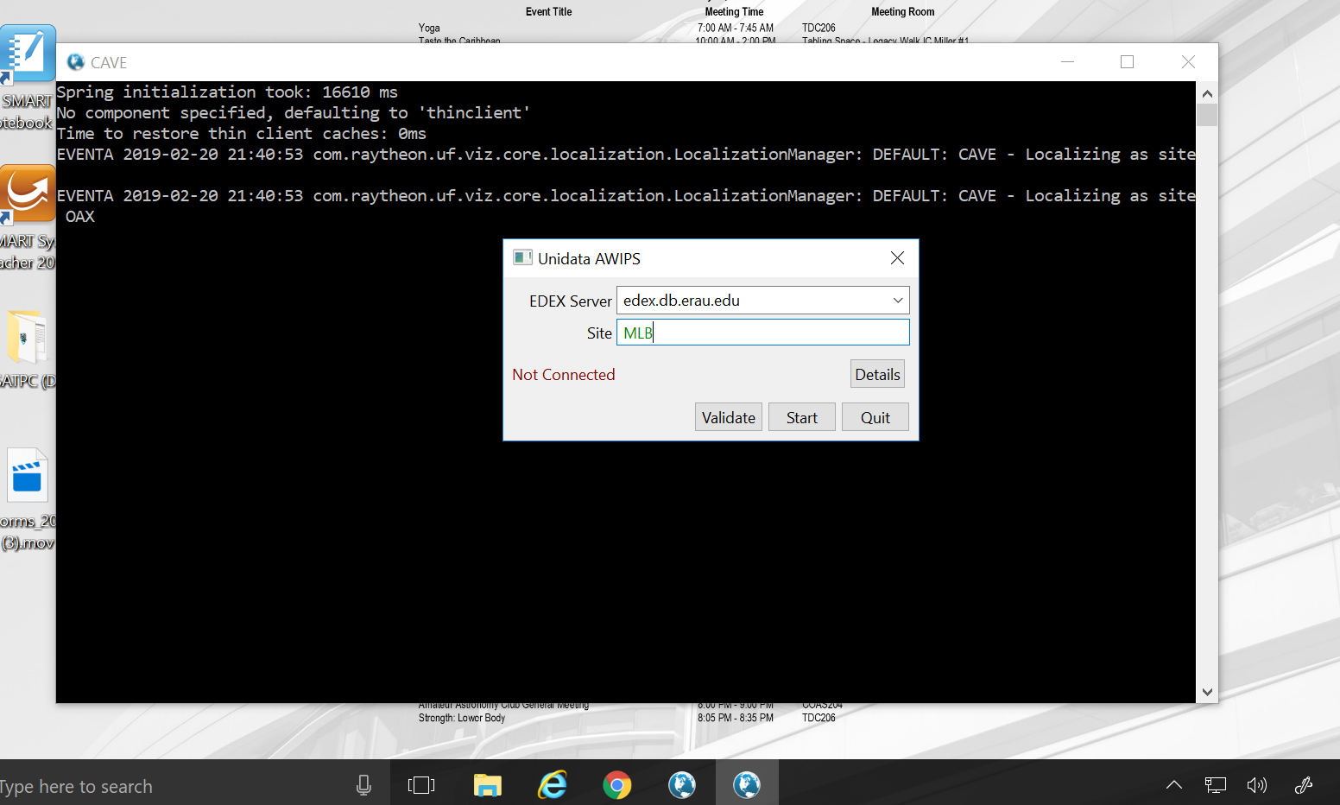
For first-time use, Insert the web-location of our ERAU Edex server, and localize to the NWS office of your choosing—closest to us is mlb.

Slide 5
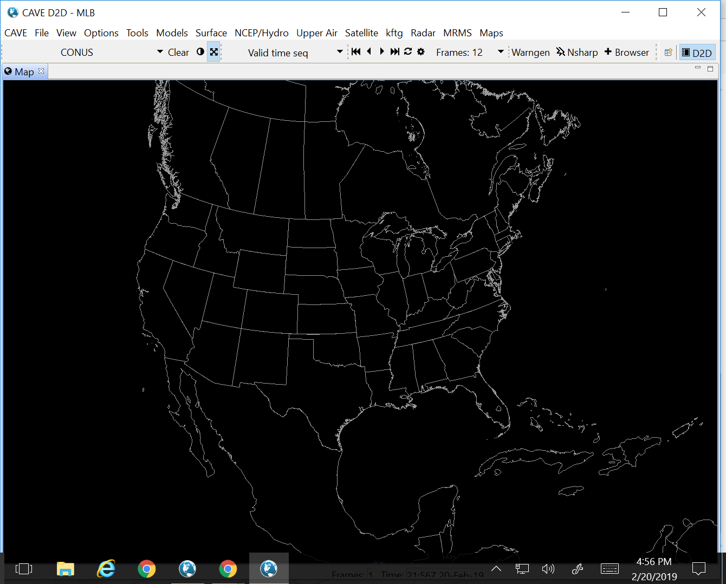
Access data by clicking on dropdown menus at the top of the “cave” window:

Slide 6
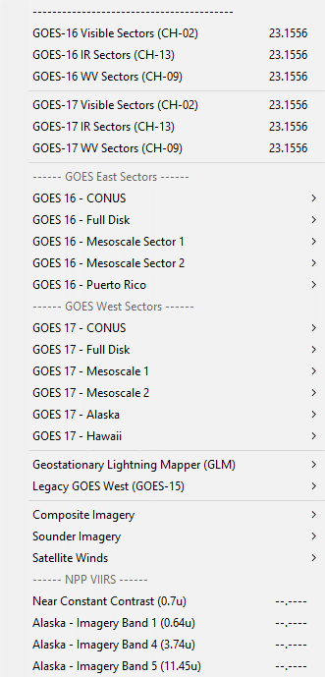
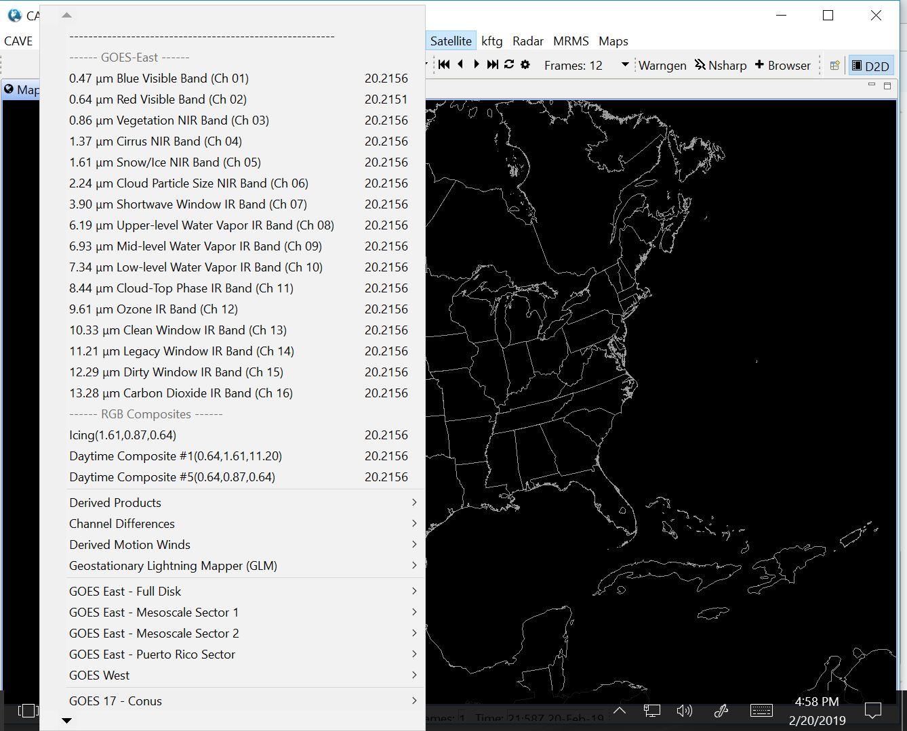
Click on the “Satellite” Menu, then select a satellite/sector and a channel:

Slide 7
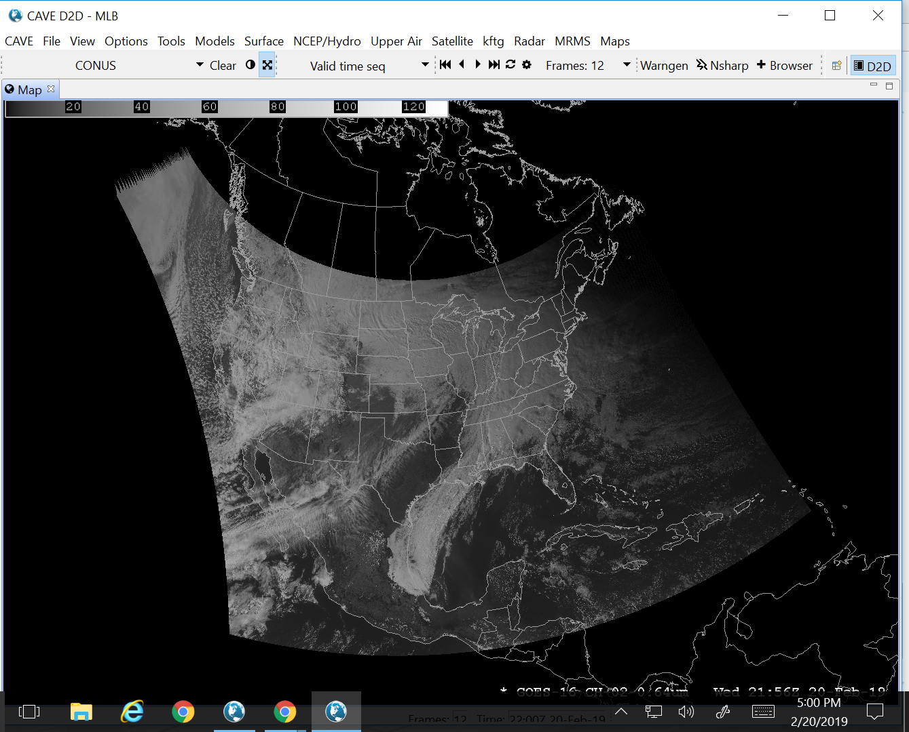
This image is from selecting the GOES-16 Conus sector, Channel 2 red visible channel—automatically loads 12 frames.

Slide 8
The animation can be toggled on and off using the button below; other animation controls are to the left:

Slide 9
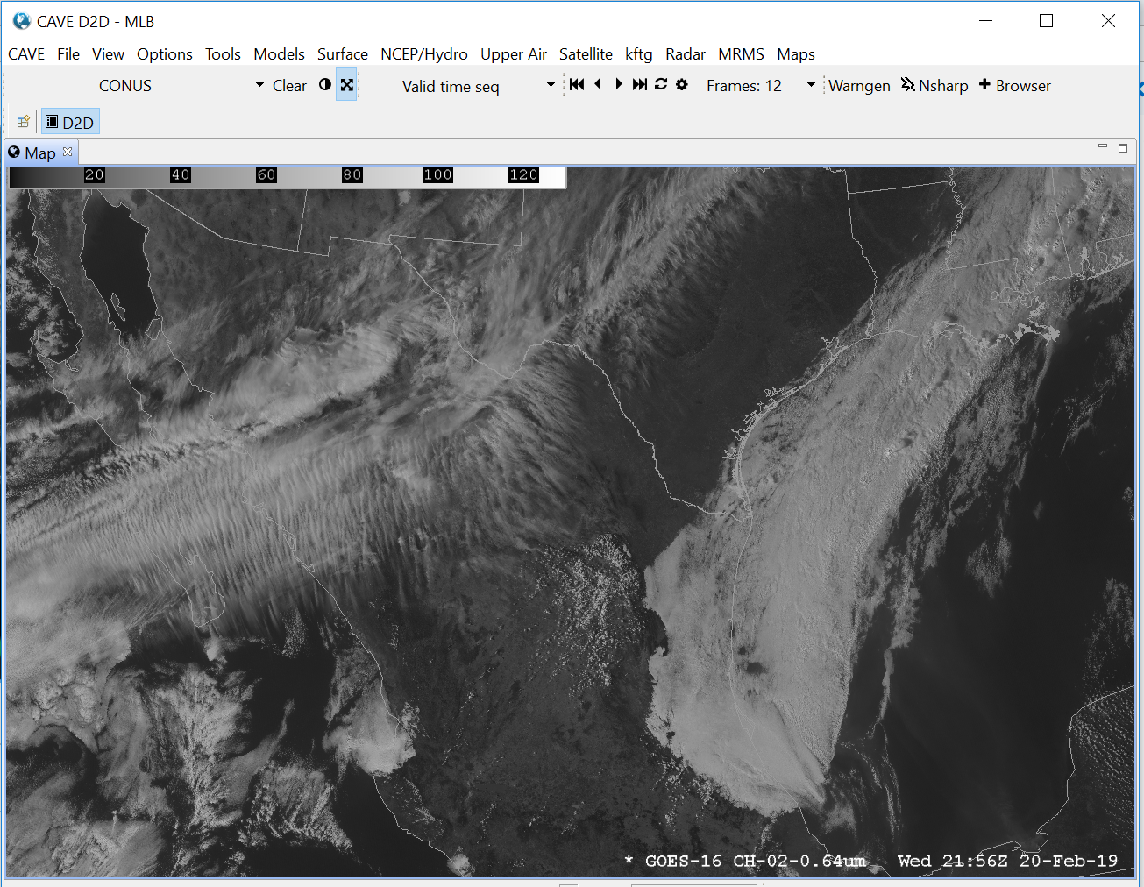
Use the scroll wheel on your mouse to zoom:

Slide 10
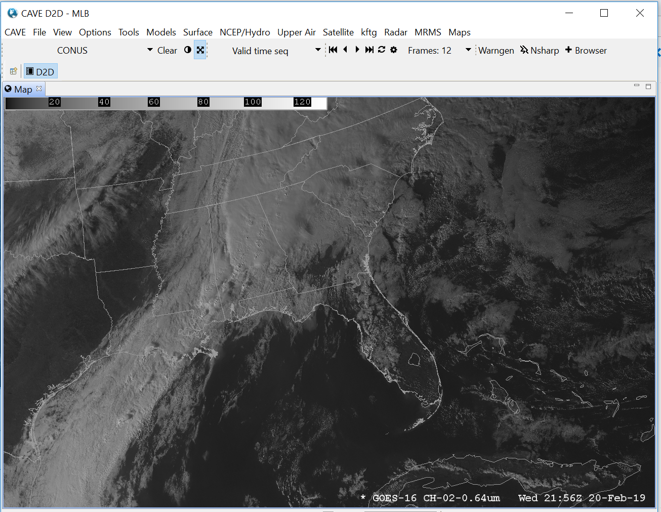
Left click Drag and drop to move to a different location

Slide 11
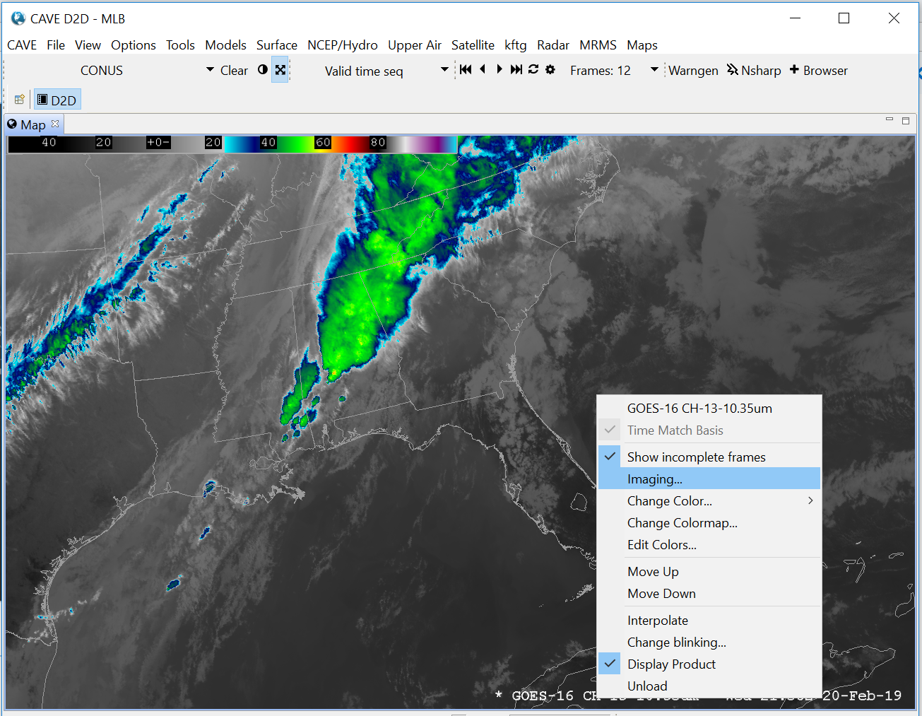
To change to a different channel you can add data by clicking “Satellite” Menu then Selecting a new channel. If you want to replace the current channel, right click and hold on the product legend and select “unload”, then load the new channel data.

Slide 12
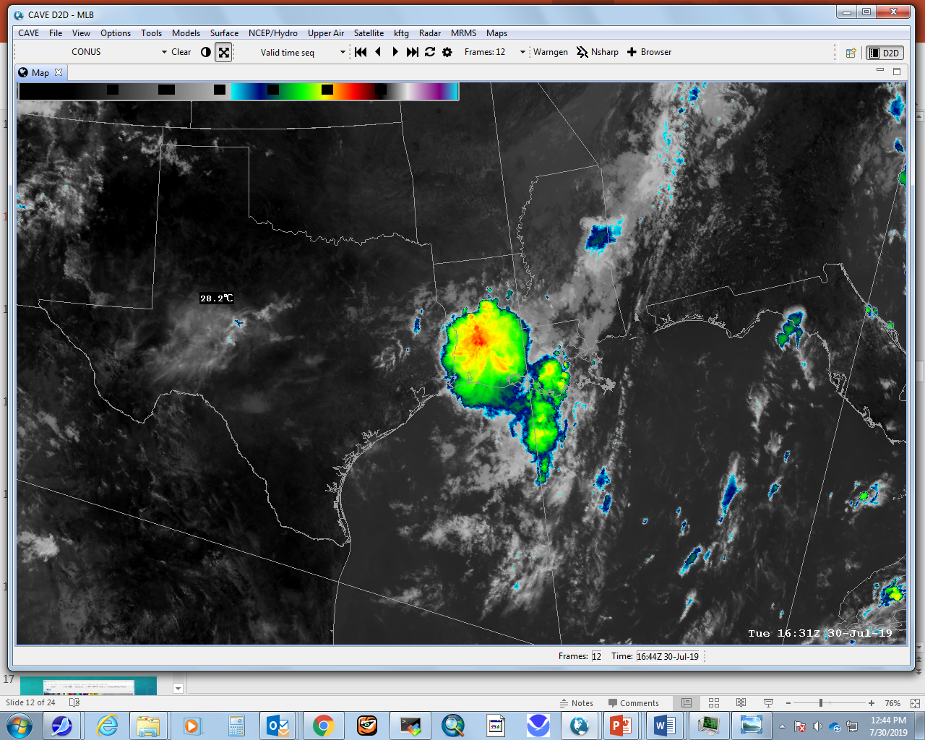
You can change how the image is displayed by changing the enhancement; below is a default ir enhancement; Note: an Enhancement is just a mapping of what colors or grey shades are used to display the different temperatures in the image.

Slide 13
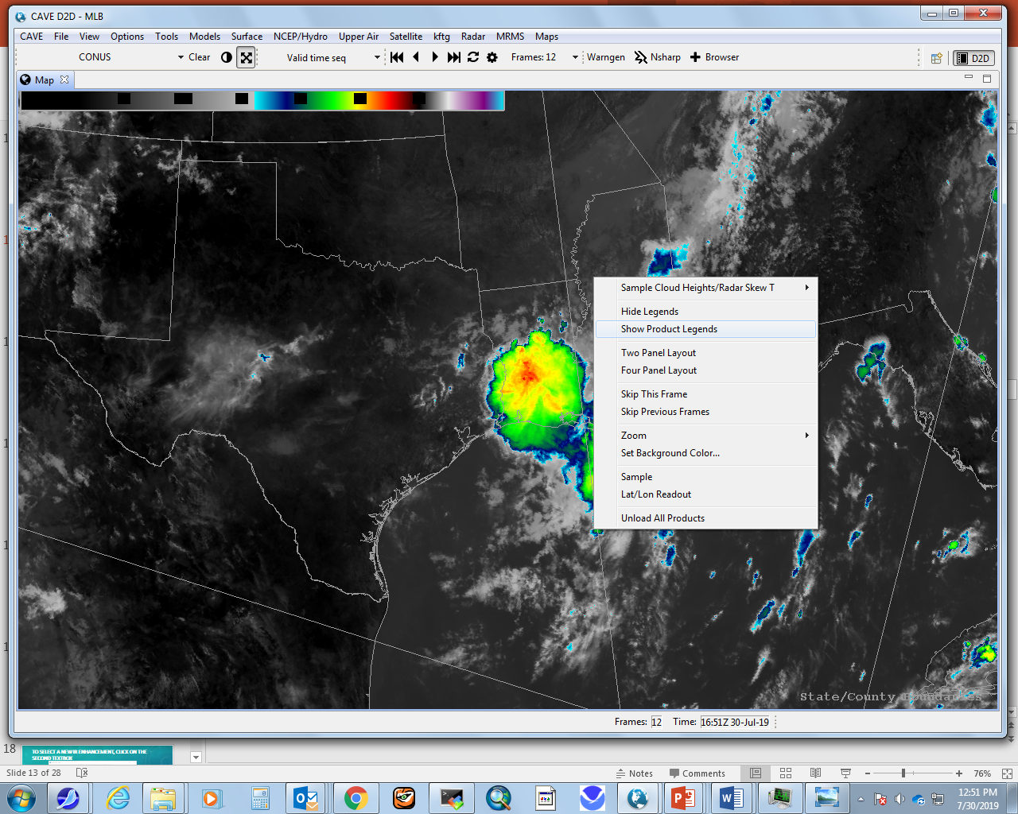

Begin by (if necessary) right-clicking on the image and select “show Product legends”

Slide 14
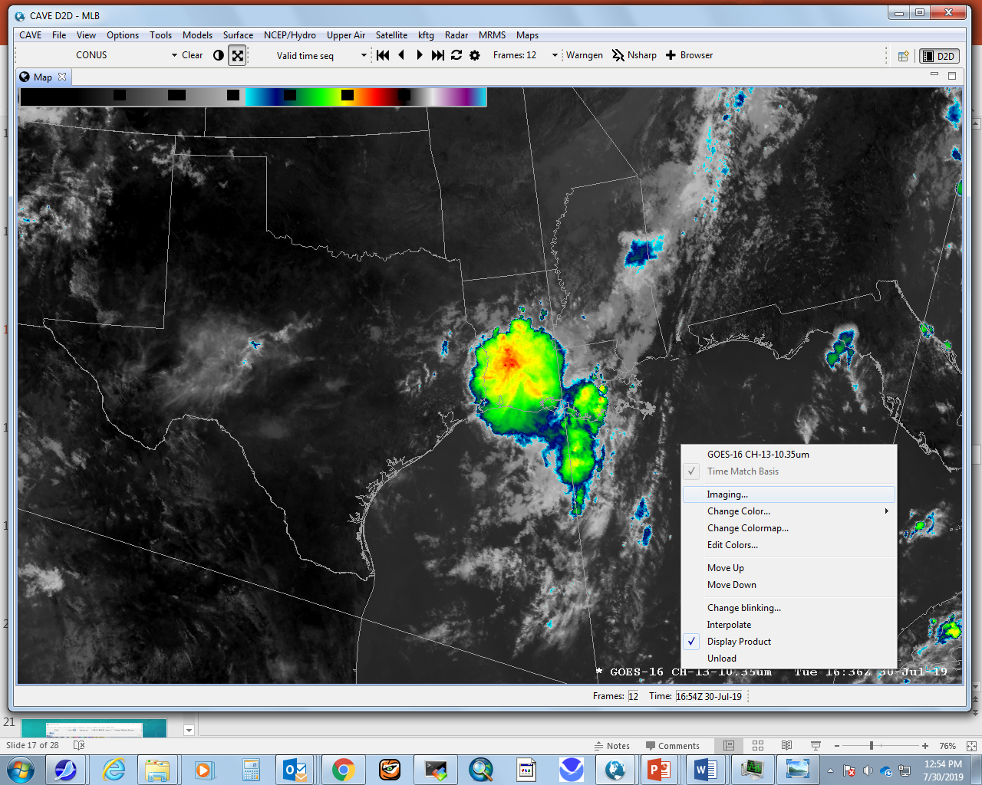

Right-click and hold on the legend and select imaging:

Slide 15
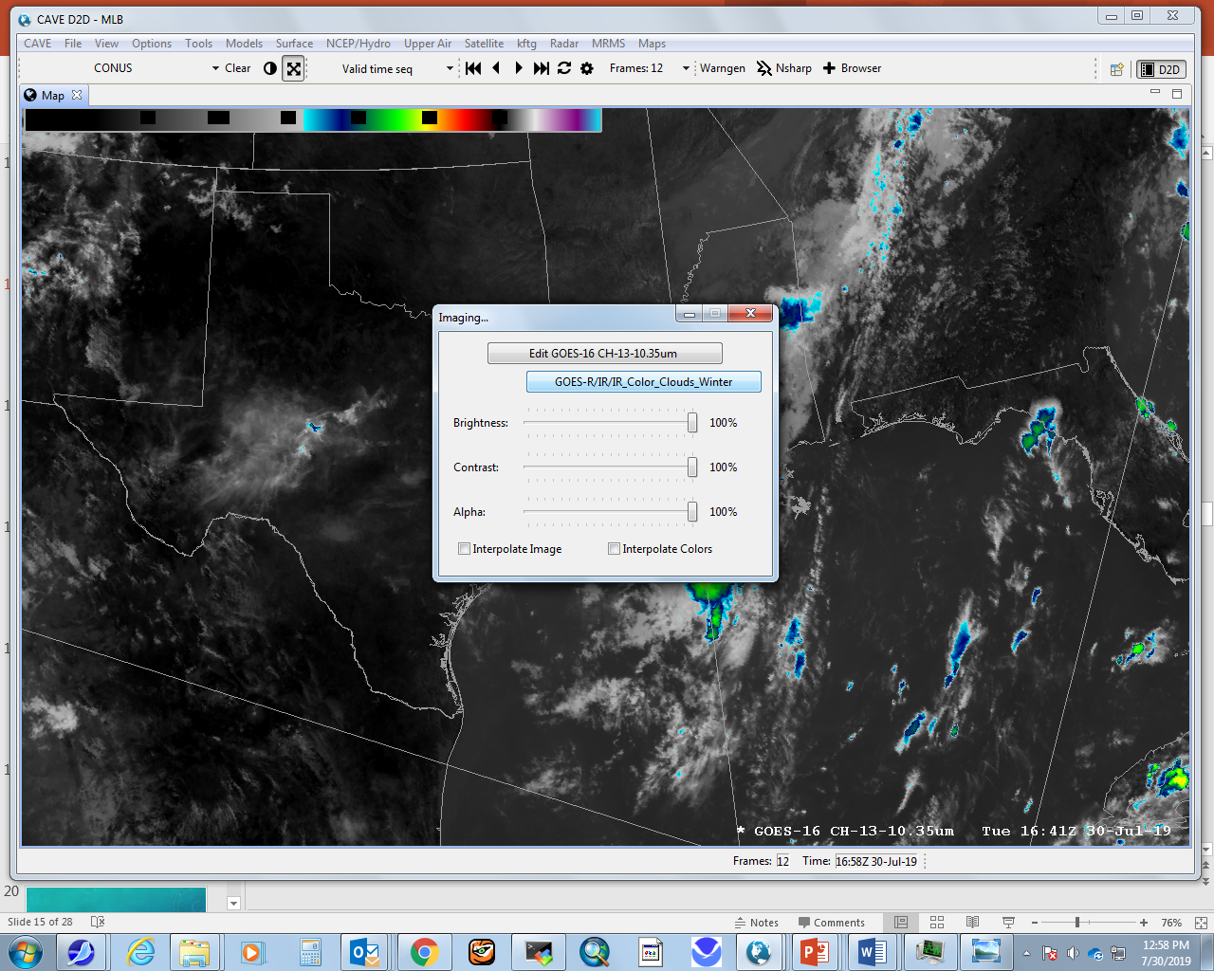
To select a new Ir enhancement, click on the second textbox:

Slide 16
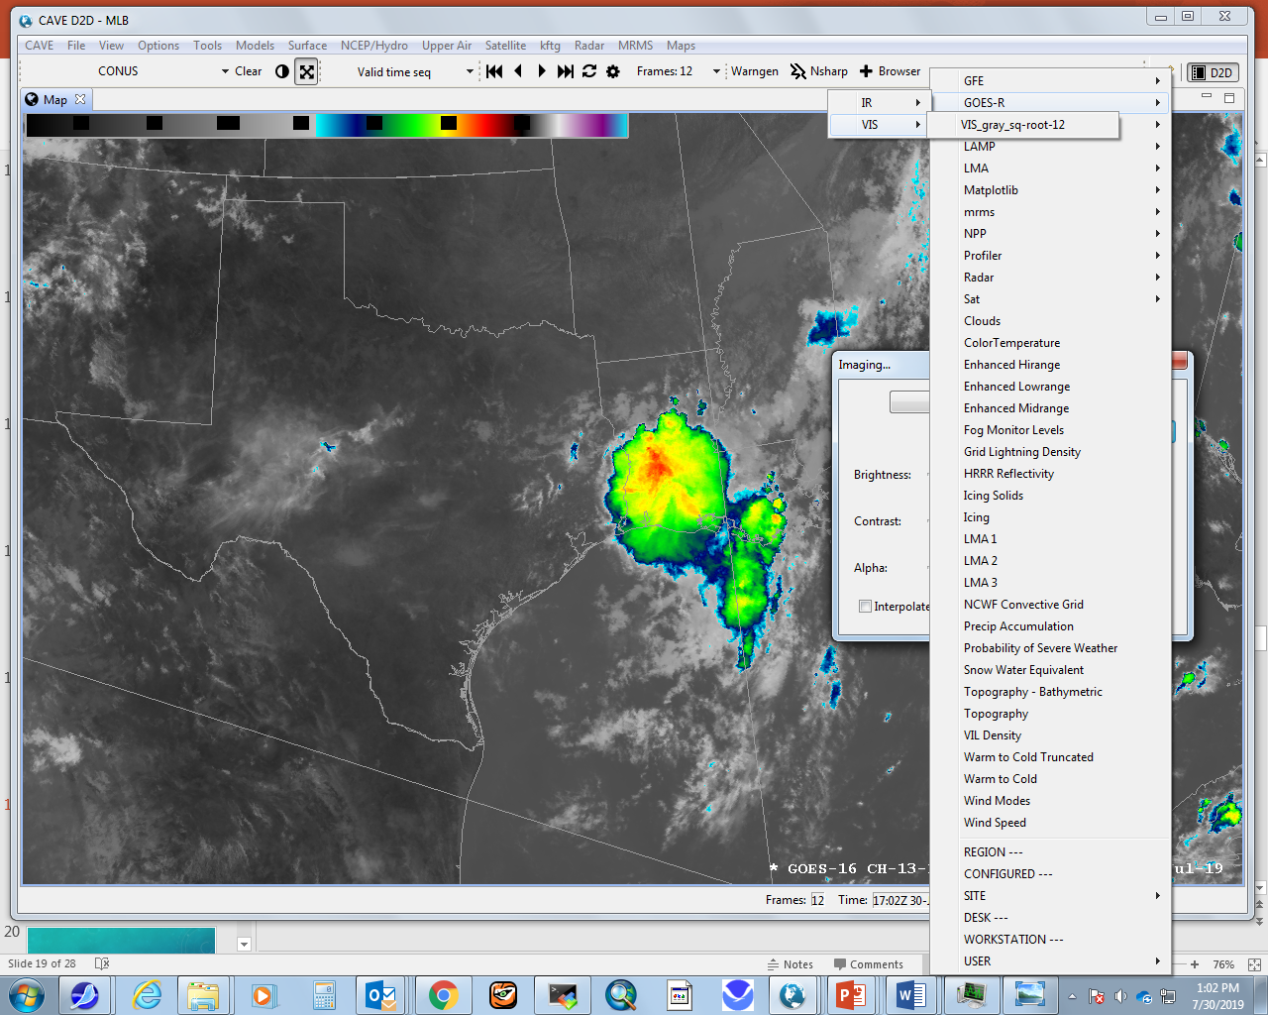


This particular set of choices makes a black and white gray-scale image:

Slide 17
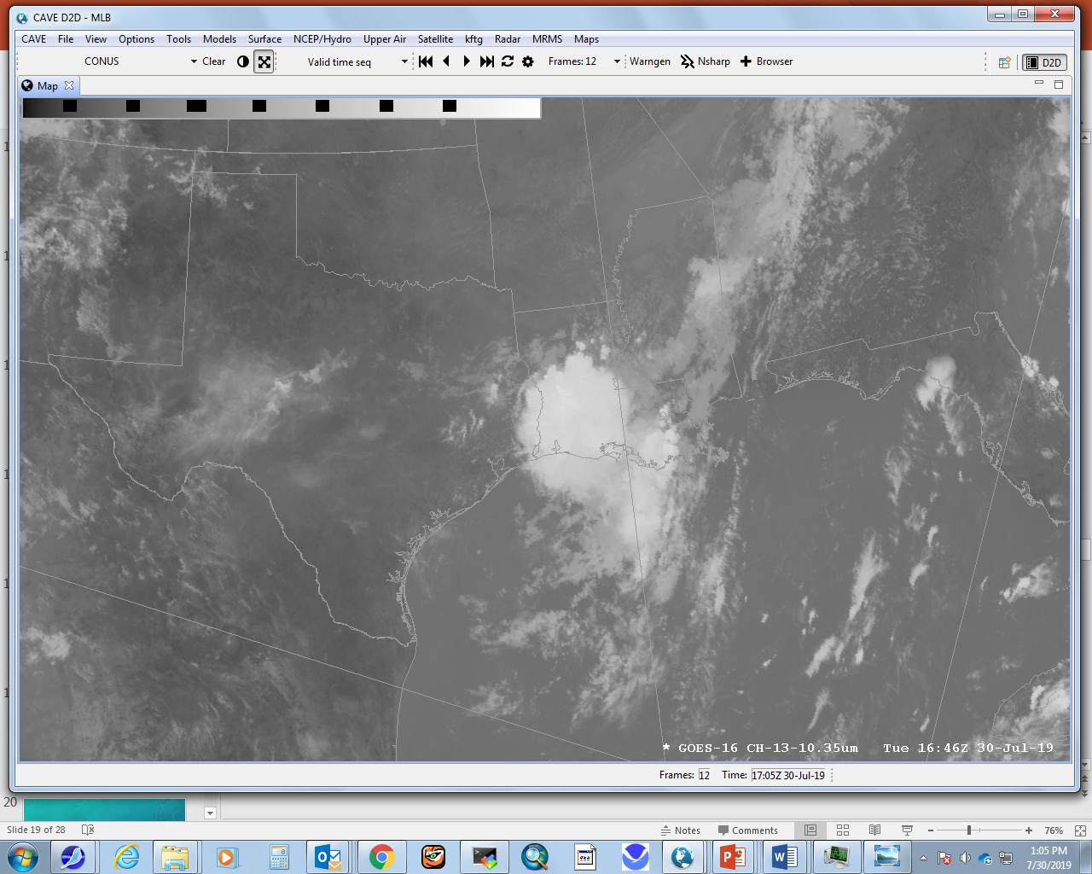

Slide 18
You can Make a 2-Panel Display:
Right-click and hold somewhere in your CAVE window and select “TWO PANEL LAYOUT”:

Slide 19
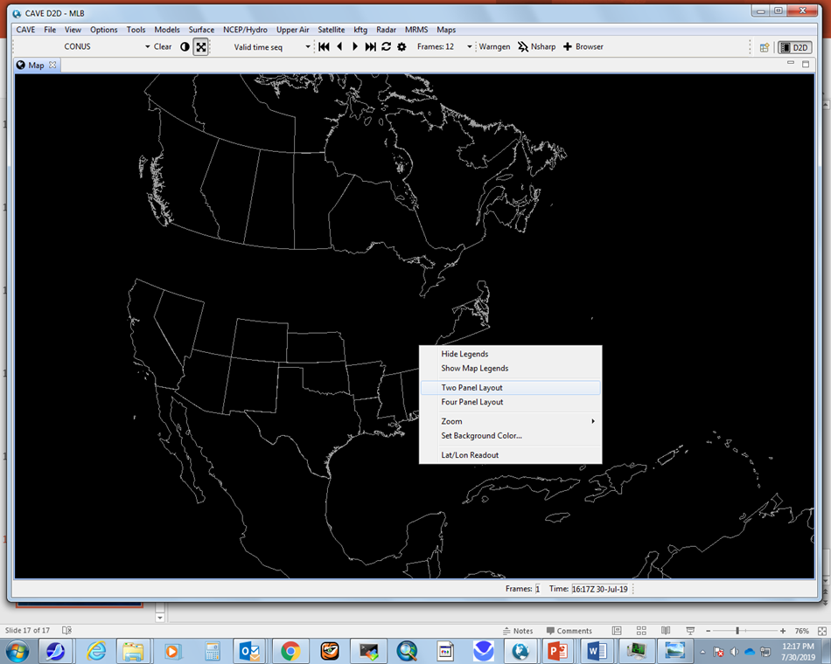

Slide 20
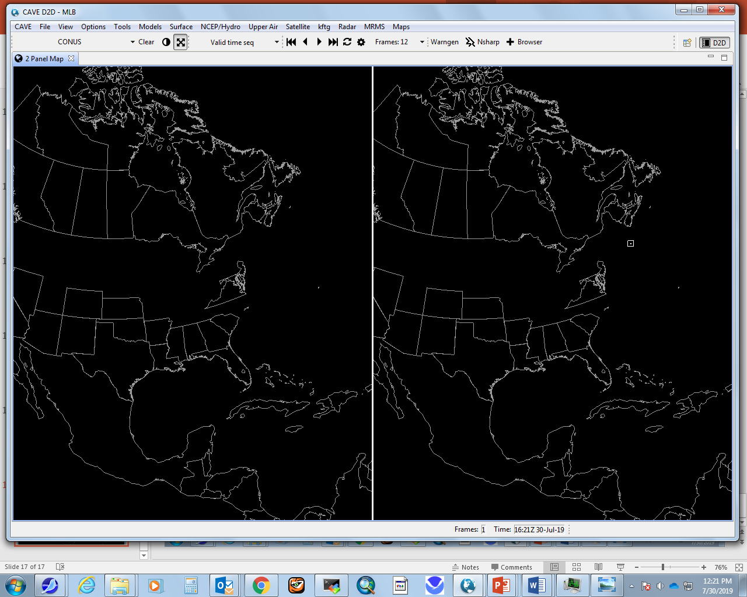

Slide 21
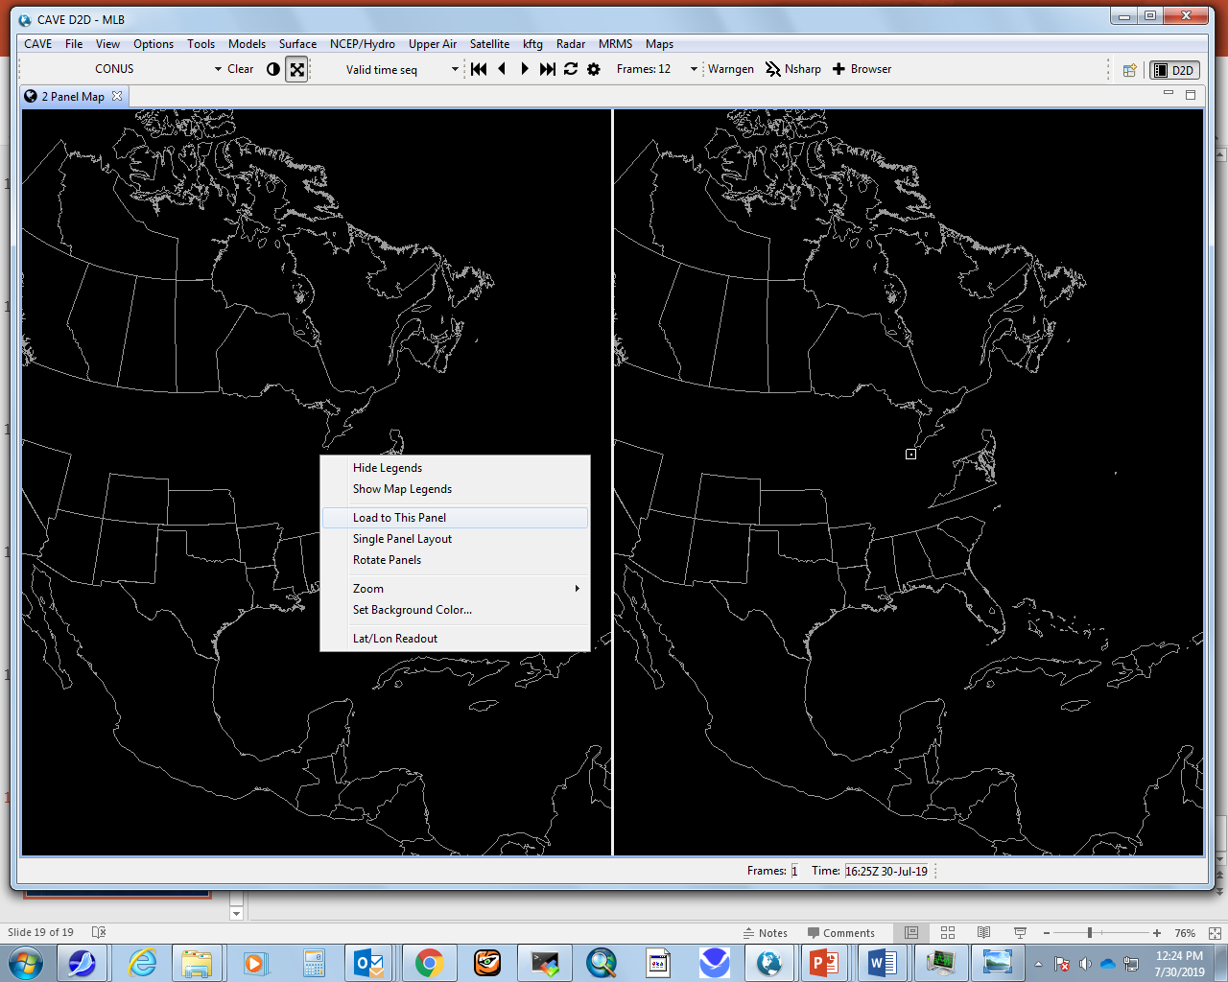
To load images to a window, left click on the window, then right click and select “load data to this window,” then load data as done previously

Slide 22
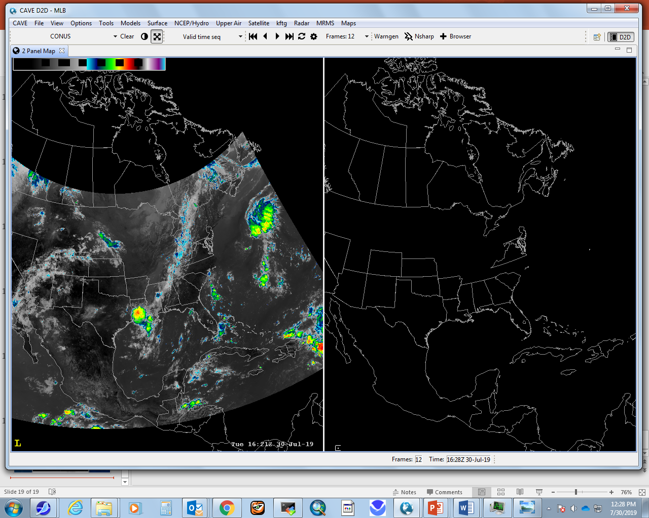
A yellow “L” appears in the active panel:

Slide 23
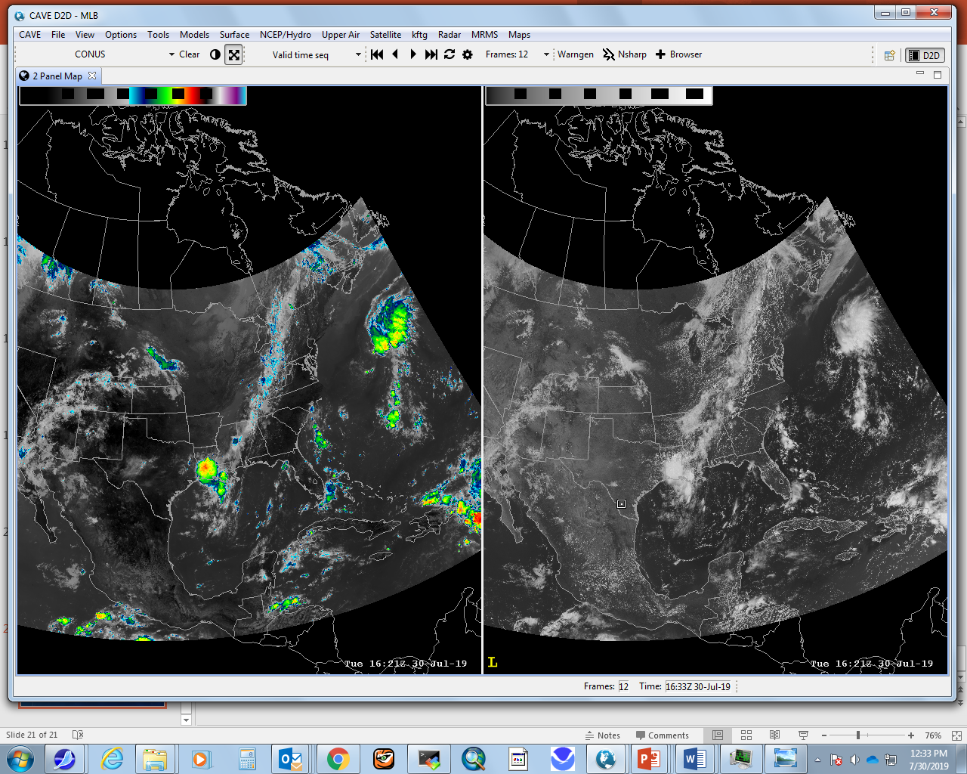
As an example, you could load an ir image from the clean longwave window (channel 13) to the left panel, and a vis image (red--channel 2) to the right:

Slide 24
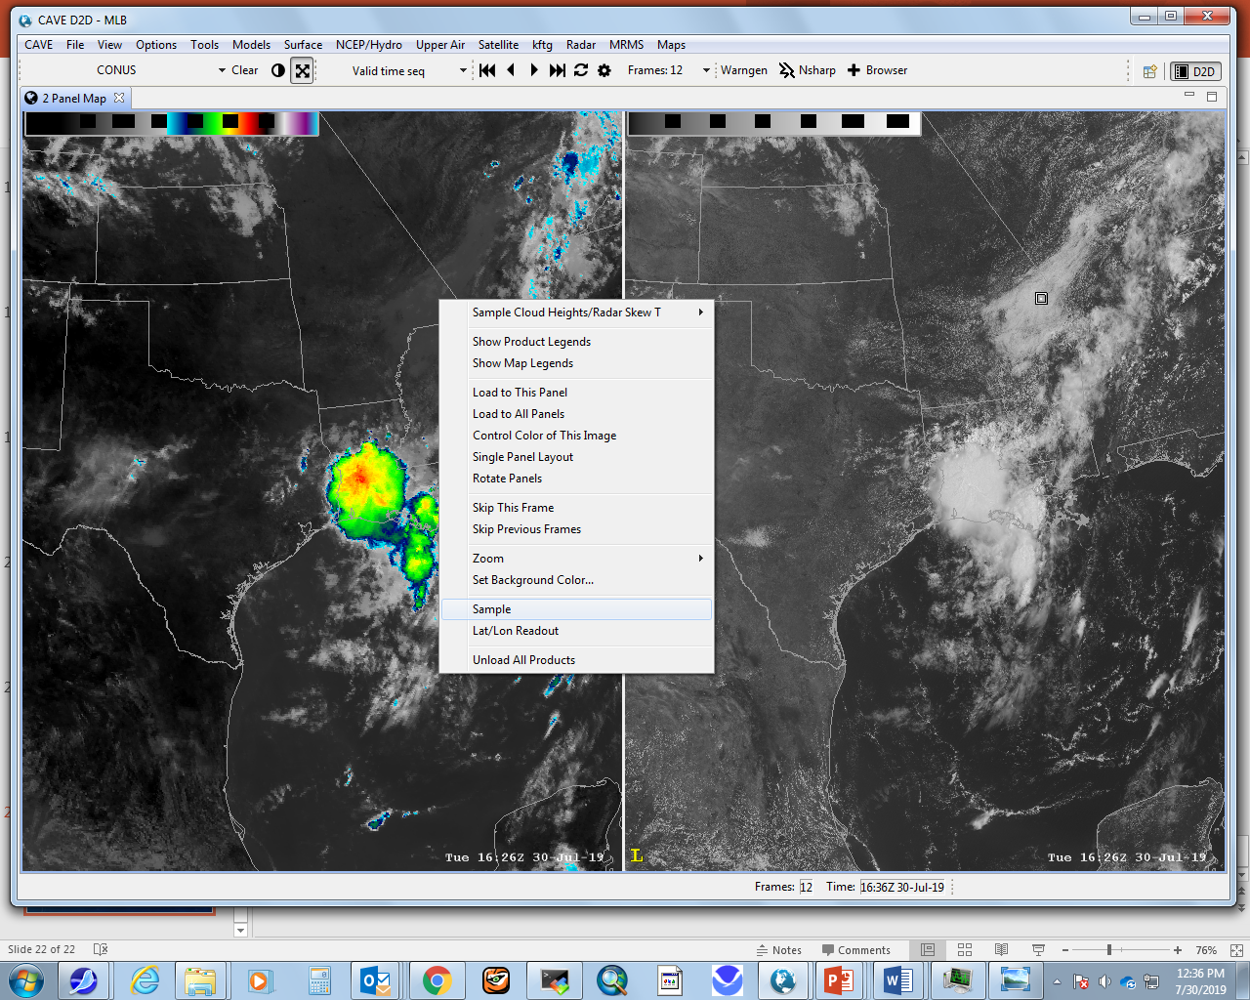
To display brightness temperature from a given location in the image, again right-click and hold on the image, then select “Sample” and move cursor to that location

Slide 25
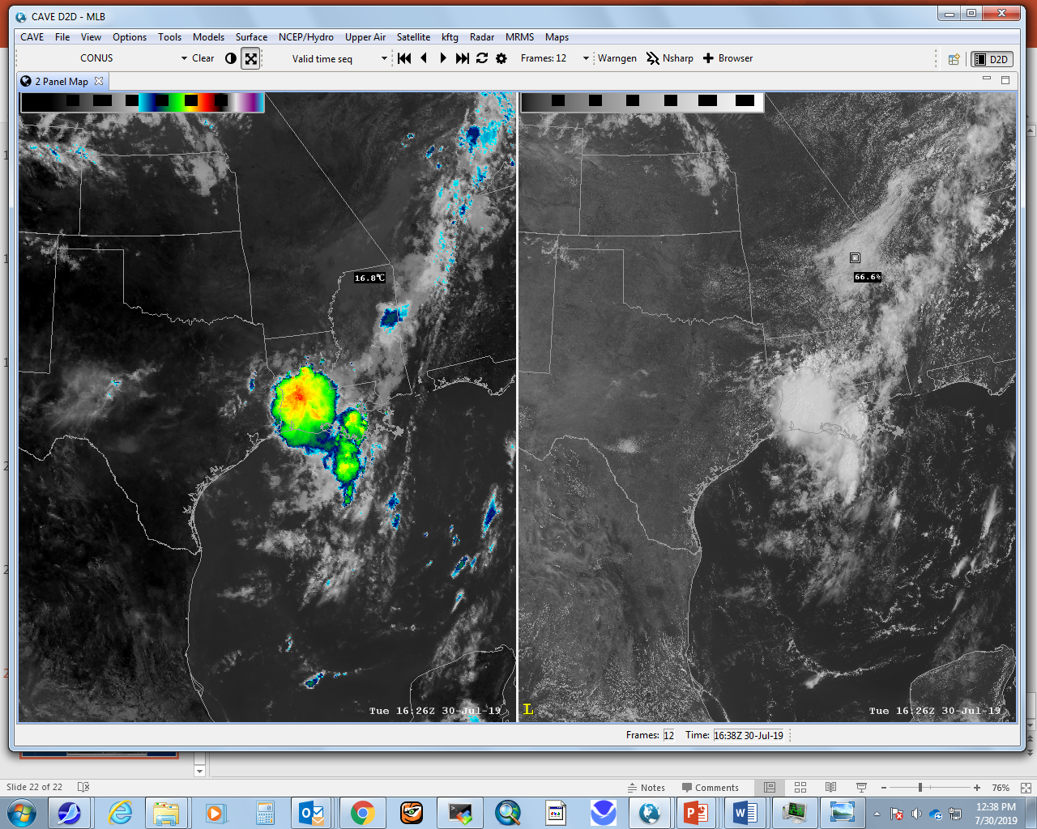

Slide 26
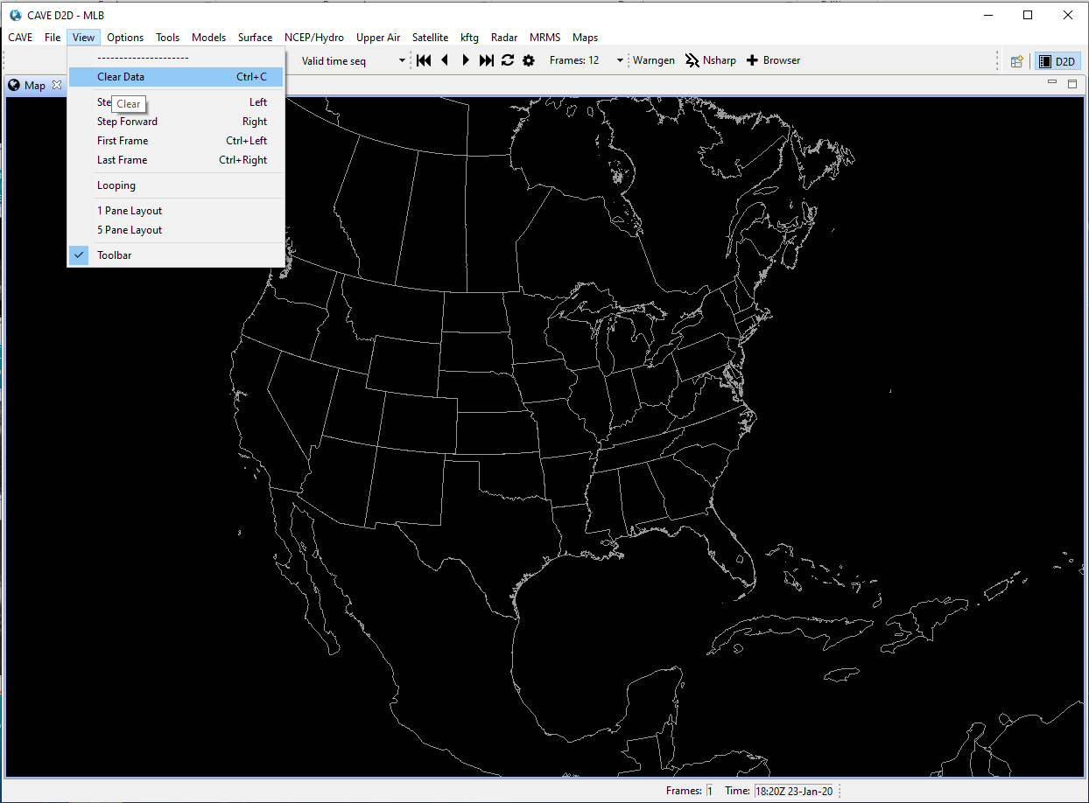
An Exercise in displaying water vapor imagery
You can first use “View” ➔ “Clear Data” to get rid of previously loaded info.

Slide 27
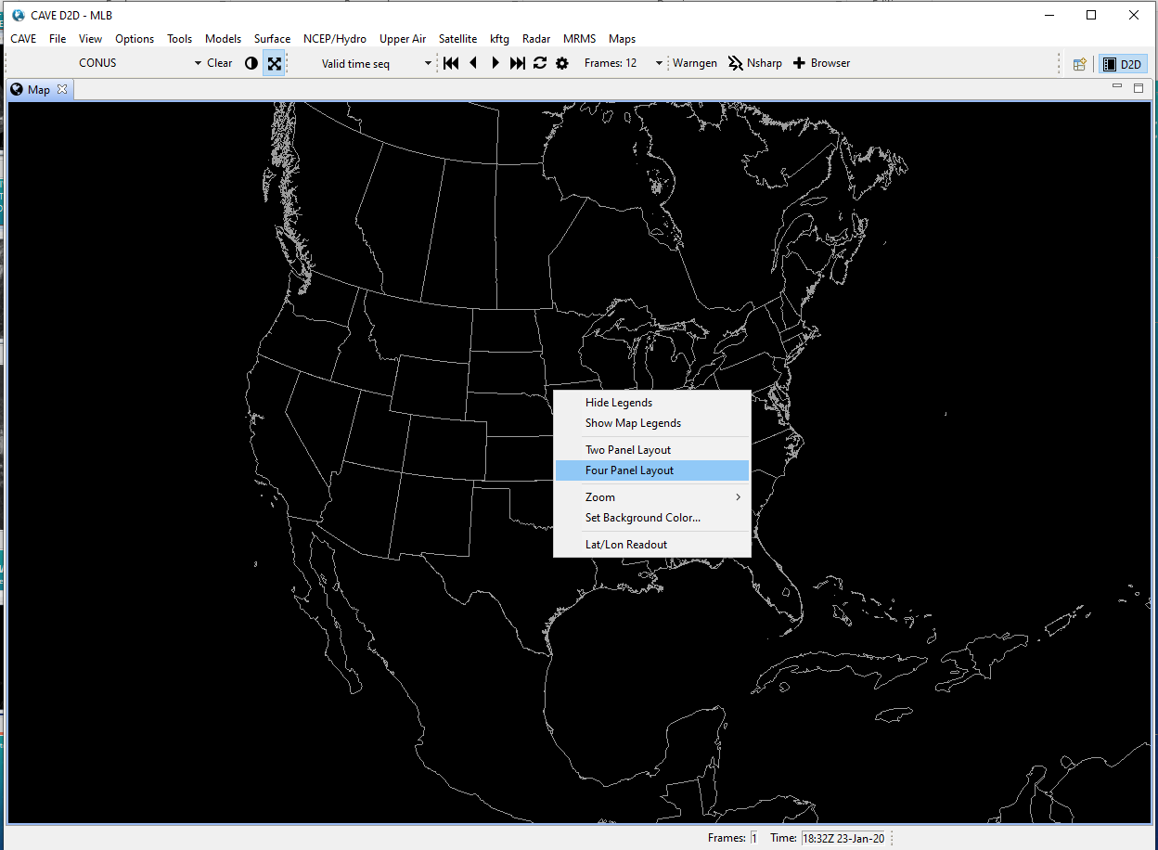
Right-click and hold somewhere in your CAVE window to generate a four-panel layout:

Slide 28
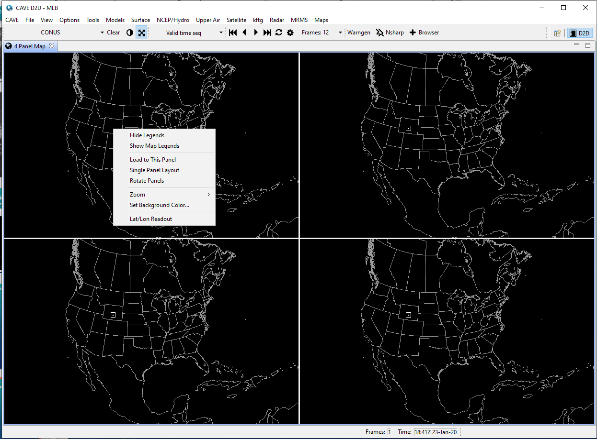
Move the cursor over the upper left window, then right click and select “load data to this window.”

Slide 29
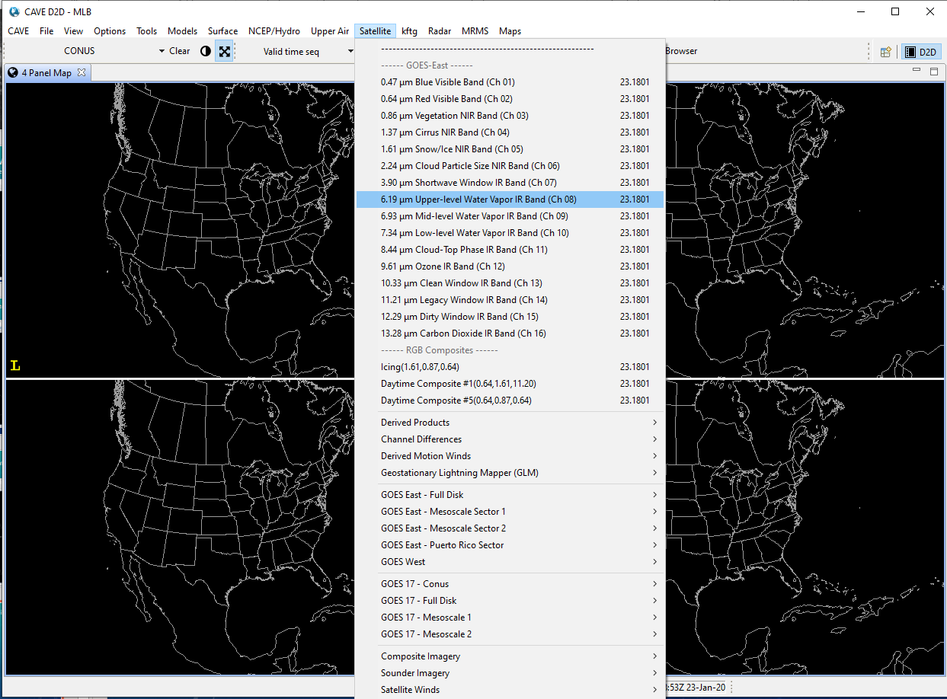
Load the “upper level water vapor IR band (Ch. 08) to this window.

Slide 30
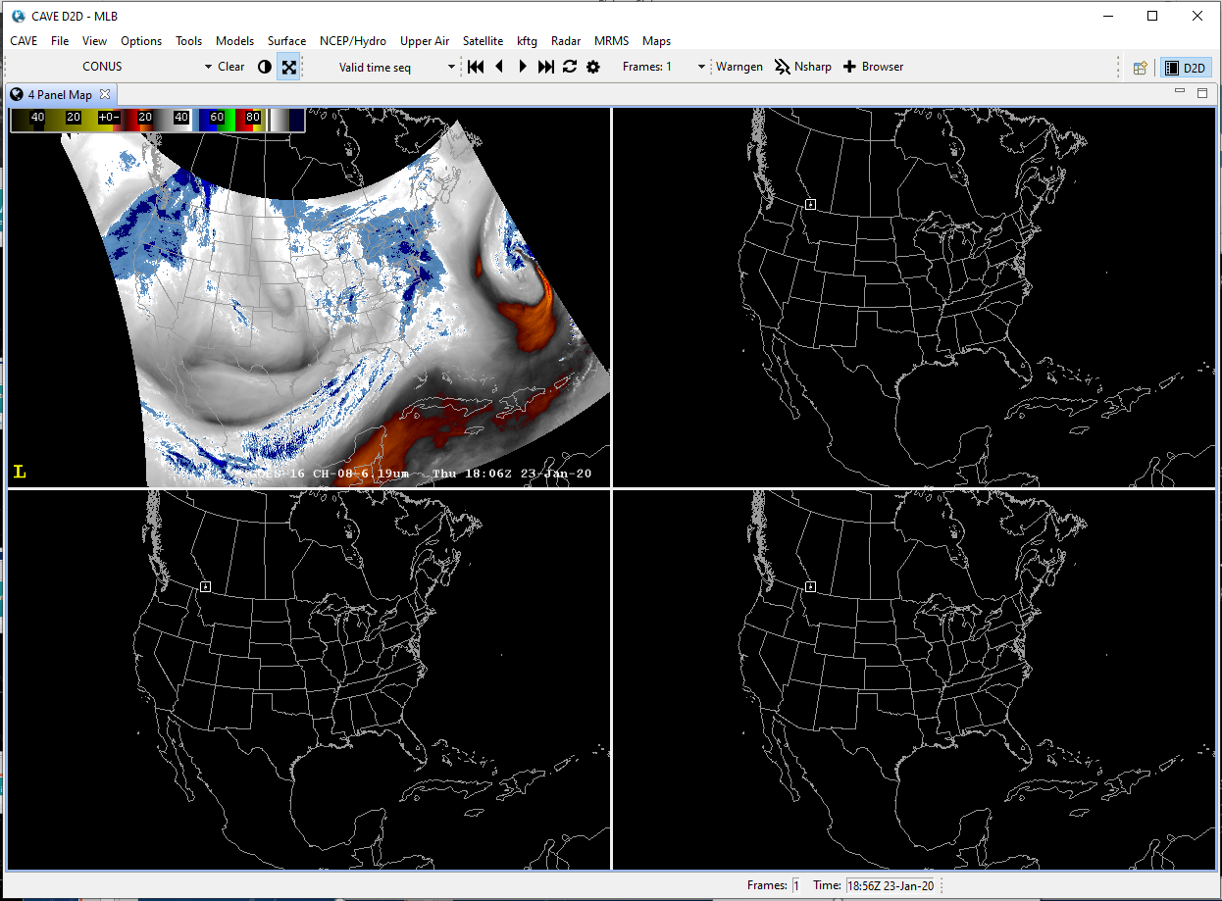

Slide 31
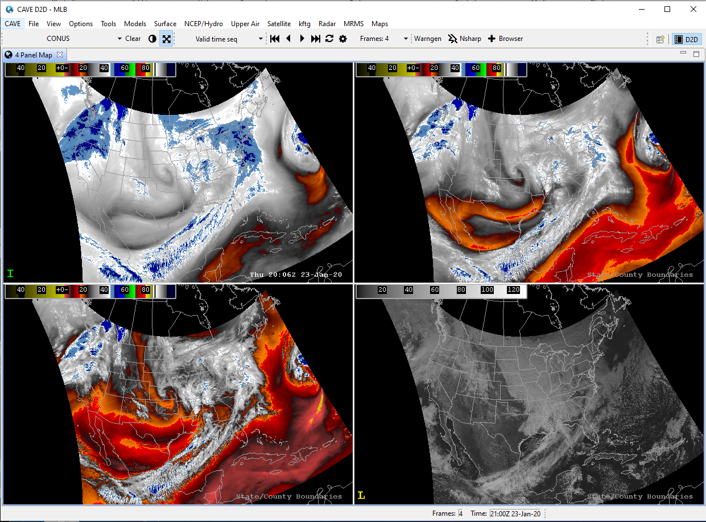
Repeat this process for both the Midlevel WV Channel 09 (upper right window) and Low-level WV Channel 10 (lower left window) and then for comparison you can put a (red) visible Ch. 02 in the lower right window; note that even though the brightness temperatures for the different water vapor channels are expected to cover different ranges because of being higher or lower in the troposphere, the default “enhancement,” that is, the colors associated with specific temperatures, is designed to cover all three types of imagery:

Slide 32
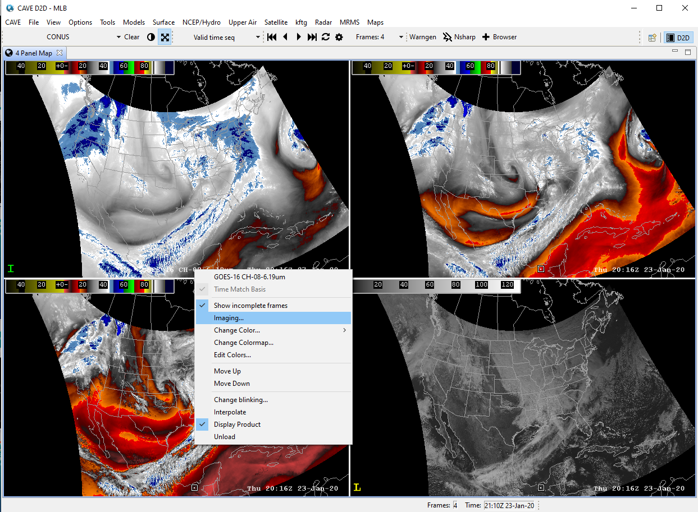
You can also change the “enhancement,” that is, the colors that represent different brightness temperatures, to a different one that also can display upper level, mid level, and lower level water vapor images with only a single scale. Start with a right click and hold on the caption to select “Imaging” (upper left) to get to where we can change the enhancement:

Slide 33
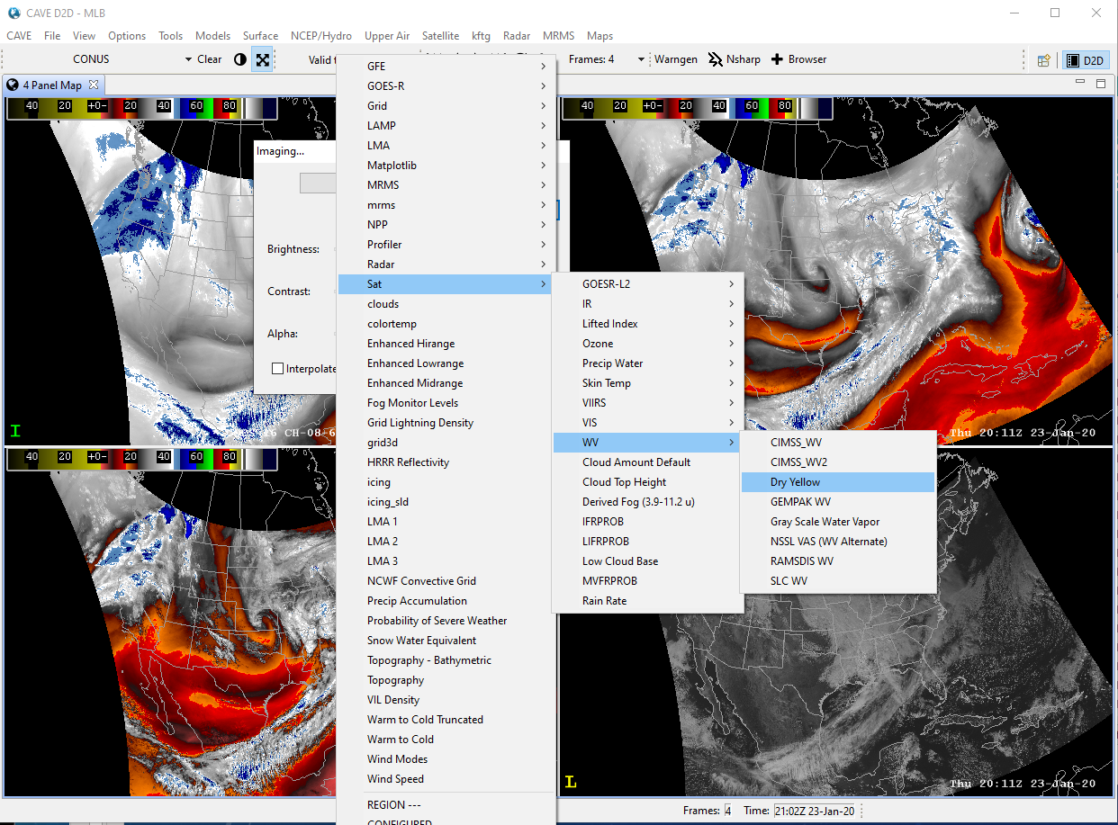
After clicking on Imaging, click on the second drop-down window then click on “Sat” ➔ “WV” ➔ “Dry Yellow” to change to a different enhancement that also can display all the channels using a single enhancement.

Slide 34
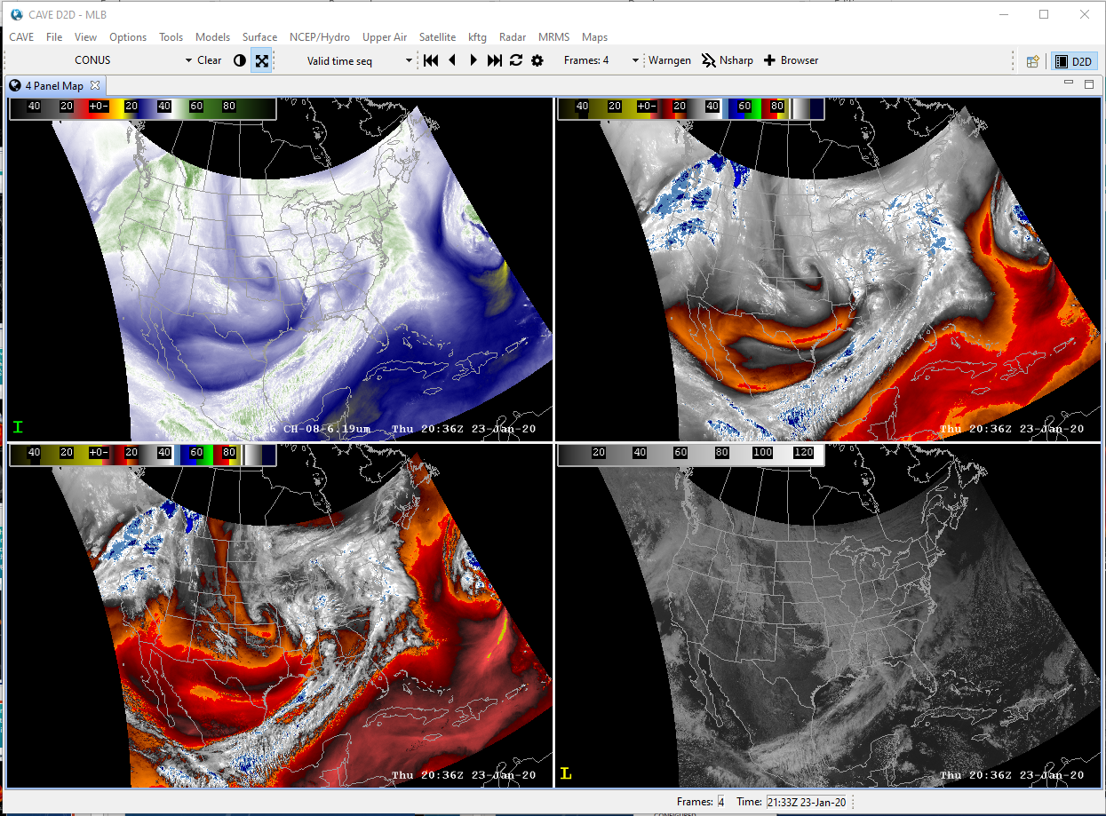

Slide 35
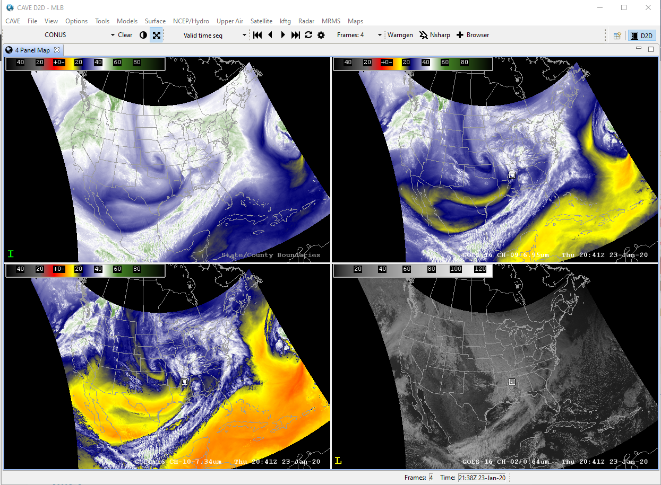
Repeat for the other two water vapor channels:

Slide 36
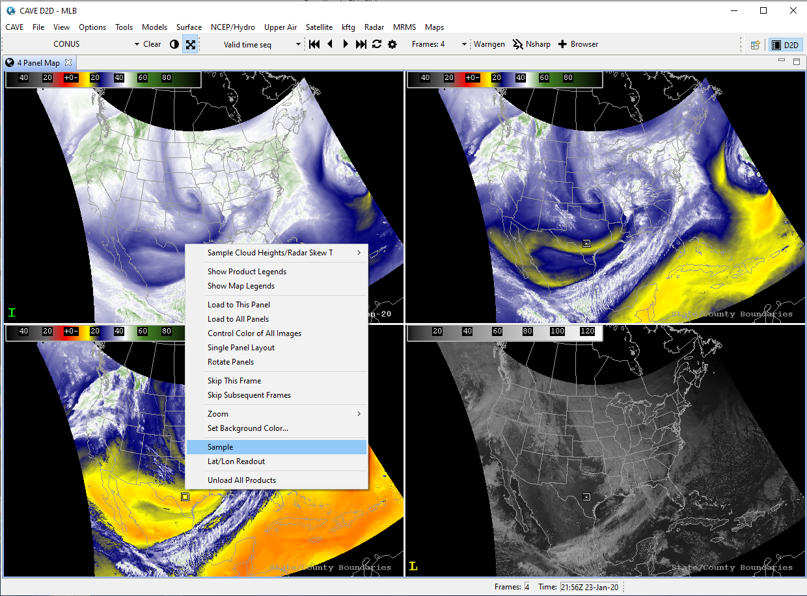
Finally, we can use the “sample” function to interrogate brightness temperatures simultaneously in the three water vapor channels:
Right click and hold anywhere in image and select “Sample”.

Slide 37
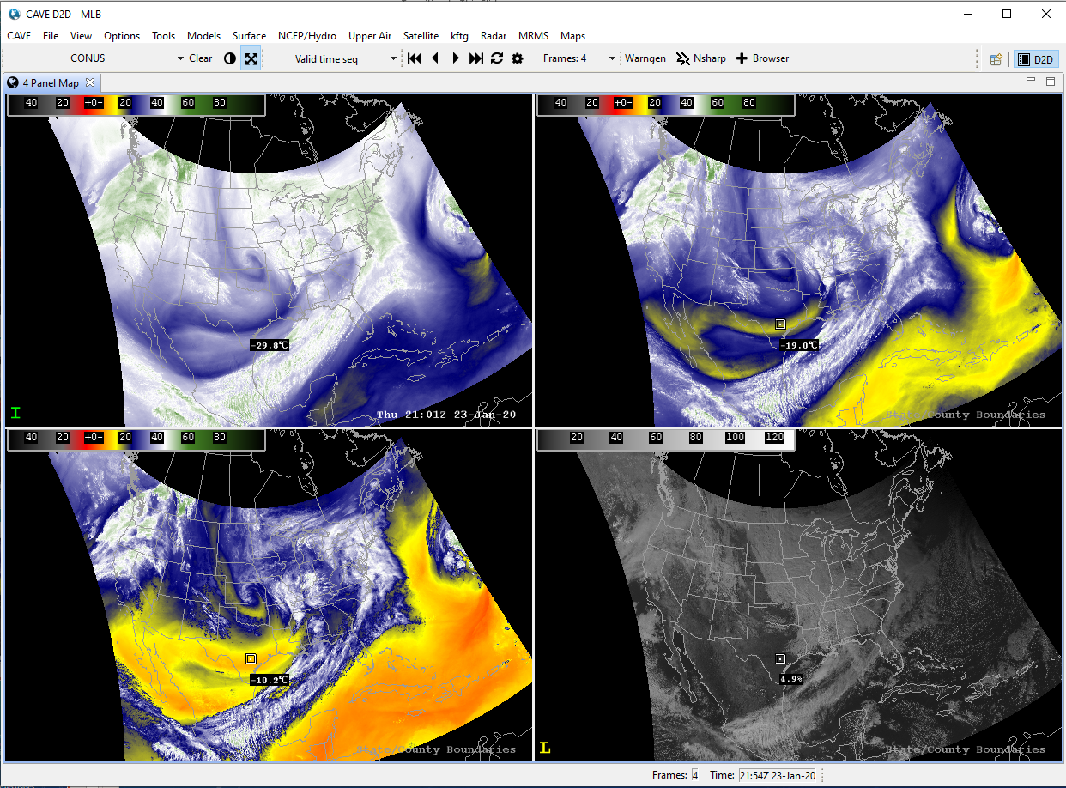
Compare the brightness temperatures from the same location in the three different water vapor channels. Which channel will have the coldest brightness temperatures? Which the warmest? (see next page for expanded image).
Answer: the upper level channel will be coldest (temperature decreases with height in troposphere) and the lower level channel will be warmest.

