Slide 1
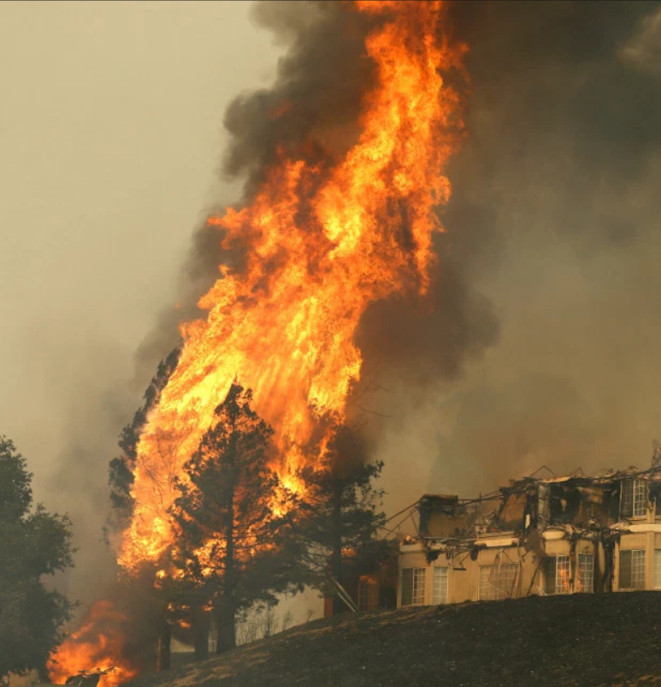
The Surprising Connection Between Mountain Waves, Surface Wind Storms, Severe Aircraft Turbulence, and Devastating Fires in California
Dr. Brad Muller

Slide 2
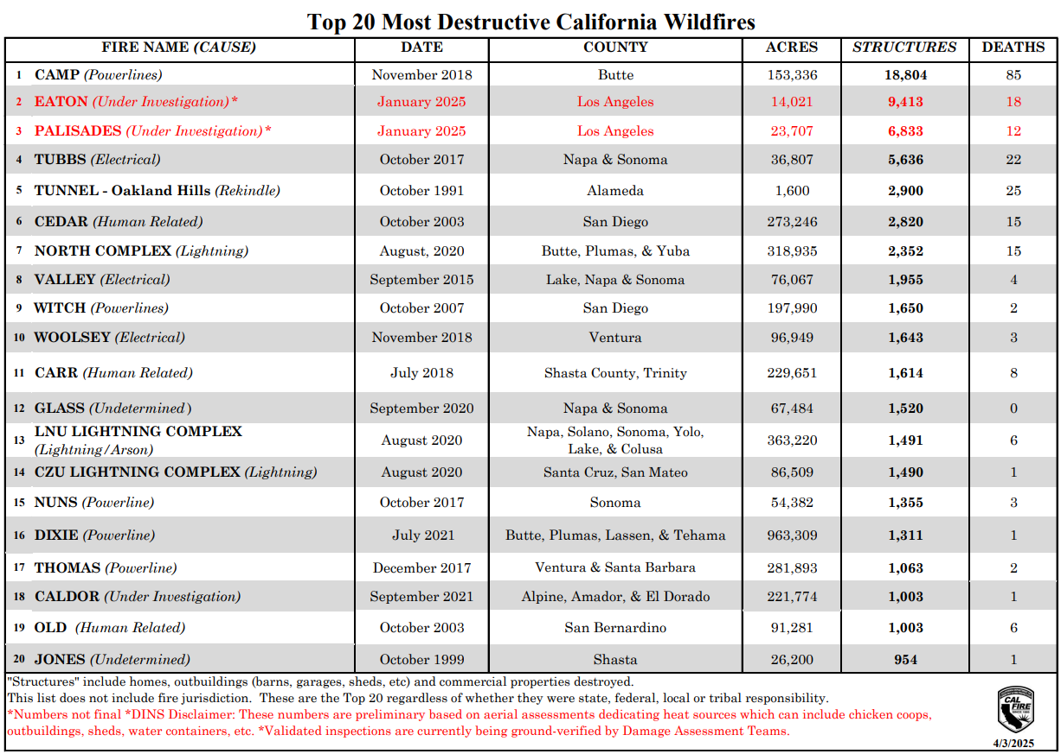

Slide 3
Why So Recent??
Urban development into the urban-wildland interface.
100+ years of fire suppression – fuel buildup.
Global warming:
  Rainier wet years—greater fuel buildup.
  Warmer, drier droughts—longer and more extreme fire conditions.
  Climate “whiplash”—greater fluctuations between annual wet years and annual dry years.

Slide 4
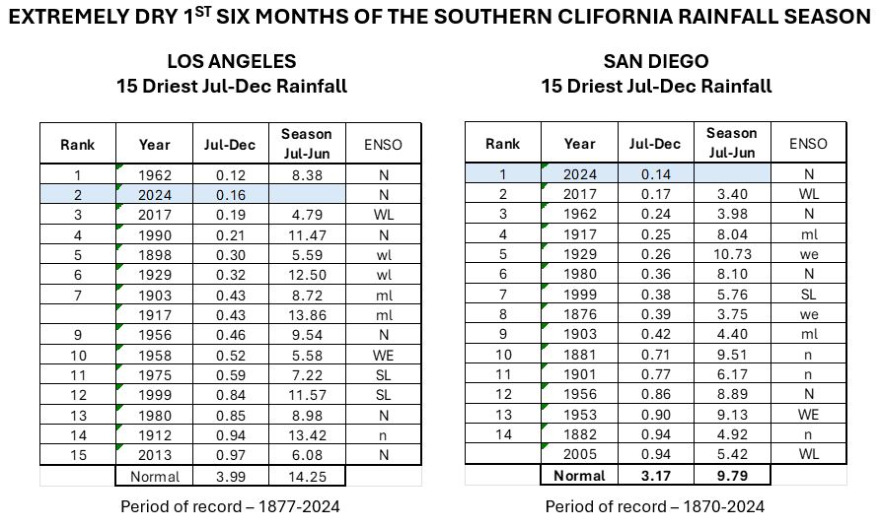

Slide 5
L.A.: 2nd driest fall on record preceded by well above average precip. previous two years:
Season (July 1-June 30) | Total Inches of Rainfall | Inches Above/Below (+/-) Overall Season Average*
2024-2025 | See month-by-month numbers as season unfolds.
2023-2024 | 25.19 | +10.37
2022-2023 | 28.40 | +13.58
2021-2022 | 12.18 | -2.64
2020-2021 | 5.82 | -9.00
2019-2020 | 14.86 | +0.04
2018-2019 | 18.82 | +4.00
2017-2018 | 4.79 | -10.03
2016-2017 | 19.00 | +4.18
Overall average for seasons beginning 1877 through 2024: 14.82 inches*

Slide 6
Common Denominators of Tubbs, Thomas, Eaton Fires:
Northeasterly offshore flow—common precursor for extreme fire conditions in California: Santa Ana Winds in So. Cal.; Diablo Winds in No. Cal.
Development of downslope wind storm (“shooting flow”) associated with mountain waves.
Temperature inversion(s) near/above mountain top level.
Extreme surface wind speeds combined with extreme low dew points.
Fragile power infrastructure

Slide 7
Mountain Waves
Need stable layer near/just above mountain top level.
Wind roughly perpendicular to the mountains.
Stronger wind speeds at mountain top level > ~25 kts.
Two types:
  Trapped waves-series extends downstream
  Vertically propagating waves-energy can propagate vertically and waves can amplify at upper levels, well above mountain top height.

Slide 8
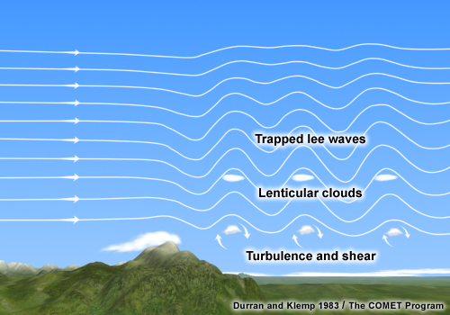
Trapped Waves
Wind speed above the mountain increases sharply with height
Stability decreases above the mountain top stable layer

Slide 9
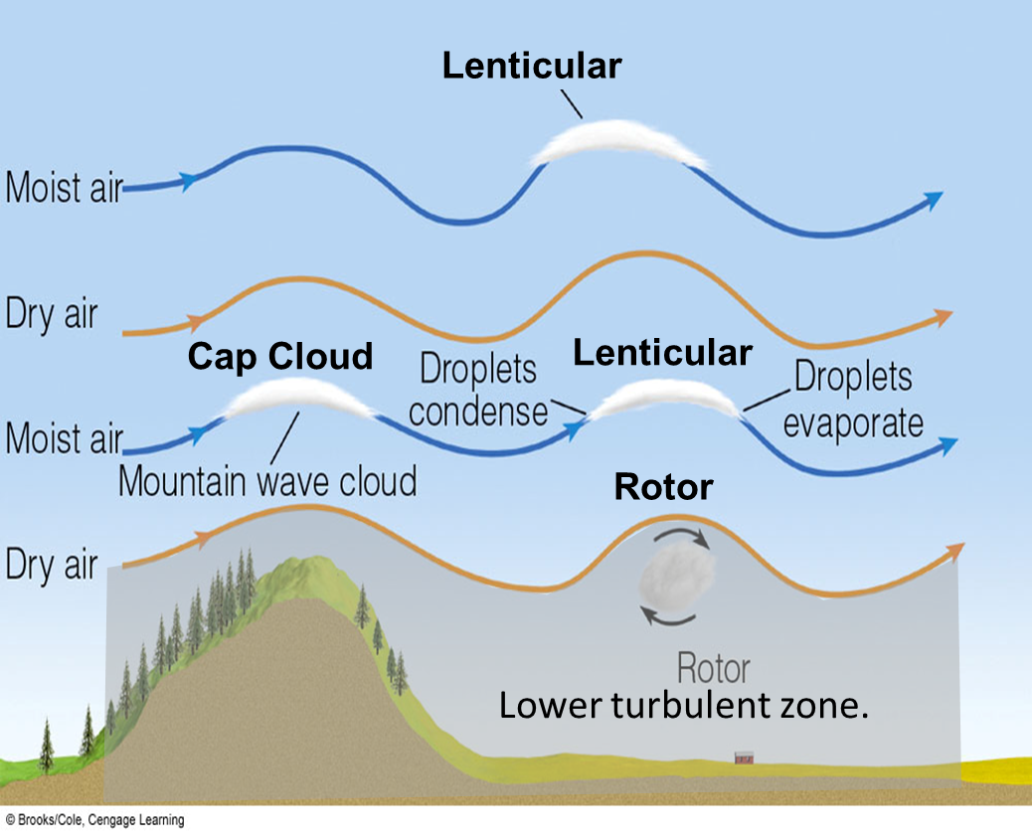
Trapped waves: rotors, lower turbulent zone.

Slide 10
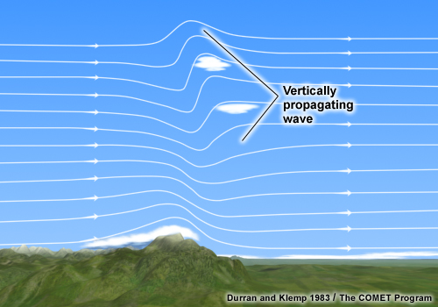
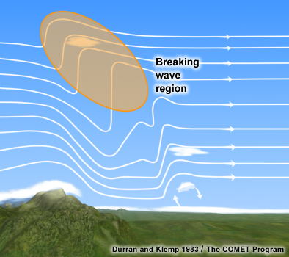
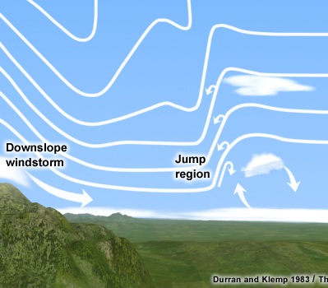
Vertically Propagating Waves
Note “breaking wave” region aloft, i.e., air is actually overturning: turbulence.
Can lead to severe aircraft turbulence at commercial flight altitudes.
“Shooting flow” leads to downslope windstorms/extreme winds at surface.
“Jump region” – flow transitions from supercritical to subcritical in rapid, turbulent deceleration

Slide 11
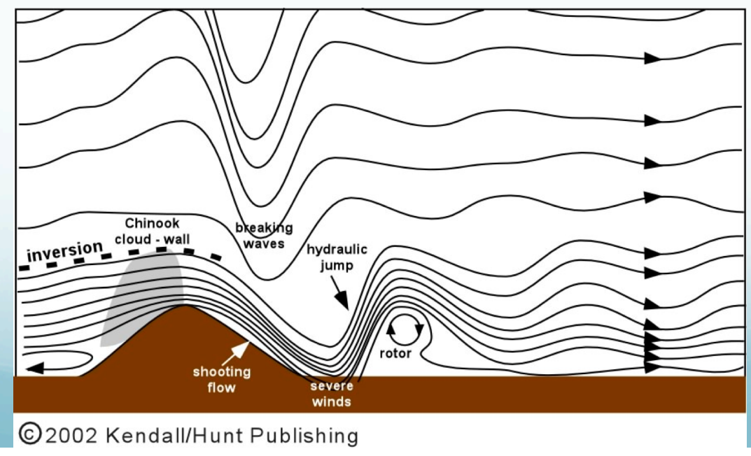
“Shooting flow”: supercritical – downslope wind storm with extreme winds at sfc.

Slide 12

Supercritical: Flow speed is greater than wavespeed – waves cannot propagate upstream
Fr = U/NH
U is wind speed upwind of mountains
N – static stability via the Brunt-Vaisala frequency
θ = potential temperature
g = gravity
z = height
H—mountain barrier height

Slide 13
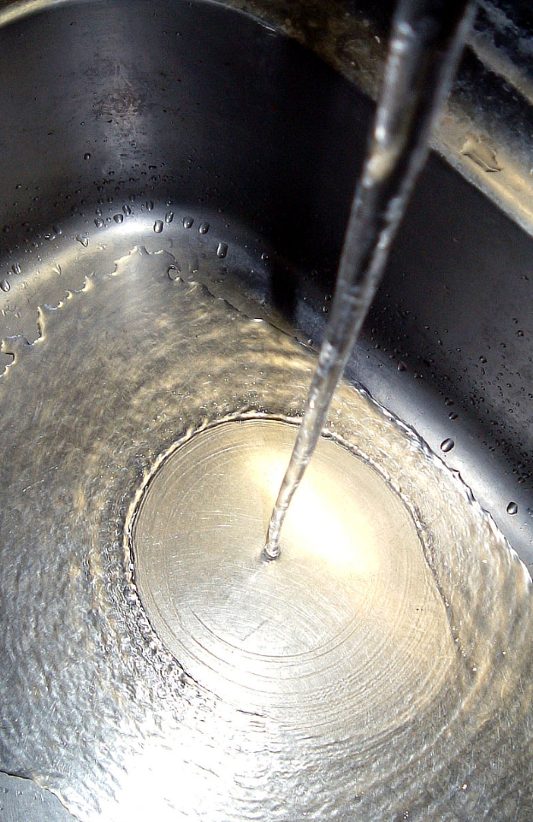
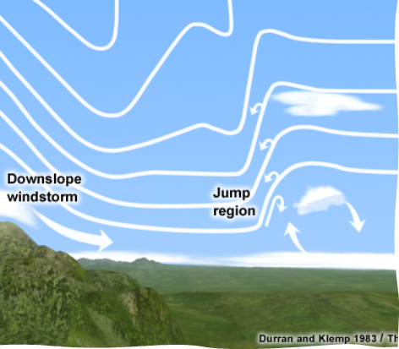
Supercritical flow is unstable—it will rapidly decelerate to subcritical in hydraulic jump:

Slide 14
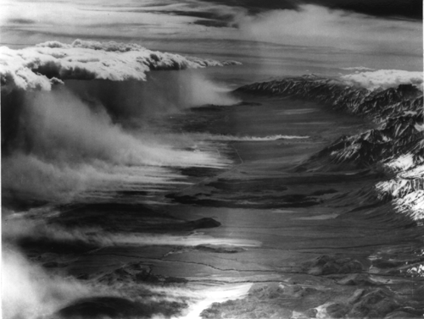
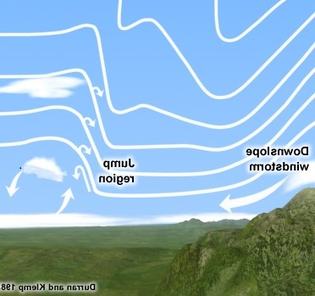
Downslope windstorm and hydraulic jump. The picture below shows a dust storm, but in a fire, burning debris can loft and spread the fire.

Slide 15
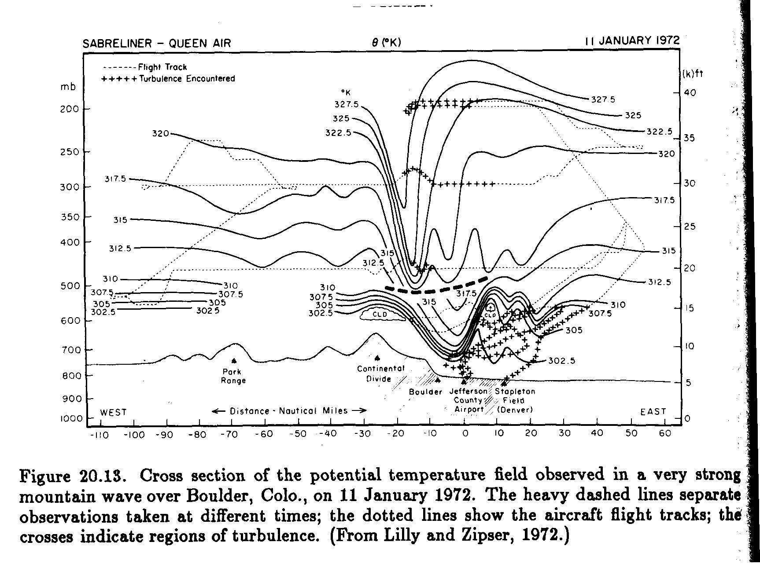
Potential Temperature Shows Wind Flow in Turbulent Vert. Prop. Mountain Wave

Slide 16
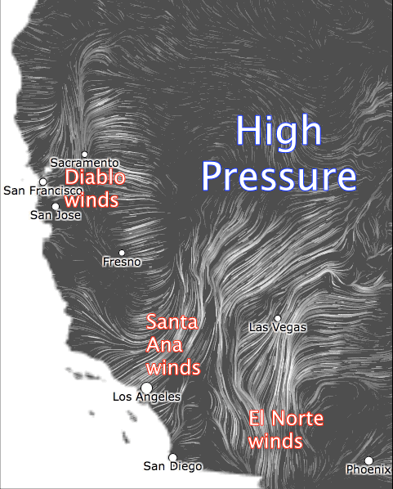
Extreme fire conditions in California result from Santa Anas/Diablo winds – high pressure over the Great Basin causes dry, warm, offshore flow with extreme low dew points.

Slide 17
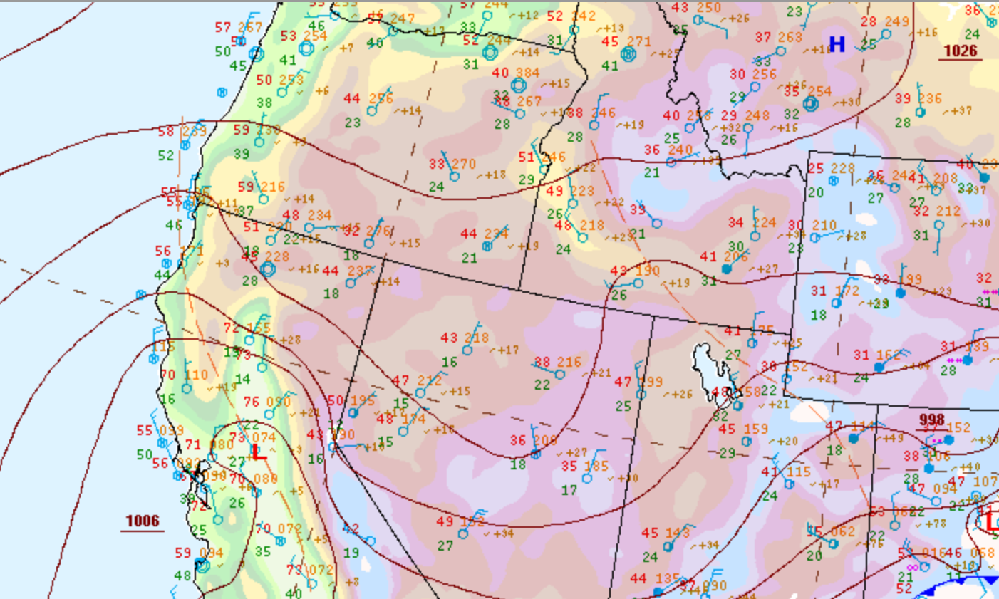
Tubbs Fire – Santa Rosa, CA, Oct. 9, 2017

Slide 18
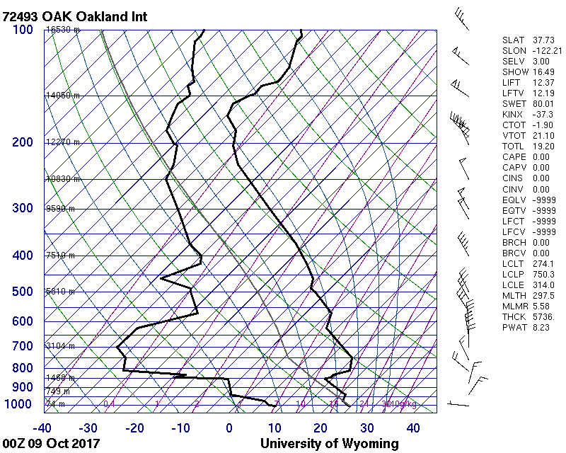
Inversion just above mountain top level – mountains only 3000 – 4000 feet high, yet strong mountain wave developed:

Slide 19
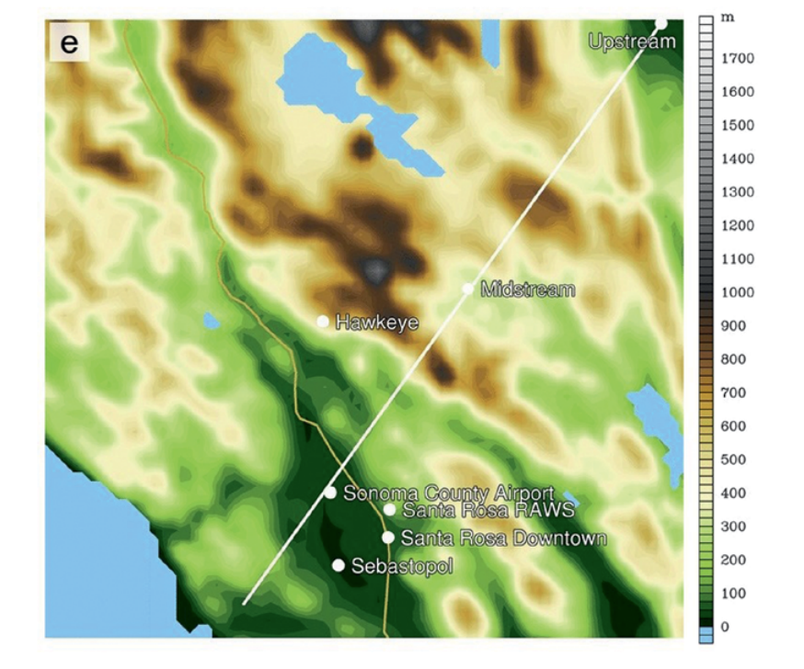
Cross section location of model terrain (from simulation by Mass and Ovens 2019); surface wind gusts measured 60-95 kts.

Slide 20
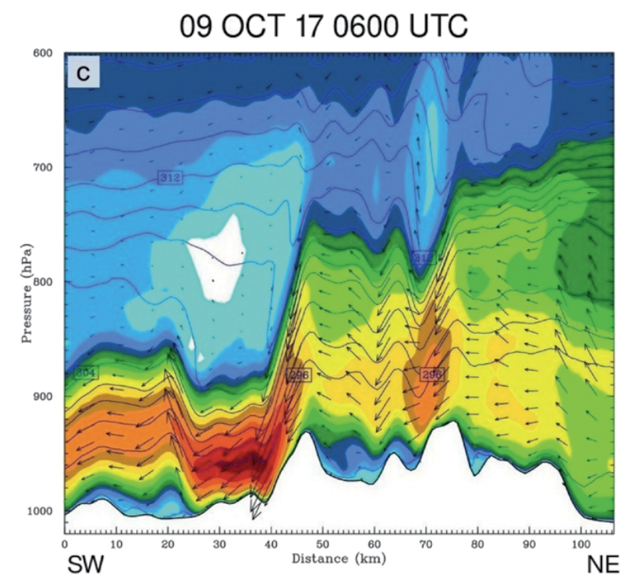

Slide 21
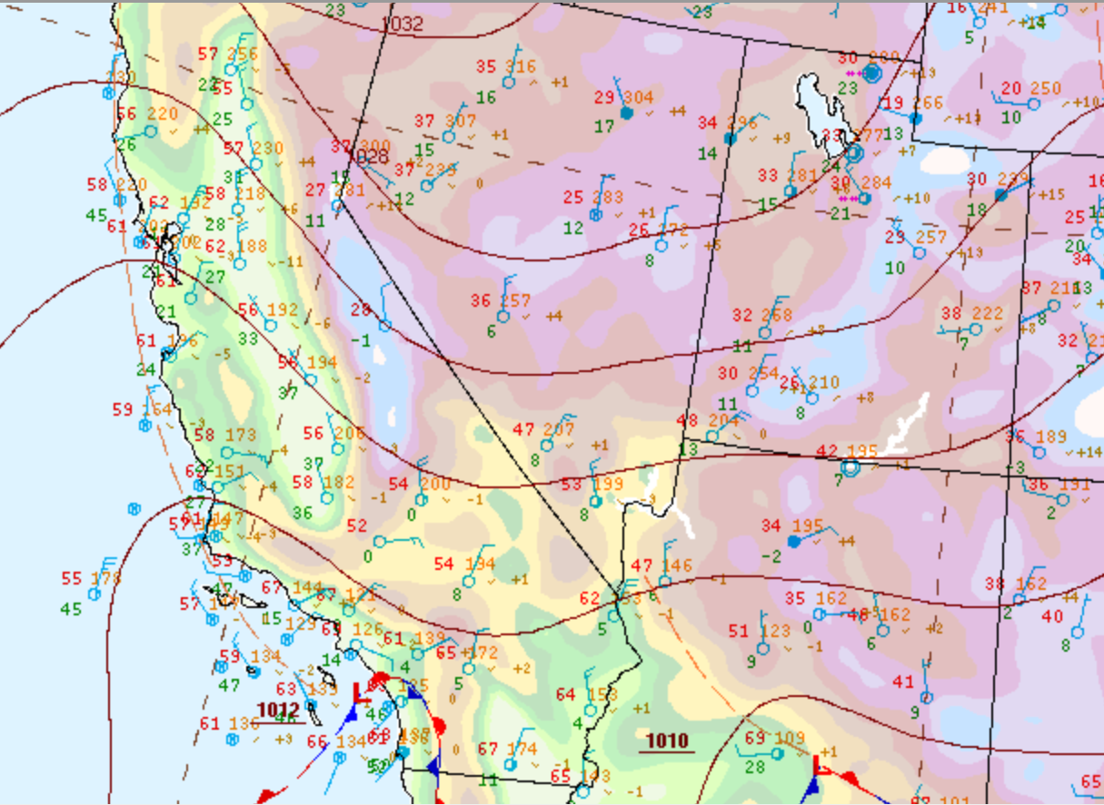
Thomas Fire – Dec. 5 2017

Slide 22
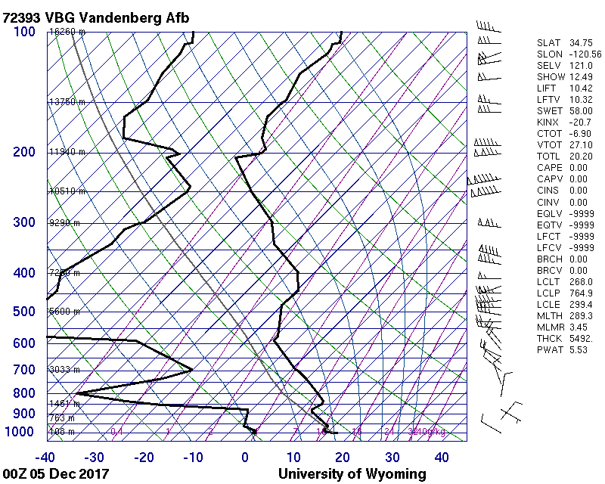

Slide 23
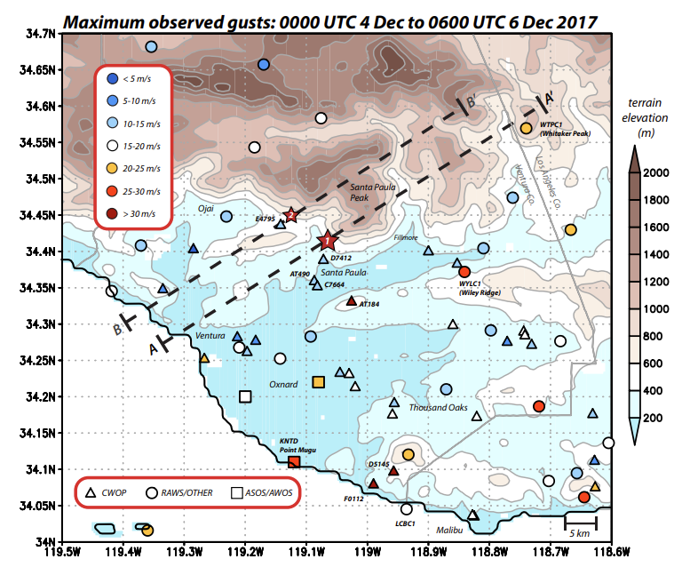
Fovell and Gallagher 2018: Many *observed* winds not that strong but…"low wind reports (especially from cooperative “CWOP” stations) are neither reliable nor representative of conditions at the fire origin sites."

Slide 24
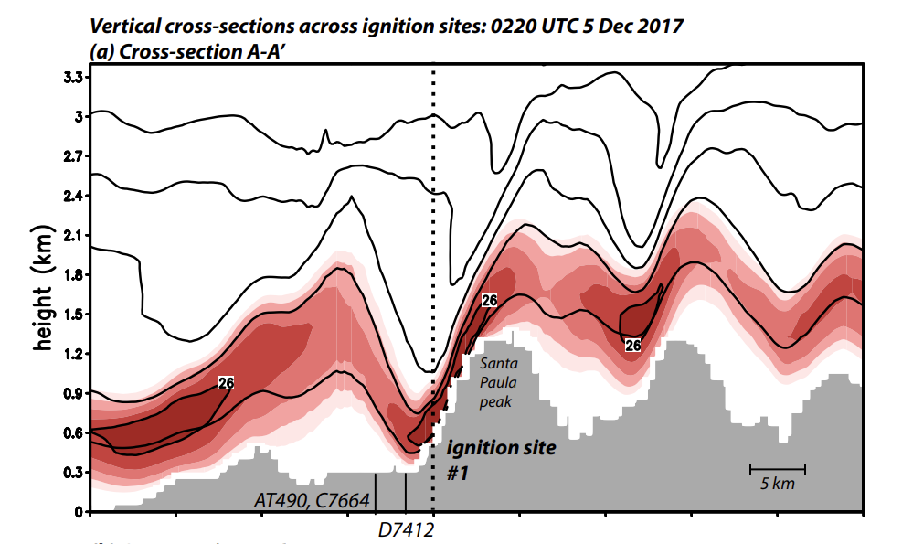

Model simulation shows development of mountain wave “shooting flow” near ignition site:

Slide 25
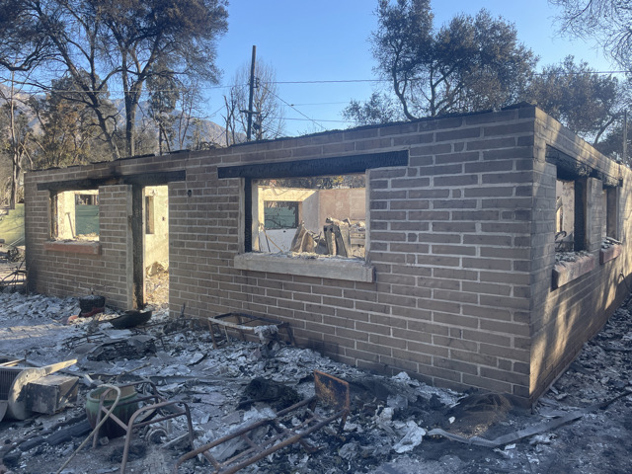
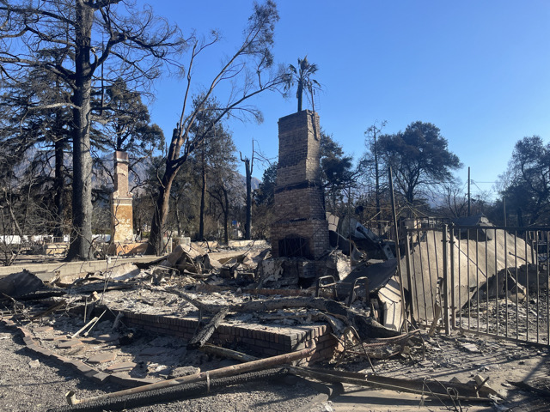
Eaton Fire – Jan. 7, 2025
Personal to me: my home 1980-1985, Altadena, burned:

Slide 26
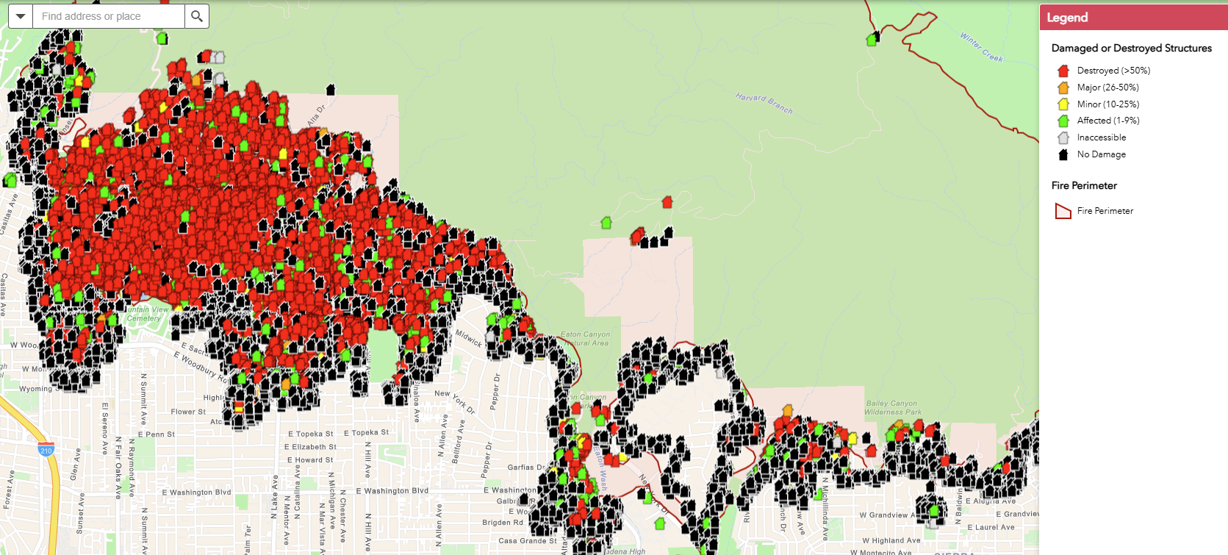
Burned Buildings in Altadena: Red are destroyed:

Slide 27
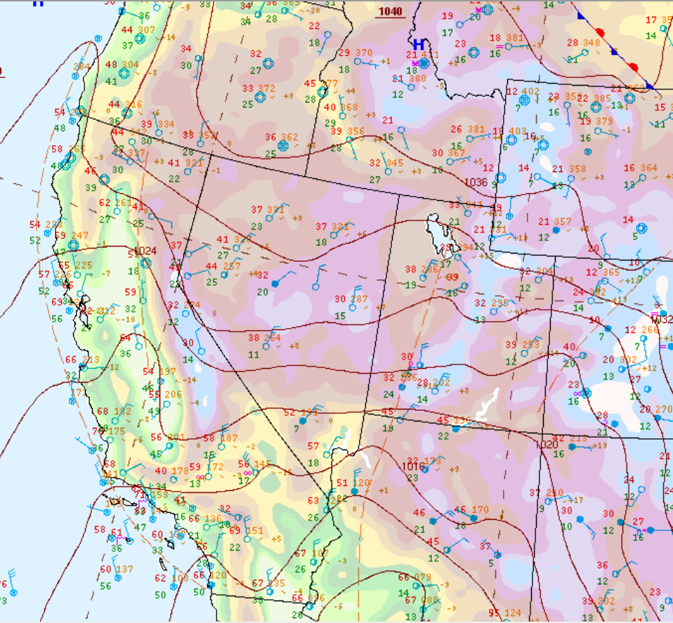
00Z Jan. 8 – Santa Ana wind setup:

Slide 28
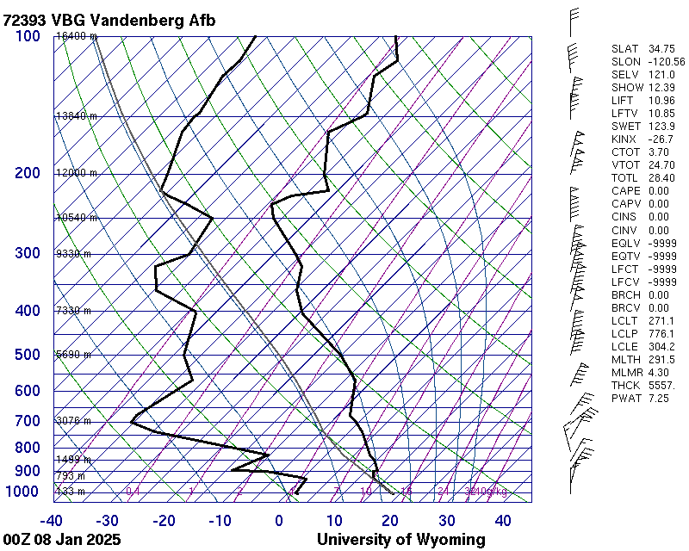
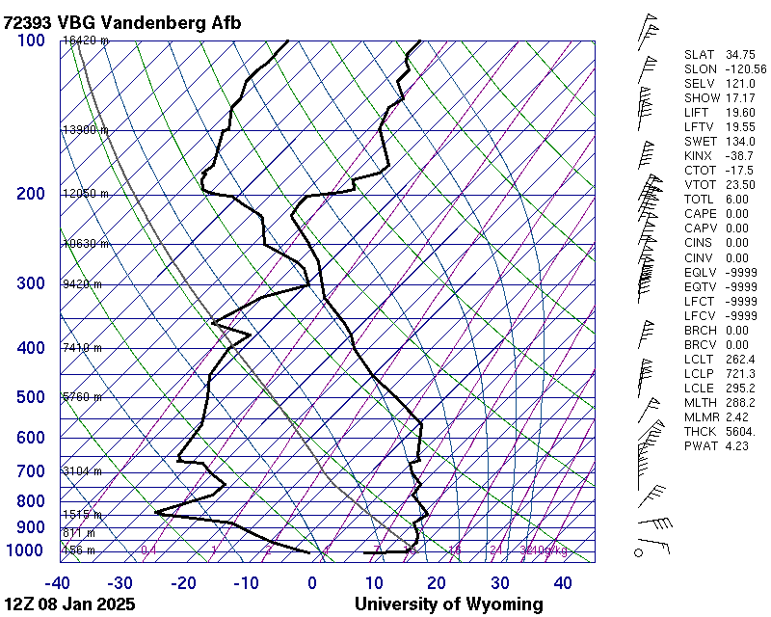
Vandenberg Soundings 00Z & 12Z Jan. 8 2025

Slide 29
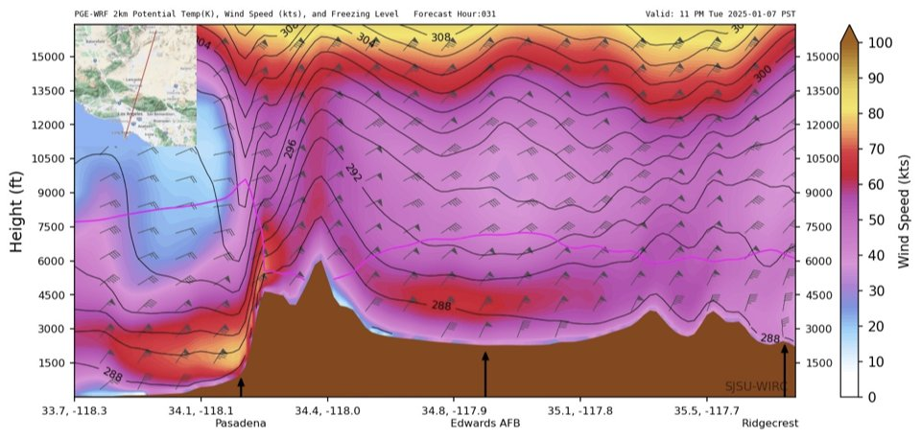
SJSU Met. Dept WRF 31hr Fcst Predicting Vertically Propagating Mountain Wave, Wind Storm Penetrating to Surface – 70-80kts

Slide 30
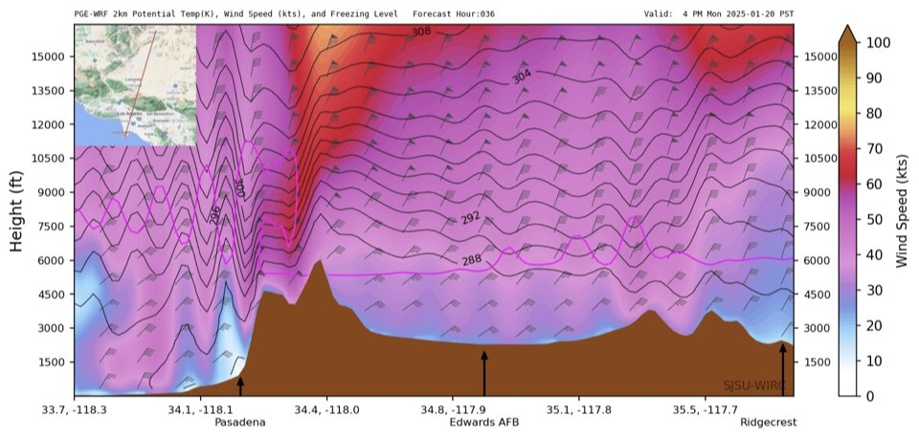
Different Day: Trapped Waves, No Surface Windstorm

Slide 31
Conditions on the ground – Nobody's stopping this fire--helicopters and firefighting aircraft grounded.
https://www.youtube.com/shorts/GphGjcs0M5o
https://www.youtube.com/shorts/mxiQ_wNAIZo
https://x.com/i/status/1880046222905405941
https://x.com/i/status/1880099592462799254

Slide 32
Other Evidence for Vertically Propagating Waves:
https://erau.instructure.com/courses/183388/pages/l-dot-a-fire-2025
Vertically propagating waves penetrate downward—and upward. Severe turbulence reported by several pilots above 40,000 feet (see next slide).

Slide 33
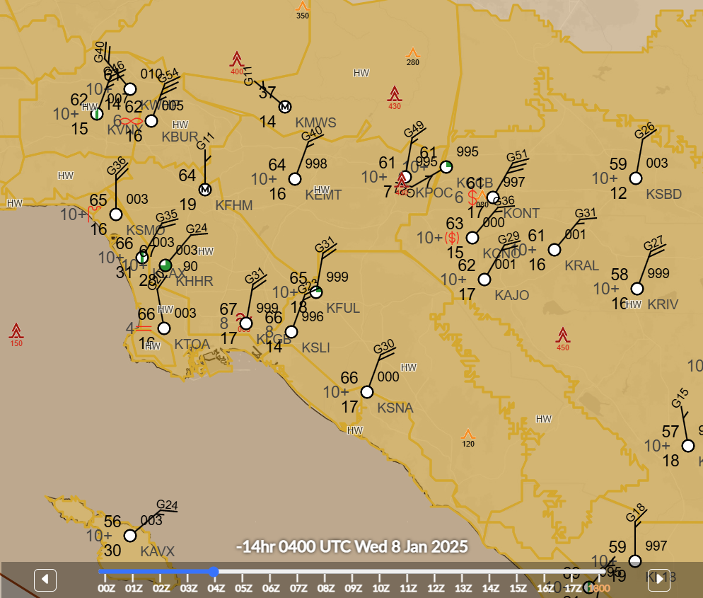

Slide 34
When the fires are over…
The danger is not over!
Rugged, burned over terrain and heavy winter rains can produce debris flows that are a combination of flash flooding, mud, rocks, tree branches, building materials etc.
Montecito, 2018, one year after Thomas fire, 23 people died when debris flows destroyed their homes in the middle of the night.

Slide 35
Conclusions/OPINIONS:
Recent deadly and destructive fires were associated with mountain waves that led to "shooting flows" that brought extreme windstorms to the surface.
The windstorms pushed wildland fires into the urban interface so rapidly that massive destruction ensued in a matter of hours.
In the Eaton Fire, vertically propagating waves penetrated both downward and upward, bringing the strong winds to the surface, but also creating an intense breaking wave region aloft leading to numerous pilot reports of turbulence above 40,000 feet."
Supercritical "shooting flows" are unstable and rapidly transition to subcritical flows in a hydraulic jump that can lead to lower level severe turbulence and also loft burning debris causing even more rapid fire spread.
The good news: current high resolution mesoscale models can predict these flows relatively accurately.
Theory of mountain waves was explored in the literature back in the 1980’s. It really is the development of these high resolution simulations that have allowed us to connect the devastating fires.

